Slide 1
CYBER RISKS AND INSURANCE
Prepared By: Richard Barnes

Slide 2
INTRODUCTION
TOWERGATE INSURANCE
Insurance & Risk Management for Social Care Sector since 1981
MY BACKGROUND
Richard Barnes
Over 25 years experience
With Towergate since 2008.
Partners of C&SW for over five years

Slide 3
CYBER CRIME
Crime is based on reward for risk
Why take the risk of robbing a bank
You WILL get caught (CCTV, DNA etc)
It is much easier to extract money from the comfort of your home.
What does a cyber criminal look like?

Slide 7
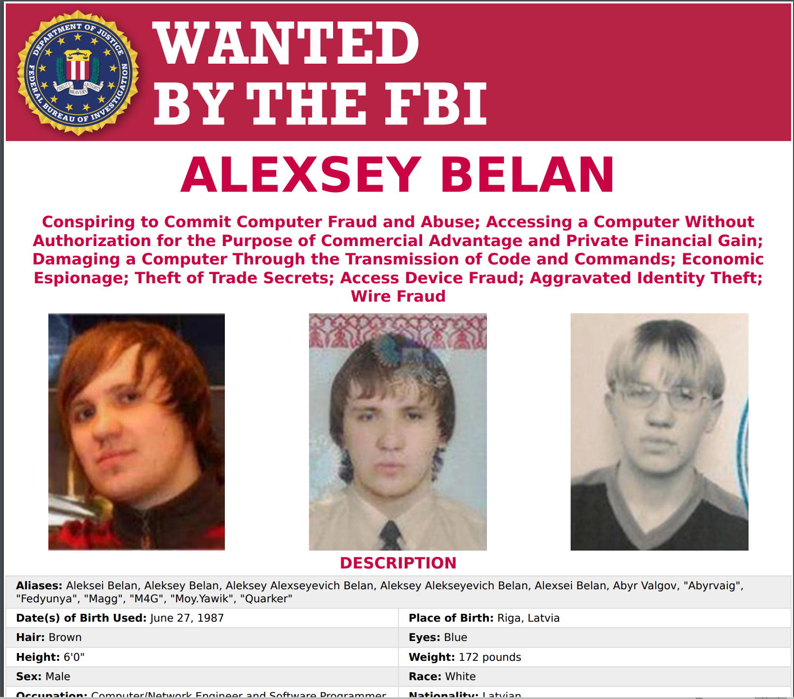

Slide 8
CYBER CRIME
Data is constantly compromised
Incredibly easy for fraudsters to obtain personal information

Slide 10
www.haveibeenpwned.com

Slide 11
Your data has value

Slide 12
NIGERIAN PRINCE?

Slide 13
TYPES OF CLAIMS
Theft of funds
Ransomware & cyber extortion
Data breach
Malware
DDOS attack
etc etc etc

Slide 14
CFC Underwriting Cyber claims 2017
Notes:
Cyber Crime 35%, Ransomware 22%, Data Breach 19%, Hacking 12% All Other 12%

Slide 15
RANSOMWARE

Slide 17
INSURANCE SOLUTIONS
Large numbers of data breaches in health sector
Limited market capacity as most insurers do not understand social care
Towergate work with insurers who have wide experience of providing cyber cover to health and social care sectors globally.

Slide 18
LAST SLIDE!
Any questions?

