Slide 1
Sophie Chester-Glyn and Deian Glyn
“Learning to let go whilst keeping control”.
Notes:
Deian Quick intro – not trying to teach how to suck eggs

Slide 2
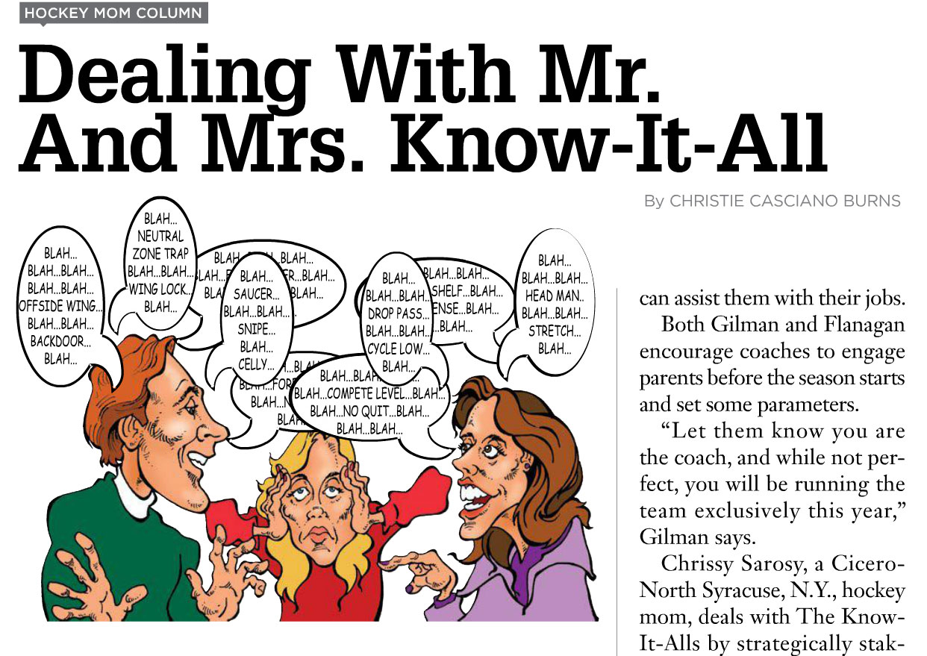
Where is everyone?
Our Journey
The Why
The How
The Benefits
The Challenges

Slide 3
Who we are

Slide 4
Interactive poll:
Please type this into your phone browser:
pollev.com/manor305

Slide 5
Our Journey

Slide 6
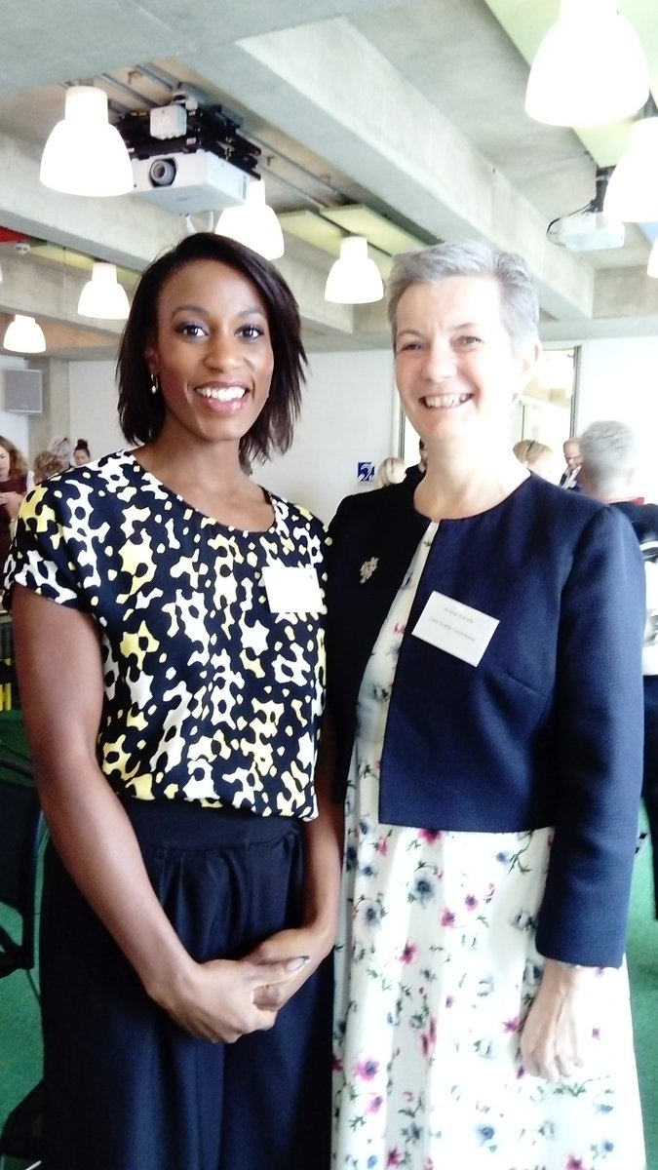
Our Journey

Slide 7
Why the need to let go?
Sustainability
Little or no time to plan
Lack of financial oversight
Lack of structure and process
Bogged down in the day to day
Manor Community?
Wanted opportunities to support, retain and promote
CONSTANTLY ON-CALL

Slide 8
The How
Clarity of goals
Setting budgets and forecasts
Advice – coaching
Implementing processes and protocols
Picture of what roles at what stage
Learning from others

Slide 9
The Benefits
Empowering staff
Time to plan
Time to talk - building knowledge
Financial
Objectivity

Slide 10
Summer Interns
Apprentices
Postgrad Interns
UWE
UWE
Consultancy Project
Local Training Companies

Slide 11
Summer Interns
Blog
Recruitment ads
Apprentices
Teams
WDIF
Postgrad Interns
UWE
Intranet site
Team collab Microsoft Teams
UWE
Consultancy Project
Values-base strategy
Local Training Companies

Slide 12
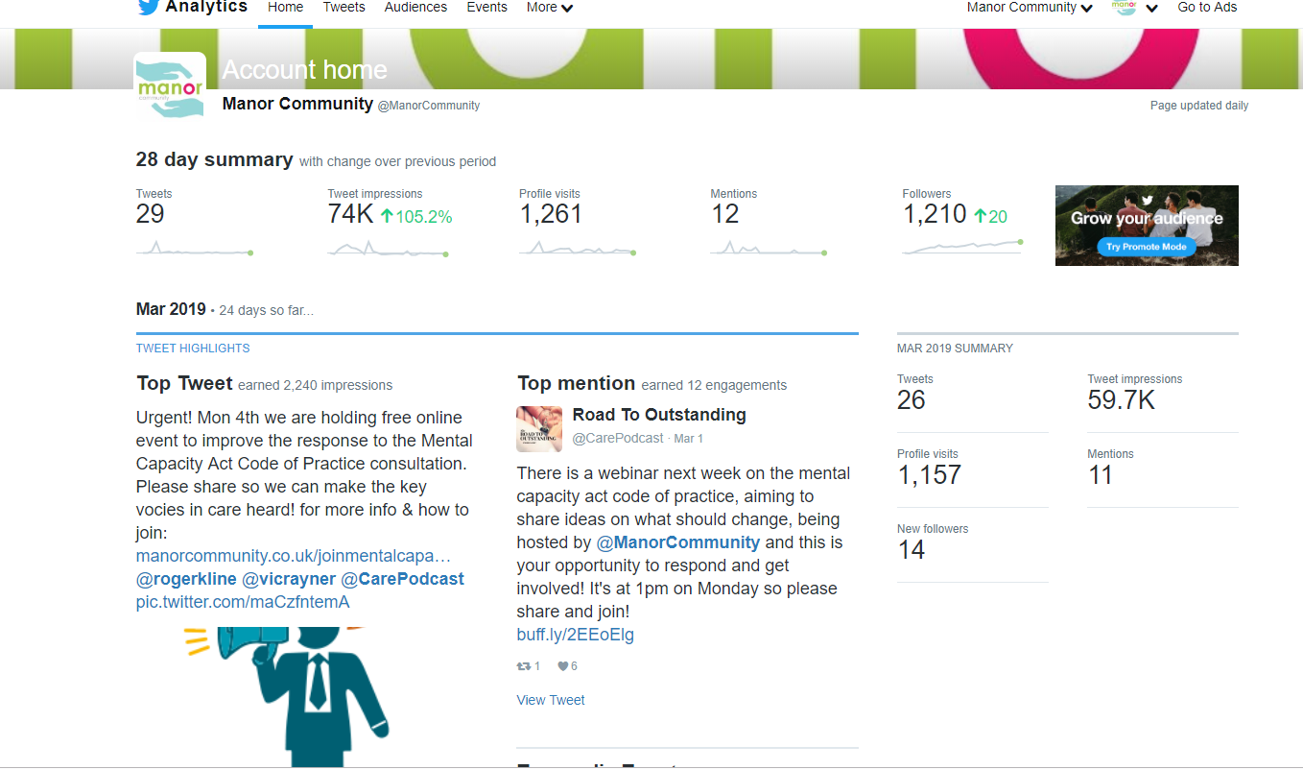
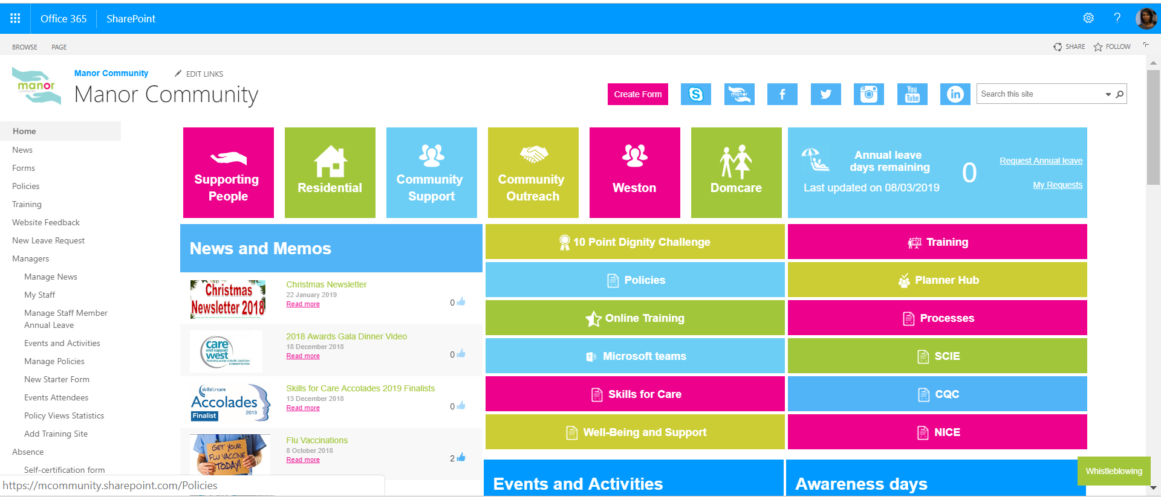

Slide 13
Workforce Development Innovation Fund

Slide 14
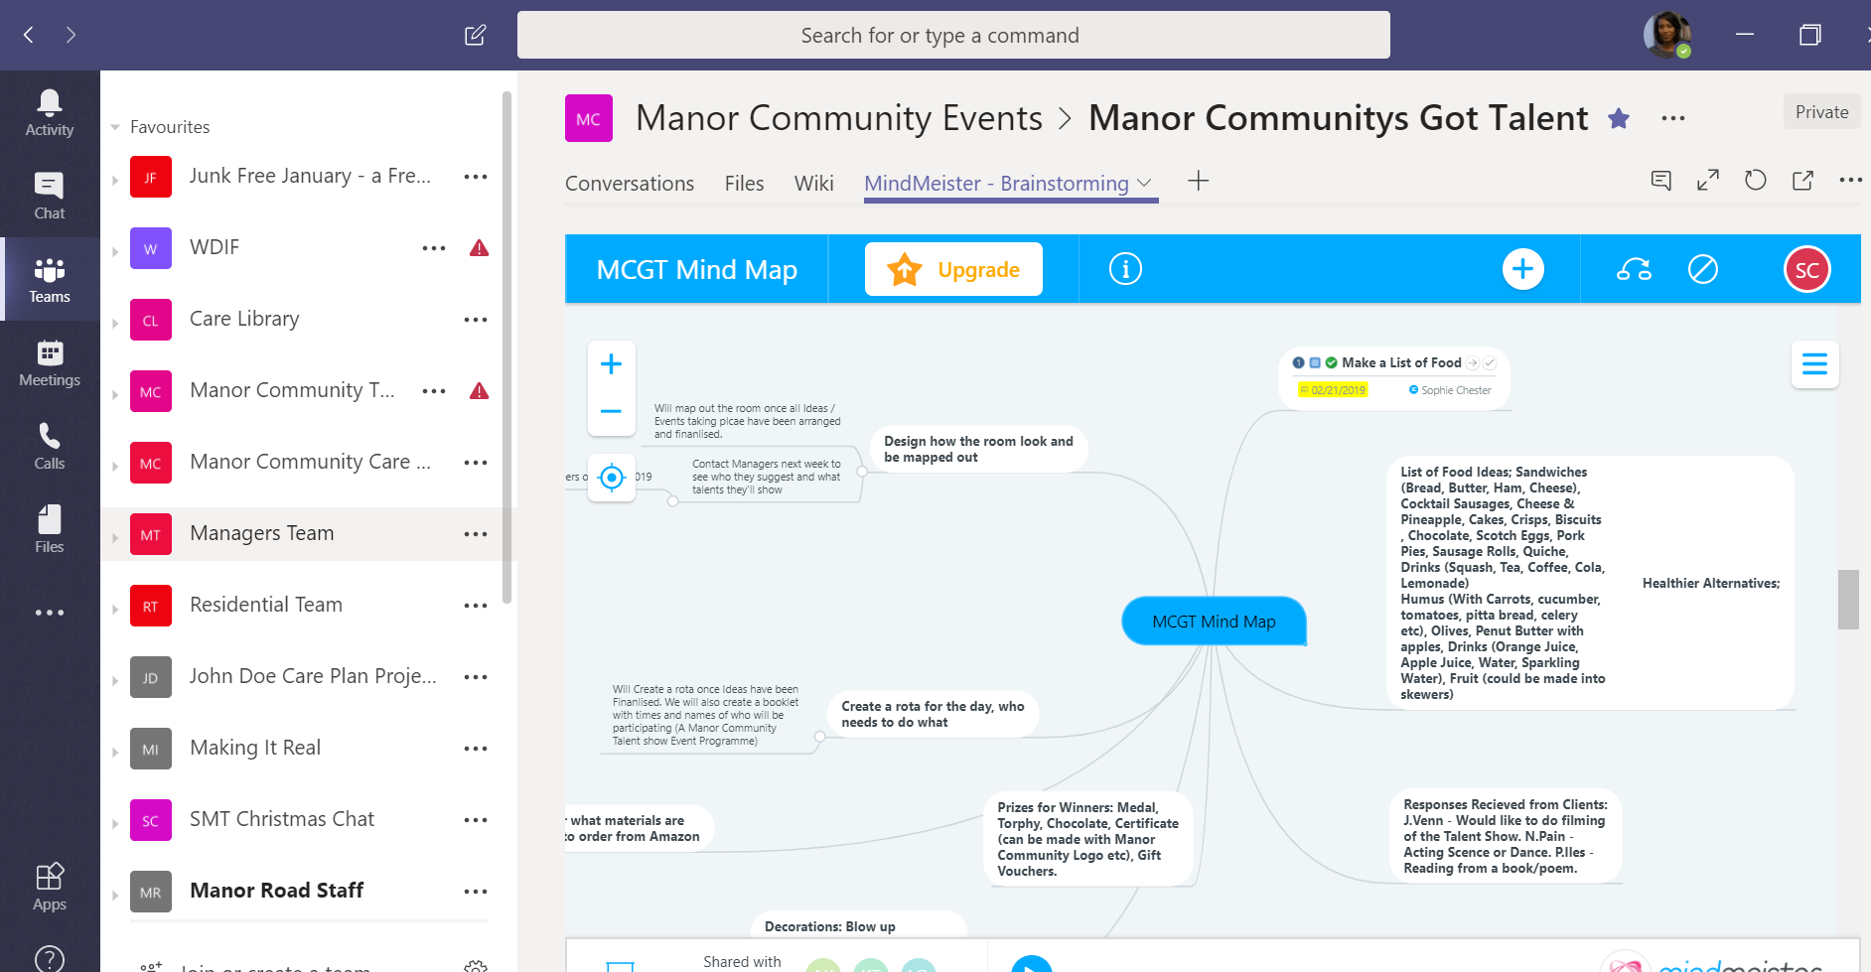
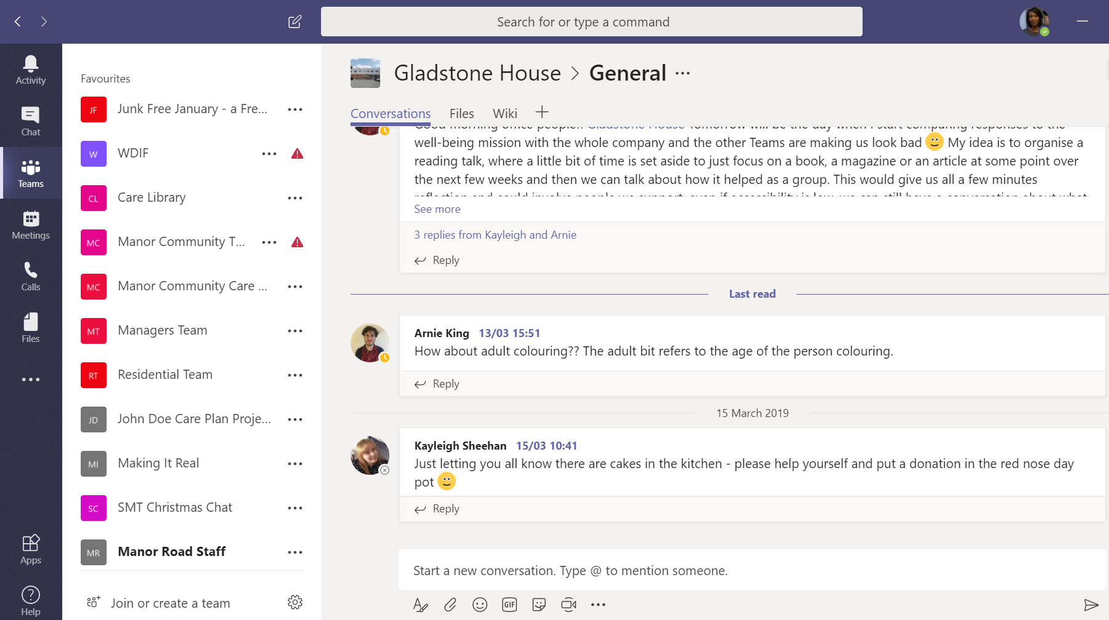
MS Teams

Slide 15
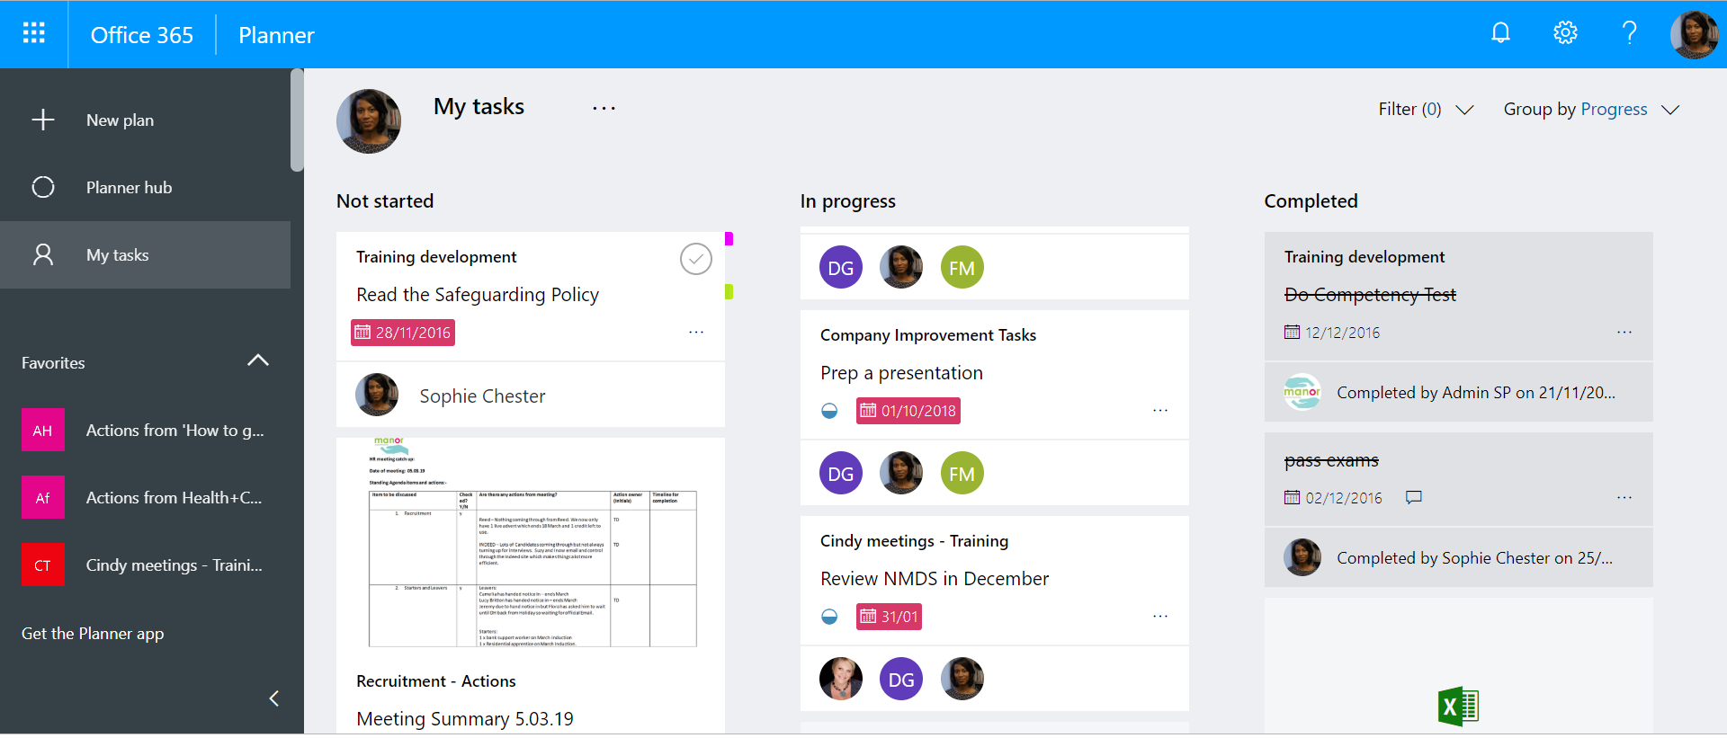
Planner

Slide 16
Accolades

Slide 17
The Challenges
Time to plan
The time it takes to implement changes
Finding the right people in the key positions
The shift in mindset
Actually letting go – much easier to keep going what you’ve always done

