Slide 1
Welcome to your Registered Manager’s Network

Slide 2
Notes:
Attended the Wiltshire RM Network … part of what they looked at was things you need to do in order to be judged outstanding … I wanted to share a few of these thoughts with you

Slide 3
CQC only judge 2-3% of providers as outstanding … do you think that is an accurate reflection of the amount of outstanding practice that is actually happening?

Slide 4
What do you do that you feel is outstanding?
Notes:
Lets spend a bit of time thinking about

Slide 5
If you are not clear about how you are outstanding … then it may well be difficult for CQC to spot it
DUNNO!

Slide 6
CQC inspectors be like …
Where’s your evidence?

Slide 7
Key area of practice |  | Evidence we are outstanding in this area is … |  | We could improve this by …
Our use of Best Practice guidance
The outcomes we help people achieve
The quality of our training
The effectiveness of our supervision and support
Our community links and integration

Slide 8
Key area of practice |  | Evidence we are outstanding in this area is … |  | We could improve this by …
The care and support we provide
Our governance, oversight and quality assurance
Our leadership within the field
Other …
Other …

Slide 9
Develop a folder to showcase how you are outstanding
Much of this should be day to day examples where staff go over and above

Slide 10
What Best Practice guidance are we using?

Slide 11
http://www.careimprovementworks.org.uk/
Great site … created by Skills for Care, SCIE and ‘Think Local Act Personal’
It enables you to go through each of the KLOEs and create a ‘my list’ of resources for each element.

Slide 12
MCA & DoLS – Codes of Practice

Slide 14
End of Life care for adults
https://www.nice.org.uk/guidance/qs13/resources/end-of-life-care-for-adults-pdf-2098483631557
Care for the dying in the last days of life
https://www.nice.org.uk/guidance/qs144/resources/care-of-dying-adults-in-the-last-days-of-life-pdf-75545479508677
Managing Medicines in Care Homes
https://www.nice.org.uk/guidance/sc1/resources/managing-medicines-in-care-homes-pdf-61677133765
Managing Medicines for adults receiving social care in the community
https://www.nice.org.uk/guidance/ng67/resources/managing-medicines-for-adults-receiving-social-care-in-the-community-pdf-1837578800581

Slide 15
Any others that people are using?
Learning Disabilities and behaviour the challenges
https://pathways.nice.org.uk/pathways/learning-disabilities-and-behaviour-that-challenges
Mental Wellbeing at Work
https://www.nice.org.uk/guidance/ph22/resources/mental-wellbeing-at-work-pdf-1996233648325

Slide 17
The statutory guidance to the Care Act

Slide 18
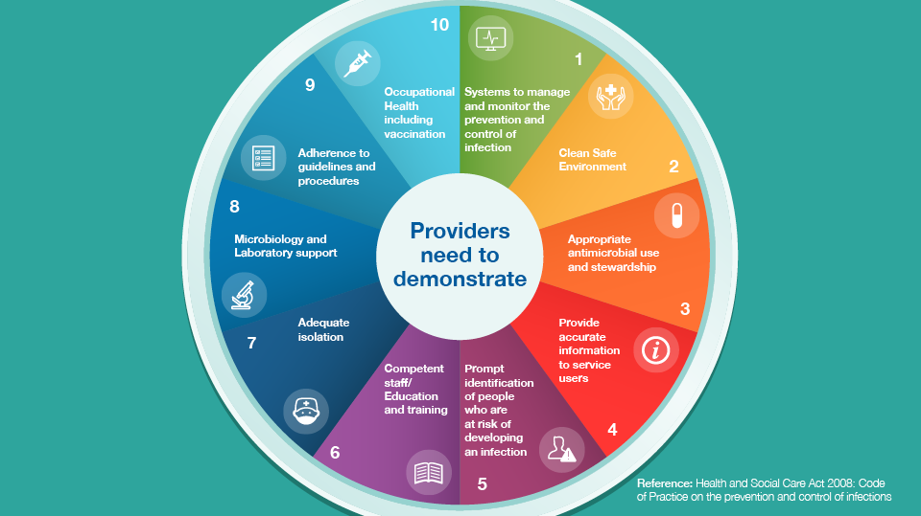
Health and Social Care Act 2008 Code of Practice – Infection Control

Slide 19
https://www.cqc.org.uk/sites/default/files/20181010_equally_outstanding_ehr_resource_nov18.pdf

Slide 20
https://www.cqc.org.uk/sites/default/files/20150416_our_human_rights_approach.pdf

Slide 21
Making it real (Think local Act Personal)
https://www.thinklocalactpersonal.org.uk/_assets/resources/personalisation/tlap/makingitreal.pdf

Slide 22
Six themes … very person centred framework

Slide 23
https://www.skillsforcare.org.uk/Documents/Recruitment-and-retention/Recruiting-for-potential/Safe-and-fair-recruitment-WEB.pdf

Slide 24
https://www.skillsforcare.org.uk/Documents/Standards-legislation/CQC/Good-and-outstanding-care-guide.pdf

Slide 25
https://www.skillsforcare.org.uk/Documents/Leadership-and-management/People-Performance-Management-Toolkit/People-Performance-Management-Toolkit.pdf

Slide 26
Webpage:
https://www.cqc.org.uk/guidance-providers/learning-safety-incidents

Slide 27
CQC – Driving improvement (case studies from adult social care services)
https://www.cqc.org.uk/sites/default/files/20180607_drivingimprovementasc_report.pdf

Slide 28
Safe to be me
https://www.ageuk.org.uk/globalassets/age-uk/documents/booklets/safe_to_be_me.pdf

Slide 29
https://www.cqc.org.uk/sites/default/files/20190221-Relationships-and-sexuality-in-social-care-PUBLICATION.pdf

Slide 31
How are you contributing to leadership within your sector?
Notes:
What groups are you involved in …. Multi agency think tanks … working groups … research groups

Slide 32
What opportunities are there to get involved … to lead the way?

Slide 33
If you are aiming for outstanding … have a plan to get there

