Slide 1
ICP Development challenge
Presentation for the ICS Symposium event
Care and Support West
March 22
Ros cox Delivery Director
One Weston ICP.

Slide 2
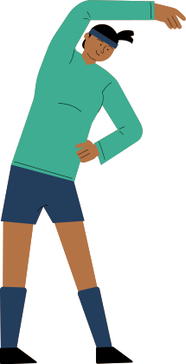
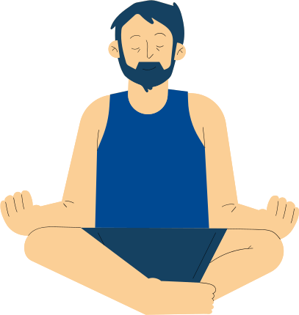
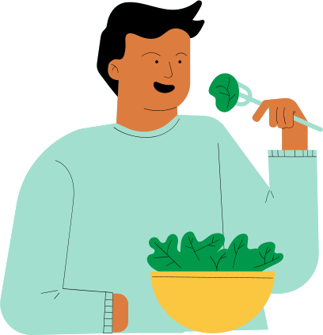
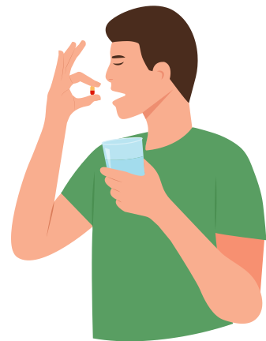
Our ability to stay healthy and well depends on a range of things, including social connections, employment, housing and education.
To make a real difference in people’s lives, modern health and care services need to reflect the importance of these ‘wider factors of health’ and the role they play in our lives.
Integrated Care Partnerships (or ICPs) are formal partnerships of provider organisations working together to deliver care by collaborating rather than competing.
Why do we need ICPs and what does this mean?
Notes:
The brief for the presentation is ‘ICP Development challenge’.
I think we need a description of ICPs and how they have come together , so the good slides you have done Phoebe which explains it and how it will be different for partners and people .
Then some slides we have about Weston (the model and what we have achieved to date) to make it real with examples

Slide 3
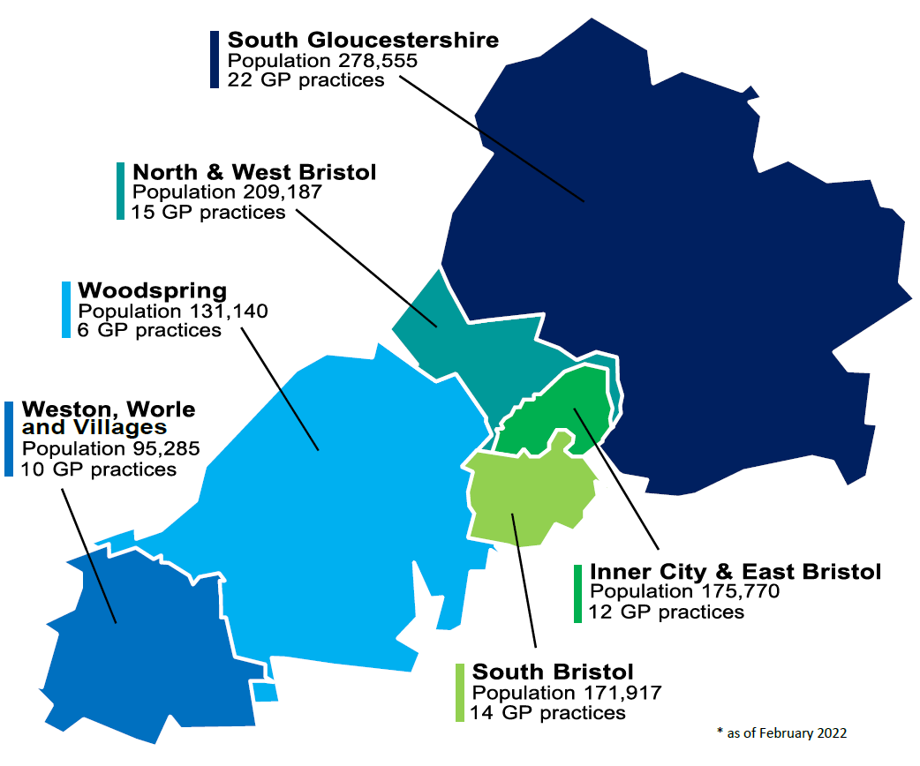
To help do this,
Integrated Care Partnerships (ICPs) have
been established in our area – to improve health and wellbeing, and design services that fit in with people’s lives
Each ICP shares this common purpose, but is unique to the needs, challenges and strengths of their population

Slide 4
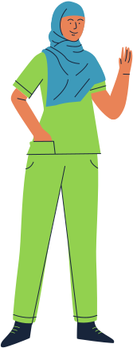
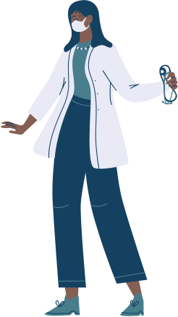
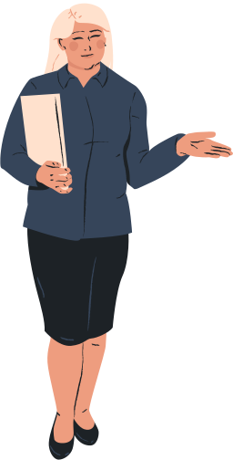
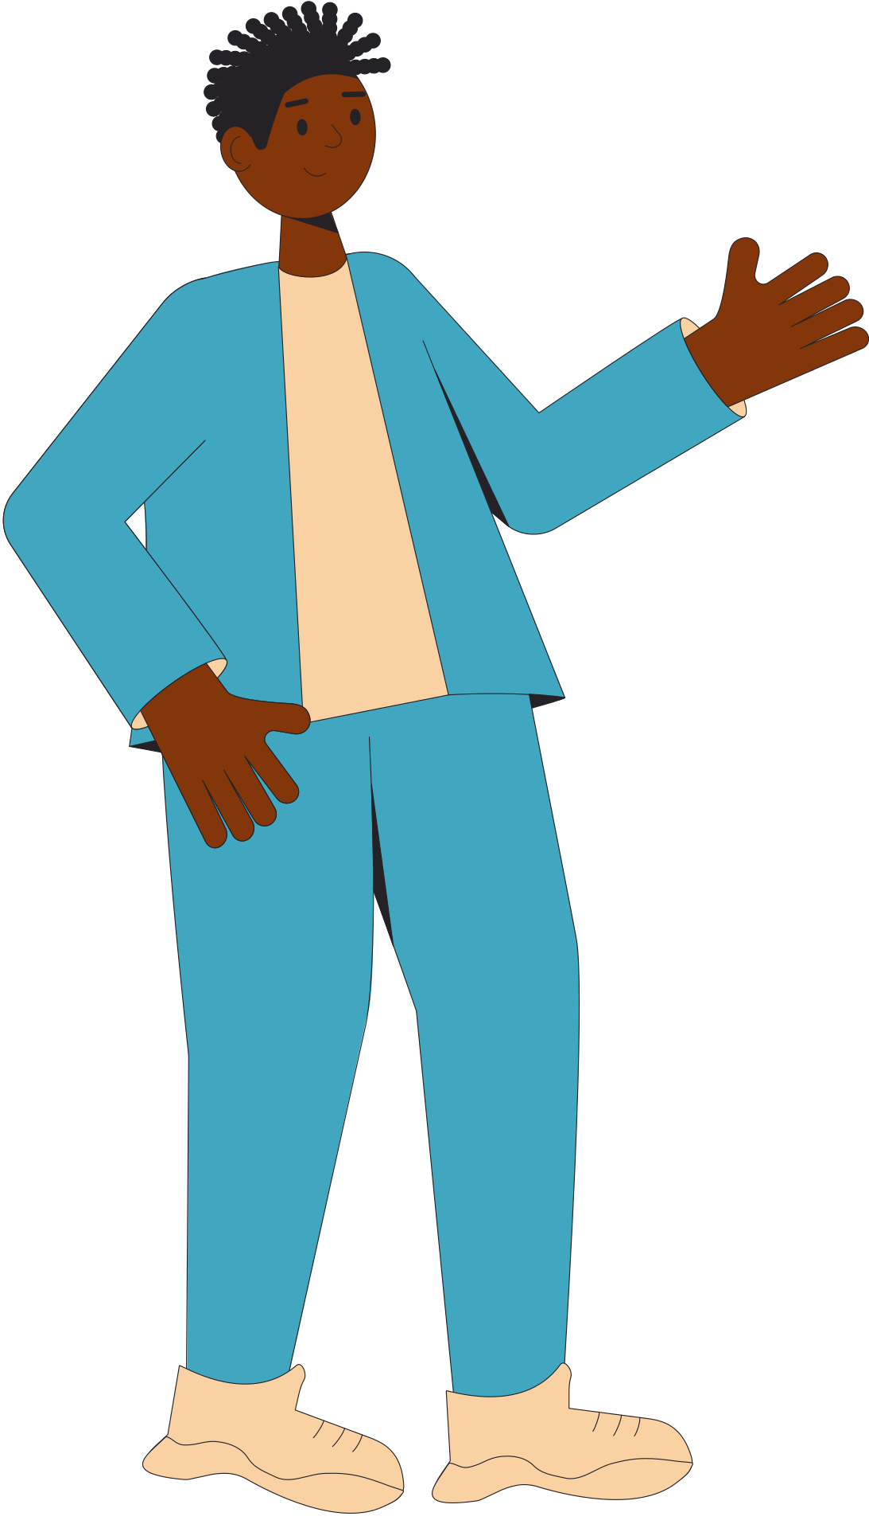
Who makes up the ICP?
ICPs are made up of general practice, social care, NHS hospitals, volunteer sector, councils, mental health and community services –with citizens and communities as equal partners.
Together they work as one team and apply their expertise and collective strength to support their community to stay healthy and well. Each ICP strives to understand what matters most to the people they serve and solve local challenges that impact the lives of their population.

Slide 5
What are the main objectives of an ICP?
Each ICP will have collaboration at its heart, with a shared common purpose to:
improve the health and care of the people they serve
integrate services for the benefit of the local population
reduce health inequalities.
increase the number of years people in BNSSG live in good health and help create communities that are positive places to live.
ICPs will engage the community as the default setting of care and will consider the person as a whole, through a population based view.
Notes:
This will enable people to receive the best preventative, proactive and personalised care. Another component will be to make it easier for staff to work productively together as a fulfilled workforce.
→ This info is covered in subsequent slides

Slide 6
How will ICPs make a difference to peoples lives?
In time, ICPs will ensure that everyone’s care is person-centred, proactive and place-based, – so each person can stay well, wherever they live.
Person-centred: care that tailors support people’s individual needs.
ICPs will strive bring services together to personalise support that meets individual needs and ensures they make a real difference in people’s lives. This will prevent people from being bounced between services and repeating their story.
Proactive: care that sees people as a whole person and will reach out to people when they need it, recognising strengths and helping to prevent illness.
ICPs care for people as a whole person – considering a person’s wider situation such as mental health, housing, financial and social needs.
Place-based: care that meets the majority of people’s needs in the place where they live.
ICPs bring health and care organisations together at a local level, to help people to maintain their health, wellbeing and independence closer to home, so they only need the hospital in an emergency or for specialist care.

Slide 7
What difference will this make to us?
Staff will find it easier to work productively together as a fulfilled workforce.
Our organisations will be closer than ever, and able to share resources, learning and experience
We will be able to make the most effective of existing resources to bring about change to people’s lives

Slide 8
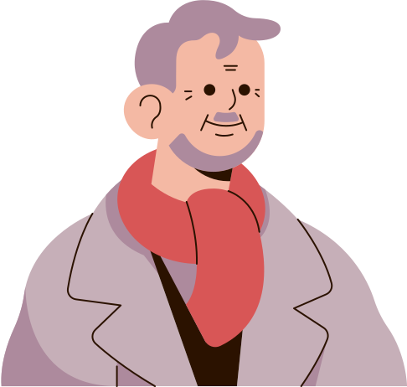
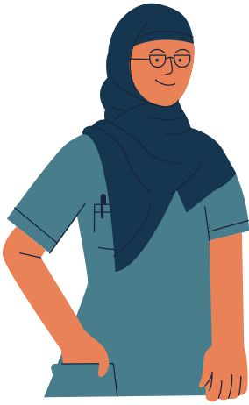
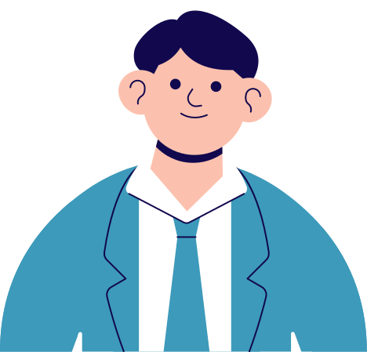
How are we rising to the challenge?

Slide 9
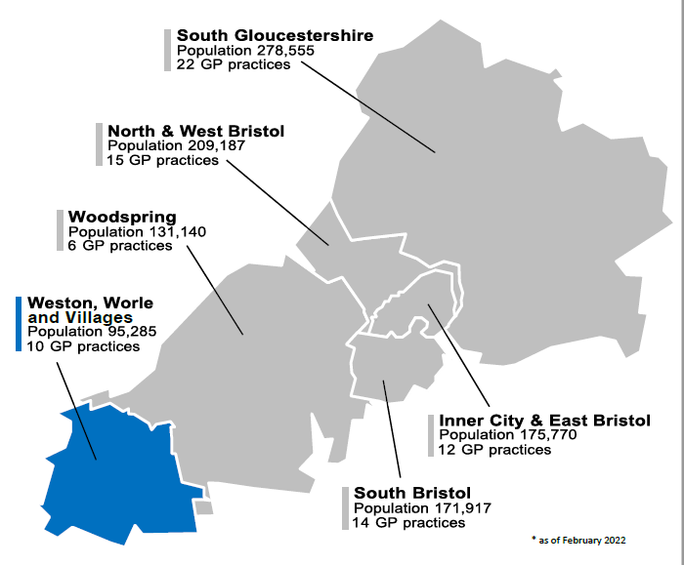
Example: Weston, Worle and Villages
Population: 93,642
20% of total population have a mental health condition.
17% Depression prevalence; 1% Dementia prevalence; 1% Eating Disorder prevalence
WSM has 5 Lower LSOAs within the most deprived 5% in England
Those living in the most deprived areas have a shorter life expectancy compared to those in the least deprived; the gap is 9.1 years for men and 6.5 years for women
Notes:
(NSC, English Indices of Deprivation 2015)
(North Somerset Health Profile, 2016)

Slide 10
What have we done so far?
Come together as a partnership to think about our priorities for the communities we serve
Started working together to improve our Community Mental Health services which is the first stage of our ICP
Jointly completed a Target Operating Model which sets out how we will deliver CMH services at a place based level.
In the process of setting up a Partnership agreement which describes the ways we will work together from April 2022.
Making links with the Health and Wellbeing Boards to ensure we are joined up with all our plans

Slide 11
Weston CMH Delivery Model
Building the foundations Phase 1 - From Feb 2022
IPCT: Shared Caseload approach
Who will the team work with ?
People with multi layered needs that cross multiple organisations with poor outcomes
What will the team do ?
Partners bring caseloads for the IPCT to manage together
Team around me approach
Work together to find creative solutions to meet peoples outcomes
Improved use of community and Voluntary sector services to support people in their communities
Developing the model
Phase 2 – from Sept 2022
IPCT: Opening the front door
Who will the team work with ?
People with low-mid level needs
What will the team do ?
Triage and offer a support conversation – not “assessment”, but light touch approach
Provide the right support at the right time, in the right place
Referrals from 111 and GPs
Improve people’s mental well-being by reducing the IAPT / Secondary Care gap
Prevent people’s needs increasing and increase independence
Upscaling the offer Phase 3 - From April 2023
Upscaling and widening the offer, including physical health
Aligning with Ageing Well Care Coordination Hub and other IPC initiatives
Local, placed-based signposting website
Additional IMHN Lived experience representatives and direct service user feedback
Recovery Navigator
Small Grant Schemes (VANS)

Slide 12
Weston IPCT & VCFSE
Joint VCSE engagement event held for ICP Development and the role of the VCFSE
Small Grant scheme in year funding from CCG to NS council for VCFSE development of community assets
Joint working groups across Social Prescribing in the area
Developing relationships and links with NS council locality Team
Engagement from VANS at CMH workstream and future engagement in the IPCT.

Slide 13
Weston Ageing Well Accelerator Site
A Care Home Hub with initial focus on 7 homes with the highest level of emergency admission and ED attendances was rapidly mobilised in Aug/September 2021
Proactive and anticipatory approach has been adopted – combined assessments, structured medical review and shared care planning for people at end of life are cornerstones of delivery, alongside training and support to care home teams.
Early indication is that this approach is having a positive impact on the number of admission from participating care homes in comparison to those not covered
The team has attracted new recruits, including GPs with special interest with frailty and registrars from WGH have started rotations into the CHH.
Recently collaborating with NS Council to stand up a soft intel sharing forum and to run a discharge pilot.

Slide 14
What feels different this time ?
Statutory responsibility across partners to work as an Integrated Care Board
Good-will from all organisations to do things differently to improve outcomes for people
Lessons learnt from COVID and real examples of how partners have worked together – motivation to continue this
People with lived experience are part of and leading the process of change
Data driven based on needs of local populations and the drive to tackle inequalities

Slide 15
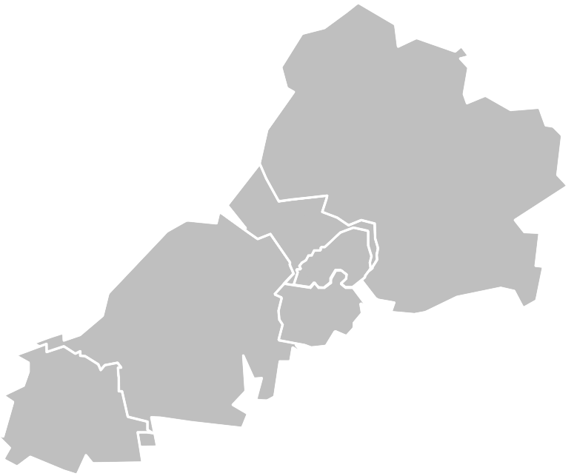
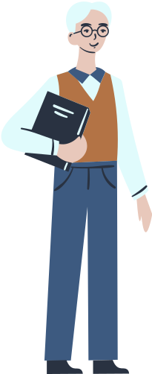
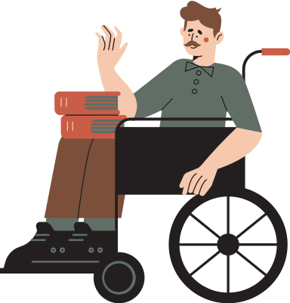
Thank you!

