Slide 1
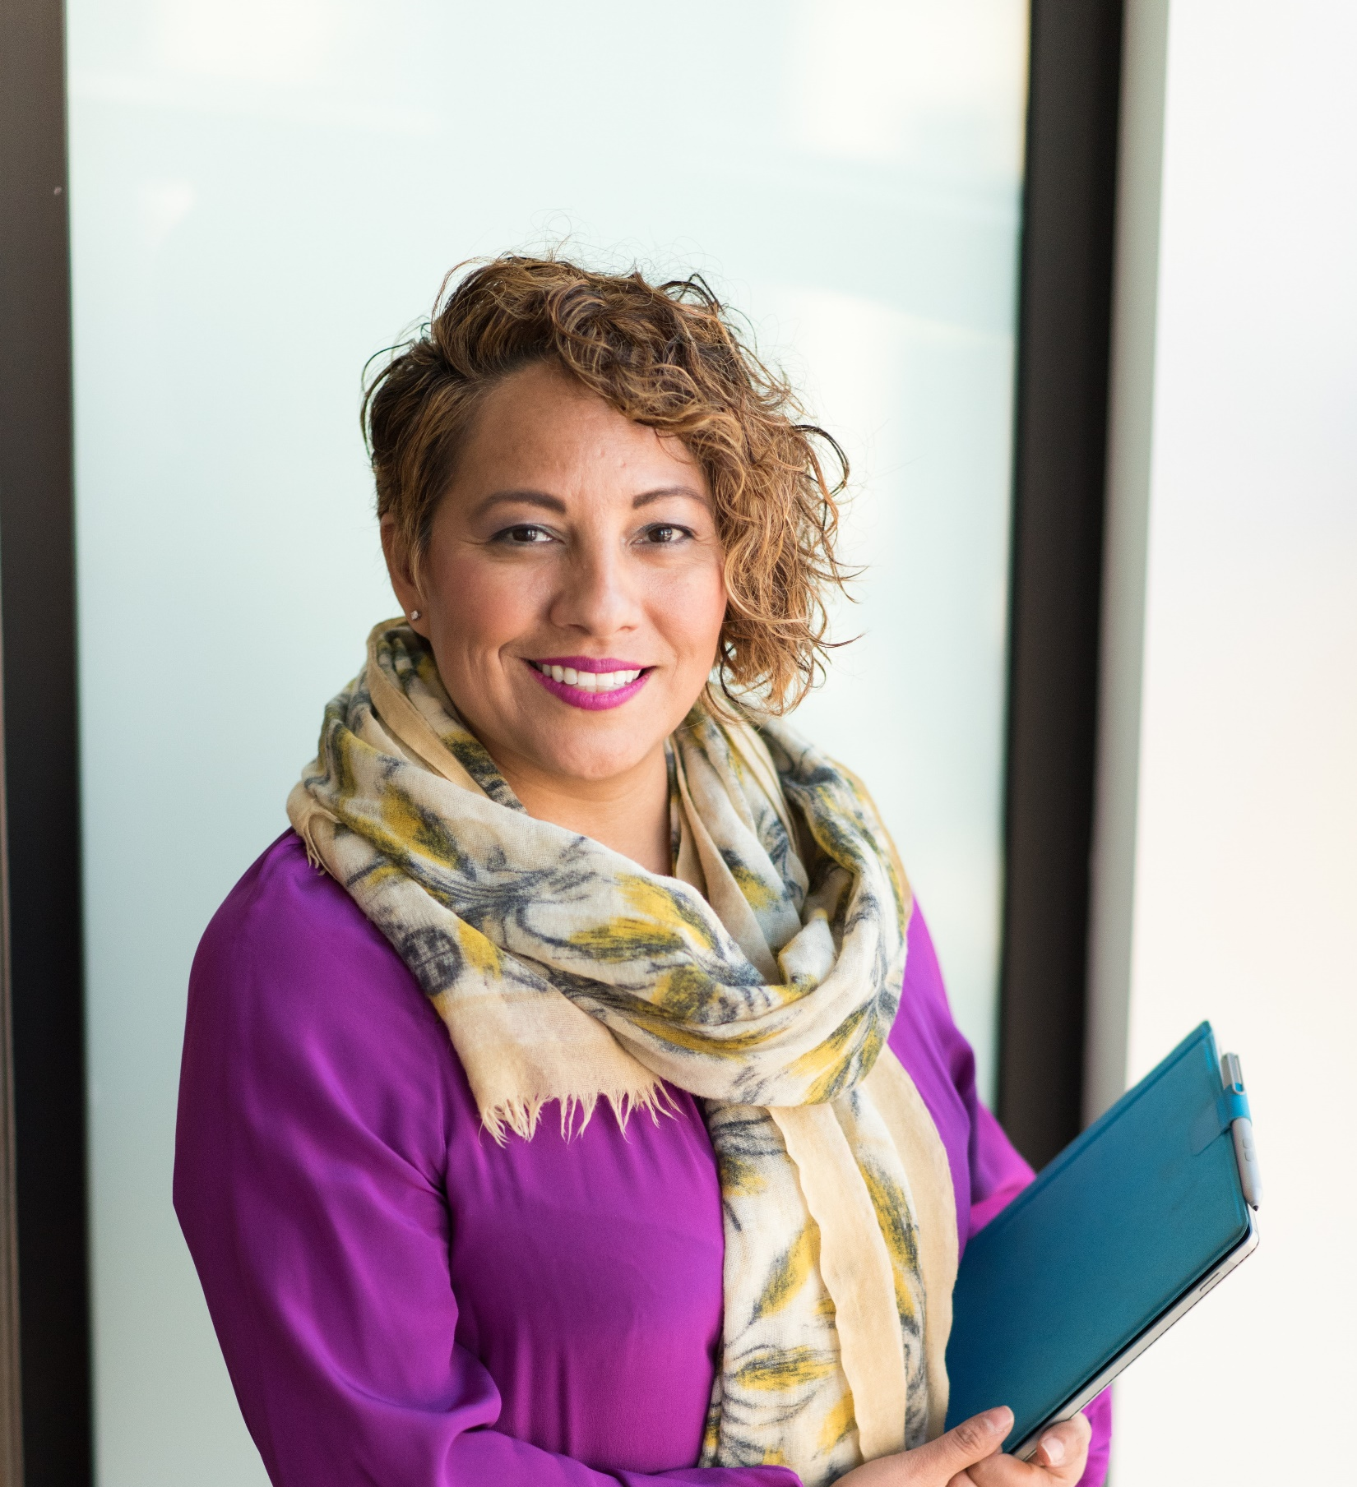
Managers in Social Care … looking for support, resources and people to share ideas with?
Why not join your local Registered Managers’ Network?

Slide 2
Your local Registered Managers’ Networks
Organised and run by Care and Support West, these networks are part of a national initiative supported by Skills for Care. We run RM Networks for managers in B&NES, Bristol and South Glos and North Somerset.
Open to: Registered (and any other) Managers providing any type of adult social care service. (All topics are chosen so that they are relevant to managers of any type of adult social care service).
Our 2023 / 24 topics include:
Overseas workers … virtual session (July 2023)
The issues you face … Face to Face session (September 2023)
CQC’s new inspection process / sharing ideas and good practice … Face-to-Face session (November 2023)
Managing people (with a focus on performance and sickness management) … virtual session (January 2024)
Cont’d …
5. Risk management / Business Continuity Planning
… virtual session (March 2024).
RM Network sessions are great for: 1) Exploring topics in detail and getting ideas 2) Talking with peers and learning from other
managers about how they are doing things 3) Realising that you are not alone 4) Continued Professional Development 5) Providing CQC with evidence of your networking.
Cost: £70 per participant for the full year’s sessions (or pro rata if you join part way through the year). This also includes access to a growing library of resources.
We recognize social care providers are on a budget and we only seek to cover our costs. These sessions are designed to provide cost effective management training and real value for money.
To express your interest or for further information please contact Mik Alban on mik.alban@careandsupportwest.com
or 07788 498909

