Slide 1
Recruitment & Retention in 2023: opportunities, challenges and integration

Slide 2
James Sage
HR & Employment Law Partner and Head of Health & Social Care
RWK Goodman LLP

Slide 3
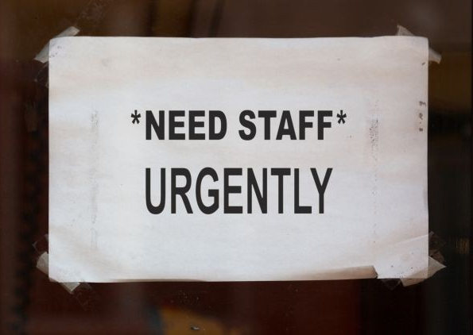
Recruitment and retention crisis: state of the nation
165,000 vacancies
Skills for Care turnover figures
28.5%
34.4% frontline care roles
Other sectors – 15%
RWK Goodman 2022 poll
19% > 40%
7% > 50%

Slide 4
1. Attract a diverse workforce
9% of ASC workforce under 25
Engagement with schools, colleges, universities
Retirees/returners

Slide 5
2. Target employee referrals from local communities

Slide 6
3. Embrace flexible working
Key to recruitment and retention
Childcare and caring responsibilities
How far can you go?

Slide 7
4. International recruitment
Recruiting from overseas
Recruiting within the UK
Student and other visas
New Government funding

Slide 8
5. Enhancing pay and benefits
Inflationary and other pressures
Negotiating fee uplifts
Pay v benefits?

Slide 9
6. Recruitment and onboarding
Candidate market
Proactive and engaging process
Measure time to hire
Track effective sources
Prevent first 90 day attrition

Slide 10
7. Proactive HR management
Fair, transparent, consistent, and PROACTIVE
People Manager training
Sufficient HR resource

Slide 11
8. Invest in training and development
Career Development Framework
Avoid attrition at 3-5 years’ service
Vertical AND horizontal progression

Slide 12
9. Well-being culture
Physical
Mental
Menopause
Financial

Slide 13
10. Black-box thinking
Remove blame culture
CQC and LA
L&D culture
Psychological safety

Slide 14
Integrated Care Systems
Workforce opportunities?
Barriers?
Collaboration v integration

Slide 15
We can help
HR & employment law advice
Sponsor licences / immigration law
Training

