Slide 1
Care and Support West Annual Conference
Suzanne Westhead
Director of Adult Social Services
Bath and North East Somerset Council

Slide 2
Content of today’s presentation
Workforce the SW and BANES
Update on international recruitment
CQC Inspections

Slide 3
The national picture for Adult Social Care
1.6m staff in Adult Social Care
£5.1 billion to the economy
Adult Social Care has a larger workforce than the NHS, Construction, Transport and Hospitality

Slide 4
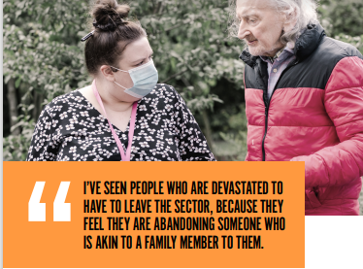
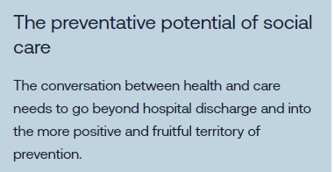
The Context
Notes:
Sarah

Slide 5
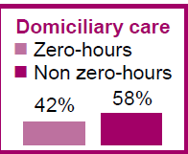
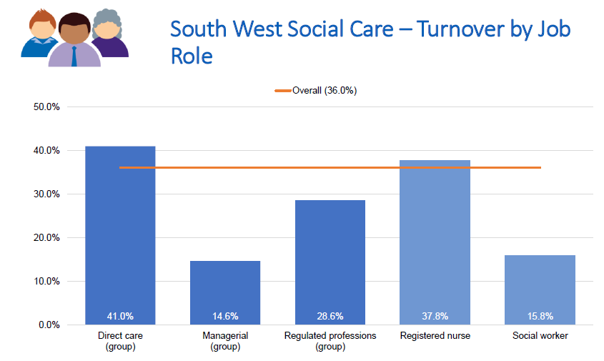
Oversight of Workforce
Skills for Care National Adult Social Care 2021/22
Notes:
Sarah

Slide 6
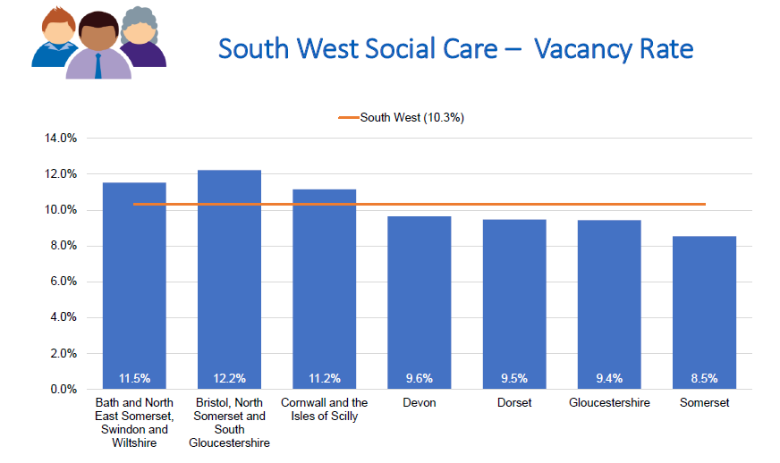
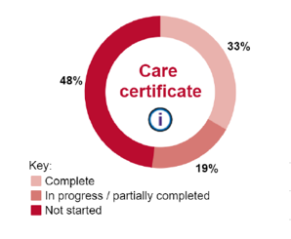
Only 46% of direct Care Workers in South West have a qualification
Notes:
Sarah

Slide 7
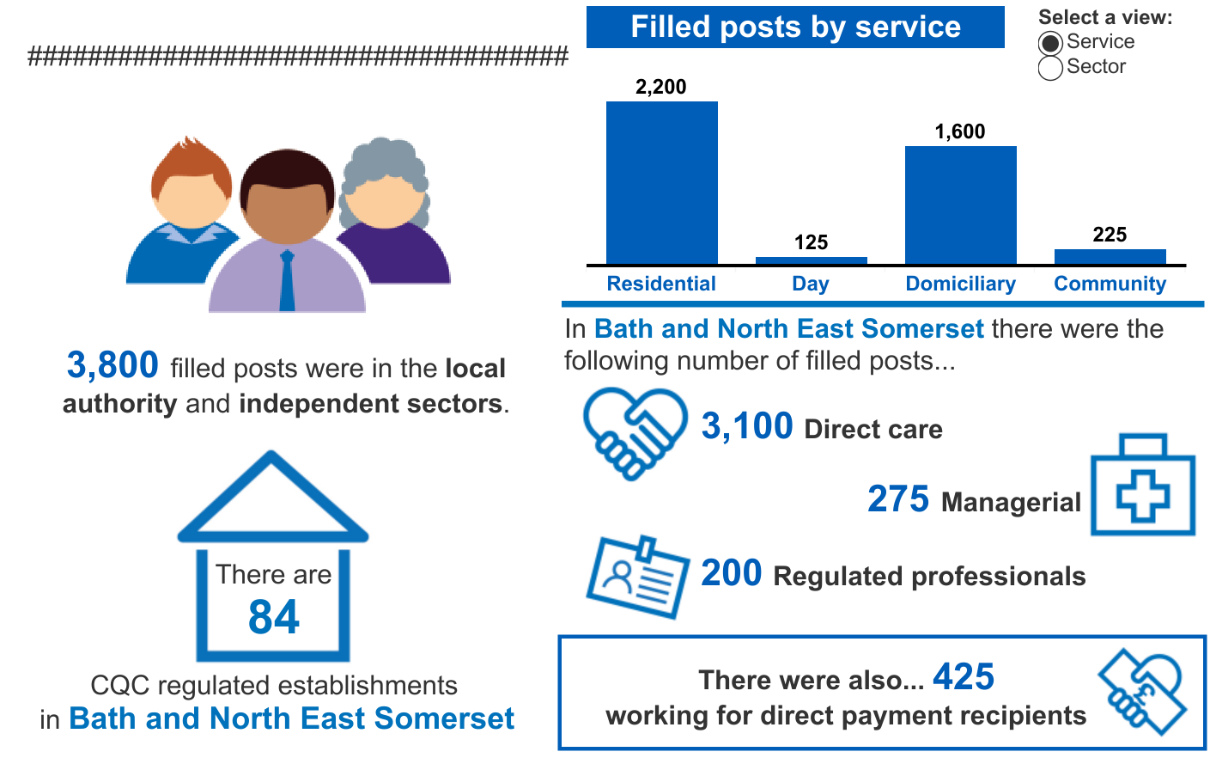
Summary of the adult social care workforce – BaNES
There were 4,150 filled posts in Bath & NE Somerset.
Skills for Care data October 2022
Notes:
Suzanne

Slide 8
International Recruitment
ADASS South West has secured grant funding for the South West for international recruitment from DHSC.
This is a partnership project involving Local Authorities, Providers, Care Provider Alliance and CQC
Grant funding has been confirmed for 22-23 for £75k and 23-24 for £1.5million
Gloucestershire County Council has contractual responsibility on behalf of the region
There are three exclusive priority areas identified by commissioners and providers and now agreed by DHSC: home care, nursing care, Social Workers and OTs with a focus on establishing the regional infrastructure to maximise retention through wrap around support

Slide 9
The Plan
Establish a hub and spoke (based on existing ICS footprints) framework to support employment, wrap around pastoral and training support for overseas workers in the priority areas, specifically:
providing wider support, dedicated/bespoke support and establish buddy networks
monitoring implementation including safeguarding
targeting areas of the market with minimal access to care and support more effectively
establishing a single point of access/signposting for both employers and employee
delivering an introduction to Social Care and Social Work in England
supporting practice education
Apply national standards to establish minimum requirements of employment, practice and training
Deliver extended pre employment support to aid transition to UK practice
Deliver ongoing continuing professional development
Co-financed programme with funding contributed (in-kind) by providers and local government to ensure a sustainable solution

Slide 10
Local Authority Assurance
• Under the Care Act, local authorities have duties to make sure that people who live in their areas:
Receive services that prevent their care needs from becoming more serious, or delay the impact of their needs
Can get the information and advice they need to make good decisions about care and support
Have a range of high quality, appropriate services to choose from
Notes:
Rob
As a reminder, local authorities have specific duties under the Care Act.
In delivering this, local authorities need to work with their communities and provide or arrange services that help to keep people well and independent. This should include identifying the local support and resources already available, and helping people to access them.
Local authorities should also provide or arrange a range of services which are aimed at reducing needs and helping people regain skills, for instance after a spell in hospital. They should work with other partners, like the NHS, to think about what types of service local people may need now and in the future

Slide 11
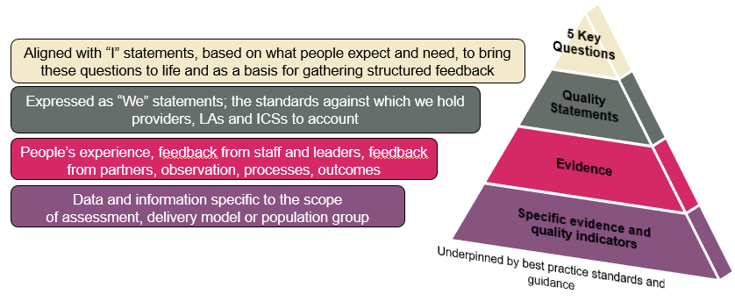
CQC’s Single Assessment Framework
The CQC framework will assess providers, local authorities and integrated care systems with a consistent set of key themes, from registration through to ongoing assessment
11
Notes:
Our assessment framework is built on our five key questions and well known ratings system and is what we use to set out our view of quality and make judgements.
We have drawn on work done previously by Think Local Act Personal (TLAP), National Voices and the Coalition for Collaborative Care on Making it Real. They co-produced a personalised care and support framework that can be used by people who work in adult social care, health, housing and people who use services. Importantly, this sets out what good and outstanding person-centred care looks like and what people should expect from providers, commissioners and system leaders.
We want to use ‘I statements’ as the starting point for our assessment framework, taking the important first step towards truly regulating through the eyes of the public. As the statements encapsulate the views and expectations of real people, we feel that giving them a prominent place in our single assessment framework helps to focus the whole health and social care system on people at a very human and relatable level.
We’ve already confirmed that our ratings and five key questions will stay central to our approach. But we are introducing a set of ‘quality statements’, pitched at the level of ‘good’ and linked to the regulations that will help us make our judgments about the quality of care. They will replace our current Key Lines of Enquiry (KLOEs) and prompts and be expressed as ‘we statements’ helping to make things clearer for providers about our expectations on them, while reducing the duplication that currently exists across our KLOEs.
We will use this set of statements in our assessments of all sectors and service types and at all levels, using them to register services with a provisional rating of good through to our new work looking at local authorities and integrated care systems. This will be the basis for our single assessment framework.
We want to be more consistent and transparent in our approach and how we make judgments on quality. To address this, we’re developing a way to categorise and score evidence as part of our assessments. The evidence ‘categories’ will bring more structure to our process for assessing quality. The six categories are:
Peoples experiences
Feedback from staff and leaders
Observations of care
Feedback from partners
Processes
Outcomes of care.
To enable us to be clearer with providers and the public about how we use the information we have about care in a service or local area we will set out what evidence will be required for each service type and at each level – including at registration.
In many ways this will all be data and evidence already familiar to providers and to our inspectors, but by bringing in the six categories and setting what we always need to collect and review in order to make a decision, alongside a way of scoring evidence, we are able to bring a more structured and consistent framework for assessing quality.
Our single assessment framework will act as the golden thread from initially registering a service at the level of ‘good’, through to ongoing assessments of quality.
We now want to test out some of those policy positions and thinking with you…

Slide 12
Proposed scope of LA assessments
Working with people - assessing needs, supporting people to live healthier lives, prevention, well-being, information and advice
Providing support - markets (including commissioning), integration and partnership working
Ensuring safety - safeguarding, safe systems and continuity of care
Leadership - capable and compassionate leaders, learning, improvement, innovation
Each of the themes has several quality statements and ‘I’ statements within it
Choice, control and personalisation are threaded through our entire framework and approach

Slide 13
1. How Local Authorities work with people
This includes: assessing needs (including unpaid carers), supporting people to live healthier lives, prevention, well-being, information and advice
Assessing needs - We maximise the effectiveness of people’s care and treatment by assessing and reviewing their health, care, wellbeing and communication needs with them.
I have care and support that is coordinated, and everyone works well together and with me.
I have care and support that enables me to live as I want to, seeing me as a unique person with skills, strengths and goals.
Supporting people to live healthier lives - We support people to manage their health and wellbeing so they can maximise their independence, choice and control, live healthier lives, and where possible reduce their future needs for care and support.
I can get information and advice about my health, care and support and how I can be as well as possible – physically, mentally and emotionally.

Slide 14
2. How Local Authorities provide support
This includes: market shaping, commissioning, workforce equality, integration and partnership working
Care Provision, integration and continuity - We understand the diverse health and care needs of people and local communities, so care is joined-up, flexible and supports choice and continuity.
I have care and support that is coordinated, and everyone works well together and with me.
Partnerships and communities - We understand our duty to collaborate and work in partnership, so our services work seamlessly for people. We share information and learning with partners and collaborate for improvement.
Leaders work proactively to support staff and collaborate with partners to deliver safe, integrated, person-centred and sustainable care and to reduce inequalities.

Slide 15
3. How Local Authorities ensure safety within the system
This includes: safeguarding, safe systems and continuity of care
Safe systems, pathways and transitions - We work with people and our partners to establish and maintain safe systems of care, in which safety is managed, monitored and assured. We ensure continuity of care, including when people move between different services.
When I move between services, settings or areas, there is a plan for what happens next and who will do what, and all the practical arrangements are in place.
I feel safe and am supported to understand and manage any risks.
Safeguarding - We work with people to understand what being safe means to them and work with them as well as our partners on the best way to achieve this. We concentrate on improving people’s lives while protecting their right to live in safety, free from bullying, harassment, abuse, discrimination, avoidable harm and neglect, and we make sure we share concerns quickly and appropriately.
I feel safe and am supported to understand and manage any risks.

Slide 16
4. Leadership
Scope of assessment includes: capable and compassionate leaders, learning, improvement, innovation and governance
Proposed Quality Statements:
Governance - We have clear responsibilities, roles, systems of accountability and good governance to manage and deliver good quality, Sustainable care, treatment and support. We act on the best information about risk, performance and outcomes, and we share this securely with others when appropriate.
Learning, improvement and innovation - We focus on continuous learning, innovation and improvement across our organisation and the local system. We encourage creative ways of delivering equality of experience, outcome and quality of life for people. We actively contribute to safe, effective practice and research.

Slide 17
Rating and scoring
A single overall rating at Local Authority level with narrative and 'sub-ratings' to provide granularity on the assessment and the areas for improvement.
CQC will use the four rating levels for the overall rating: outstanding, good, requires improvement, inadequate.
Each of the Quality Statements would be scored.
The overall rating and scores for the quality statements will be published alongside a narrative report.

Slide 18
Improvement/Intervention required
CQC Inspection
SoS considers escalation to stat. intervention
DHSC winds down intervention
SoS judges additional support/oversight is required after engagement with LA
SoS concludes LA unable to lead its own improvement
Concerns around safety and capacity to lead change
Peer Review Support/ADASS LGA
LA arranges additional support with oversight from DHSC/CQC (non-stat)
LA unable to improve in agreed timescales
LA demonstrates sustained grip of its own improvement
LA rep; statutory
intervention begins
LA demonstrates sustained grip of its own improvement
Additional monitoring withdrawn

Slide 19
The national picture for Adult Social Care
1.6m staff in Adult Social Care
£5.1 billion to the economy
Adult Social Care has a larger workforce than the NHS, Construction, Transport and Hospitality

Slide 20
Timetable for CQC Inspection
So far 4 councils have agreed to be the pilot CQC requires 5
September 20 councils will be chosen for inspection and then feedback on the learning between the pilots and the inspections
December - to March 20 more councils and then role out of inspection across all councils

