Slide 1
CQC Endorsement “A great way to promote the wellbeing of residents is through exercise and fun. It’s all part of the person centred approach that my inspectors are looking for. Congratulations to Oomph! for the enthusiasm and energy they have brought with their creative approach” Andrea Sutcliffe, Chief Inspector, CQC

Slide 2
Outstanding activity provision and exercise has positively impacted CQC ratings for clients…

Slide 3
CQC report extracts… from Oomph! partner homes
October 2016 highlighting Outstanding creative and person centred activity provision…”There is just so much stimulation here it is wonderful”
August 2016 highlighting the impact of physical activity on mood and social interaction… “ The group exercise sessions were effective and the positive impact on people’s moods was visible” Achieved Outstanding responsiveness rating

Slide 4
New Wellbeing package…

Slide 5
Oomph! Wellbeing Package
Home Manager support
Detailed report with observations and suggestions following site visits
1 ½ -days in-house Activity training
Creating and evidencing a unique, varied and person-centred programme: 4 hours with Activity leads in home
Driving a whole home approach to activity: 2 x 2 hour sessions for Activity team, wider staff team and Management
1 ½ -days in-house Exercise training (for up to 5 individual attendees)
Delivering inspiring chair-based exercise (covering group and one-to-one sessions)
Includes a set of props and music for the home
3 x 1/2 day site visits (upweighted packages available)
Access to digital resources
Telephone support on request
Quarterly reporting to Head office

Slide 6
Oomph! Workshop options Plus 4 x Individuals each attending a regional 1-day Activity or Exercise Skills Workshop
Exercise Workshops
Activity Workshops
Oomph! Sport Oomph! Music
Oomph! Relax Oomph! Create
Oomph! Active Oomph! Nature
Oomph! Sensory Oomph! Culture

Slide 7
Exercise is an integral part of the new wellbeing workshops and sport is the first one to be rolled out!

Slide 8
Credible Partnerships…
Slipper Soccer
Clock Cricket
Seated Volleyball

Slide 9
Learning Outcomes for each sport:
A clear understanding of the basic rules of the sport
Understanding the health and wellbeing benefits of playing
To demonstrate competency in leading the sport’s drills and games
To explain the importance of using adapted equipment to reduce the risk of injury and how to mitigate potential risks related to a match or training drills
To demonstrate competency in adapting the activity for players with varying physical and cognitive needs and promote inclusivity
To understand how to encourage participation
A clear understanding of the rules of the sport and scoring
Demonstrate understanding of how to run competitions

Slide 10
Questions…

Slide 11
Appendices…

Slide 12
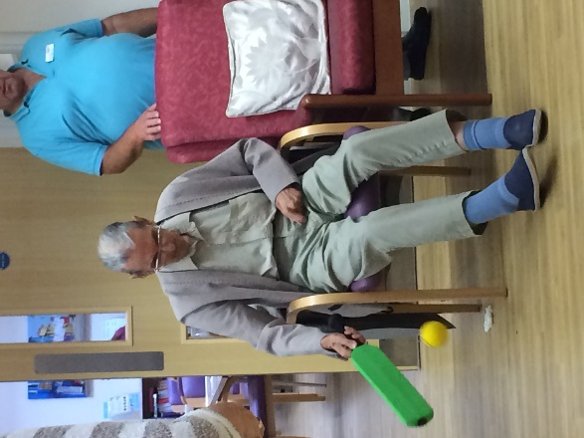
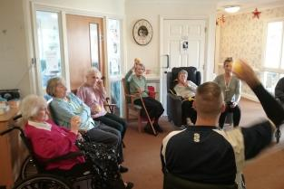
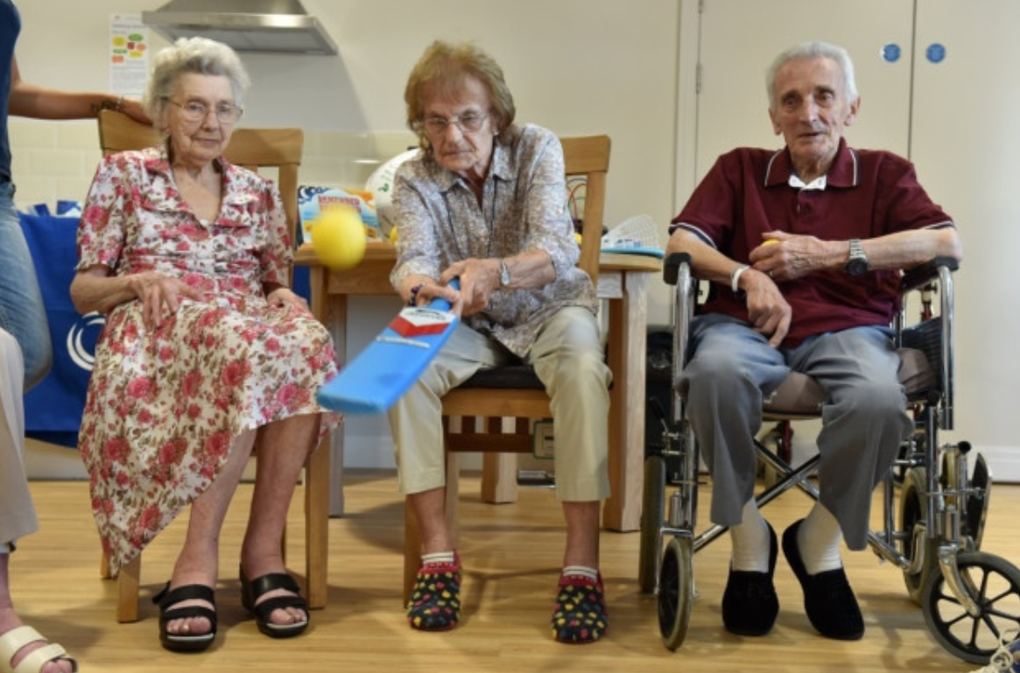
Clock Cricket
Clock Cricket was developed by the English Cricket Board, led by Hertfordshire Cricket.
Clock Cricket takes the principles of cricket (bat and ball, team sport, points based game) and makes it accessible to people with mobility challenges.
The physical benefits are in developing balance (asymmetrical movements), hand-eye coordination and torso, upper body and grip coordination and strength.
Clock Cricket is designed as a team game to include 4 or more players, but is an activity can be included in pairs and 1-2-1 support.

Slide 13
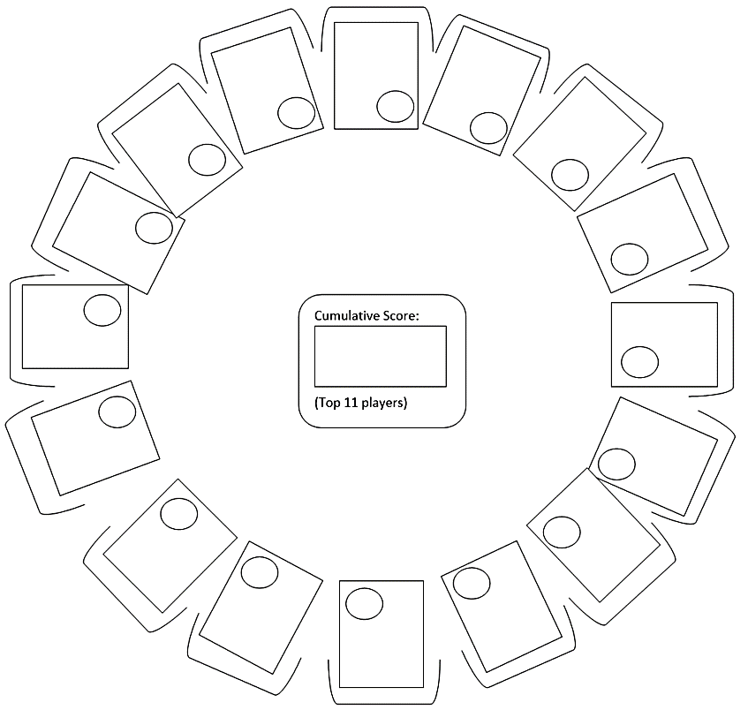
Clock Cricket Rules
Runs are scored as follows:
ONE run is awarded each time the batter hits the ball
TWO runs are awarded if the ball is hit outside of the circle
FOUR runs are awarded if the ball reaches a wall
SIX runs are awarded if the ball hits the ceiling!
if the ball is caught by one of the fielders, then the batter loses 3 runs.
After their eight balls, the batters score is calculated and recorded.
The bat and the ball is then handed to the next person the right.
The game continues until all participants have batted
The 'team' score is calculated by adding together the 3 best scores from each member of the team.
SCORE
SHEET

Slide 14
Clock Cricket Workshop
Working with the ECB, Oomph! have collaboratively designed a workshop on the principles of cricket including Clock Cricket and additional cricket-based games, activities and exercises.
Clock cricket involves the use of a foam bat and ball but no wickets or stumps
The Clock Cricket workshop focuses on the principles of cricket and how it is reflected in the adapted Clock Cricket version. It includes the umpiring and managing of a Clock Cricket match alongside the activities and exercises that have been designed to improve players batting, bowling and fielding skills that incorporate upper body and grip strength and co-ordination.
Clock Cricket League
Clock Cricket is a highly accessible version of the sport where it’s easy to run home competitions and inter-home leagues at a regional and national level.
Clock Cricket is a highly social activity with a focus on team spirit

