Slide 1
Key Contents
Oomph! – an overview
Results and CQC
New Wellbeing Training package
Questions

Slide 2
OUR MISSION… To ensure older people enjoy the quality of life they deserve!

Slide 3
OUR POSITIONING…
An award winning wellbeing business dedicated to transforming the lives of older adults…

Slide 4
OUR PROPOSITION… Changing the face of ageing

Slide 5
See Oomph! in action…
Click here to view video or when in slideshow mode click on the image

Slide 6
An Overview…
Training and support services to enable care home staff to deliver high quality exercise and activity classes
Over 60,000 classes with 1600 plus trained instructors
Last year we launched Out and About enabling care Homes to offer regular trips to culturally relevant activities and events – we are already taking 1000 residents out per month
Plus recent partnership and funding with Sport England to roll out Oomph! model to the wider community across the UK, with a minimum target of 27,000 consumers!

Slide 7
SIGNIFICANT SCALE AND REACH… with Clients, Investors and Partners
Investors & Advisors
Clients
Partners

Slide 8
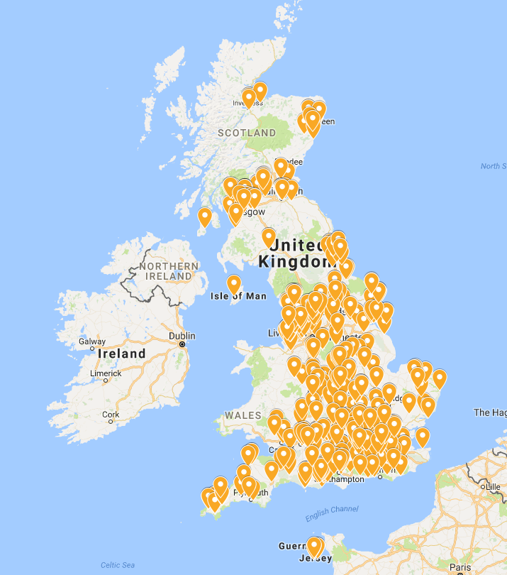
Widespread coverage…
MARKET LEADERS
IN WHAT WE DO!

Slide 9
HIGH PROFILE PR COVERAGE…
Achieving huge scale and impact!!
https://www.theguardian.com/society/2017/feb/22/residential-social-care-day-trips-minibus
https://www.ft.com/content/fe559314-bd49-11e7-9836-b25f8adaa111
BBC - https://youtu.be/WIw8xj7YeoM
ITV - https://youtu.be/hc8mpePzXfE

Slide 10
Proven results and endorsement…

Slide 11
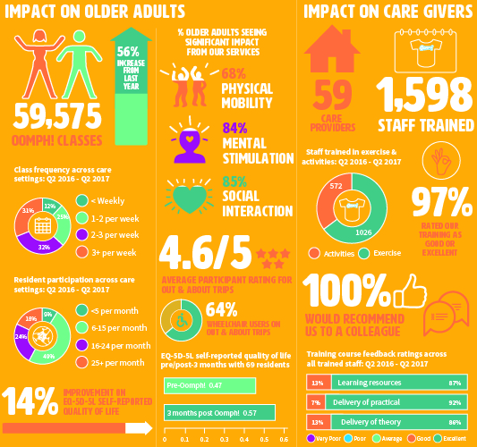
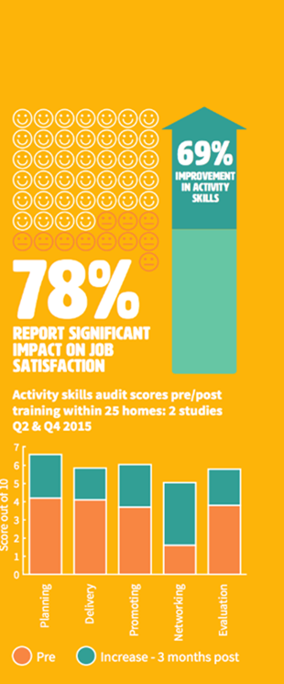

Slide 12
CQC Endorsement “A great way to promote the wellbeing of residents is through exercise and fun. It’s all part of the person centred approach that my inspectors are looking for. Congratulations to Oomph! for the enthusiasm and energy they have brought with their creative approach” Andrea Sutcliffe, Chief Inspector, CQC

