Slide 1
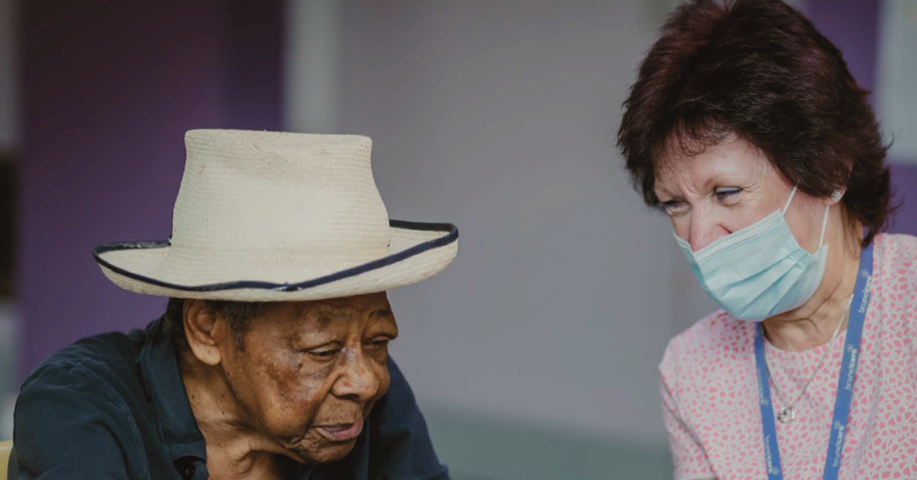
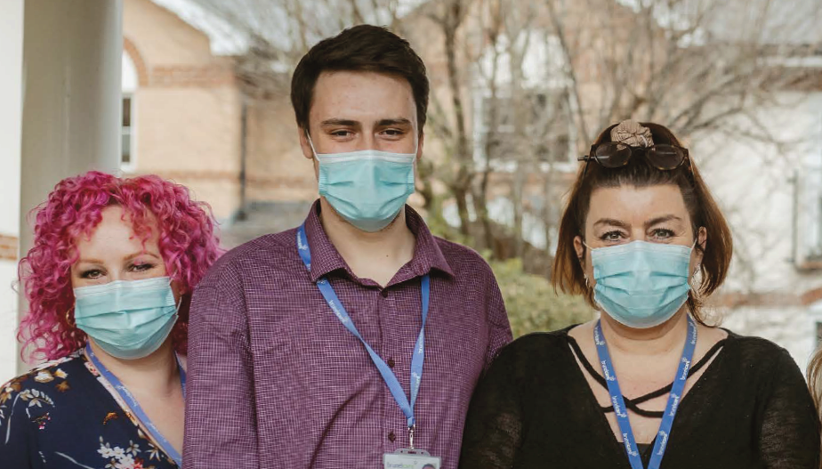
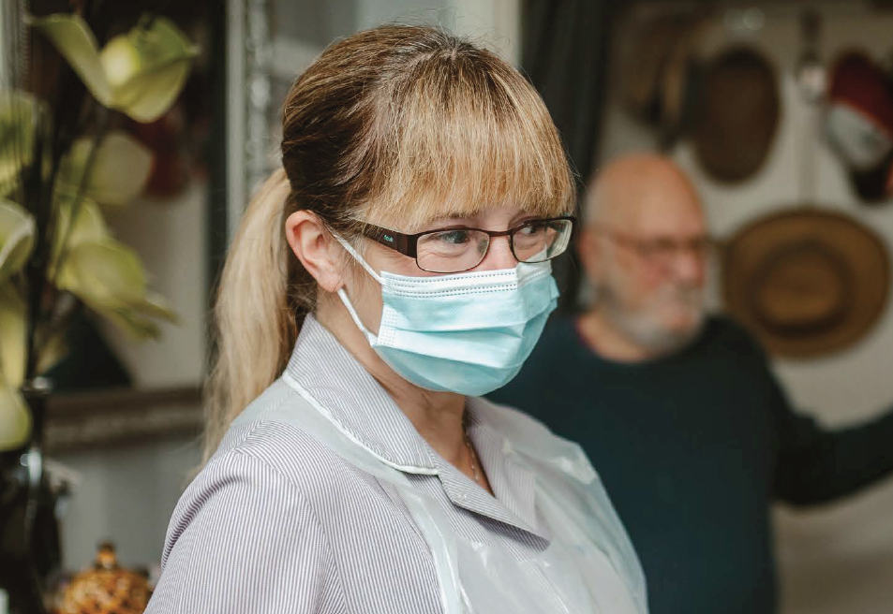
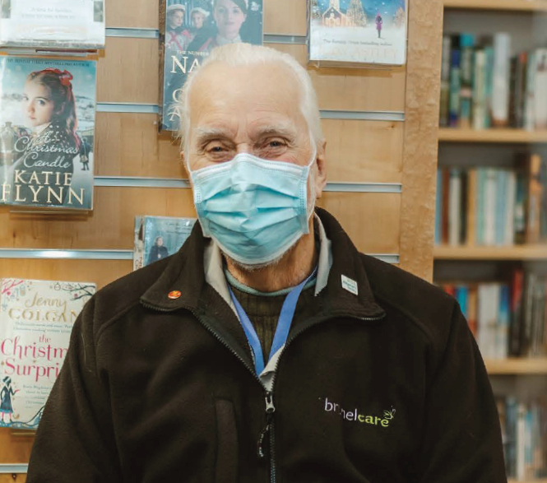
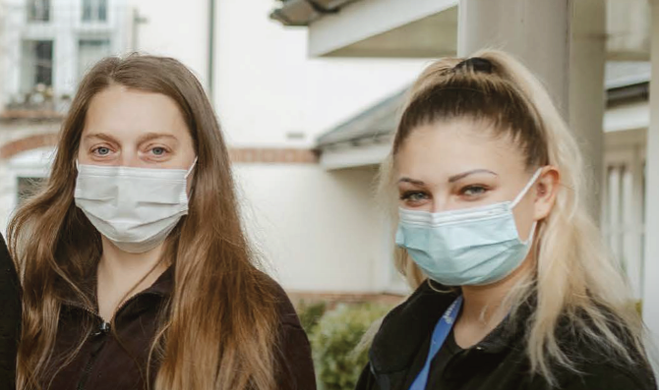
Integrated Care Partnerships
The Provider Perspective

Slide 2
Why Integrated Care and Health Matters
Don’t we all want to live in the place we call home with the people and things that we love, in communities where we look out for one another, doing the things that matter to us?
“
”
- Social Care Futures

Slide 3
Why Social Care?
ICS - Health AND Care
Why Social Care - workforce, population health, gaps in LAs
How - Care & Support West
South Bristol ICP

Slide 4
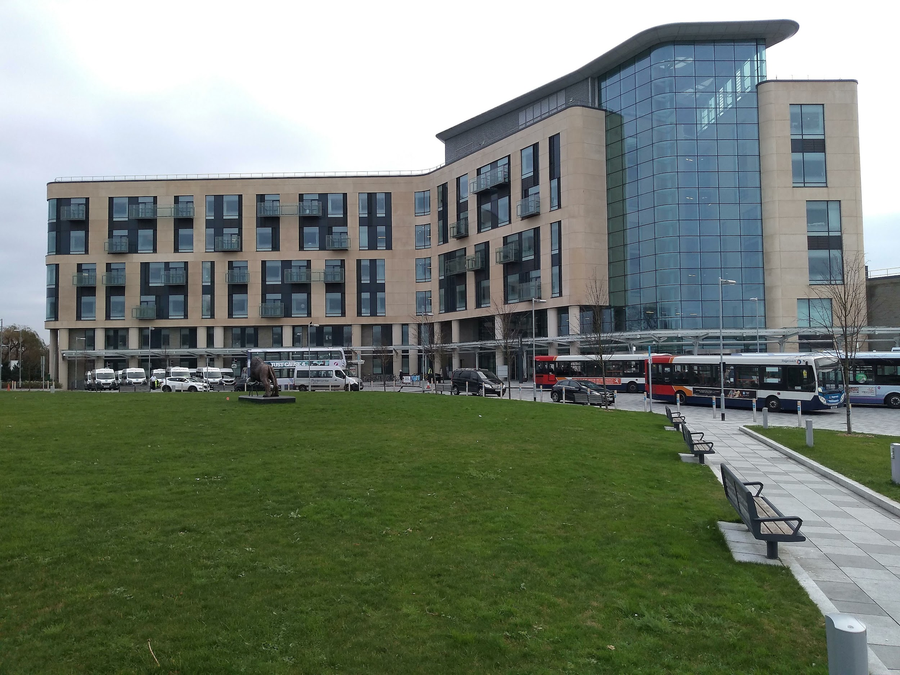

Slide 5
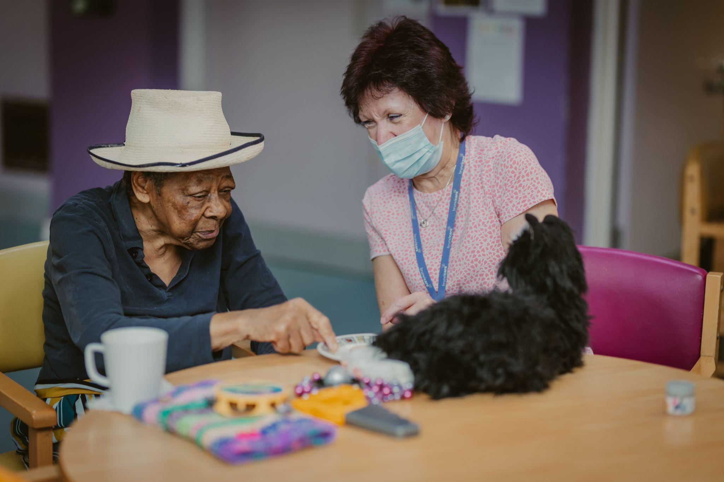
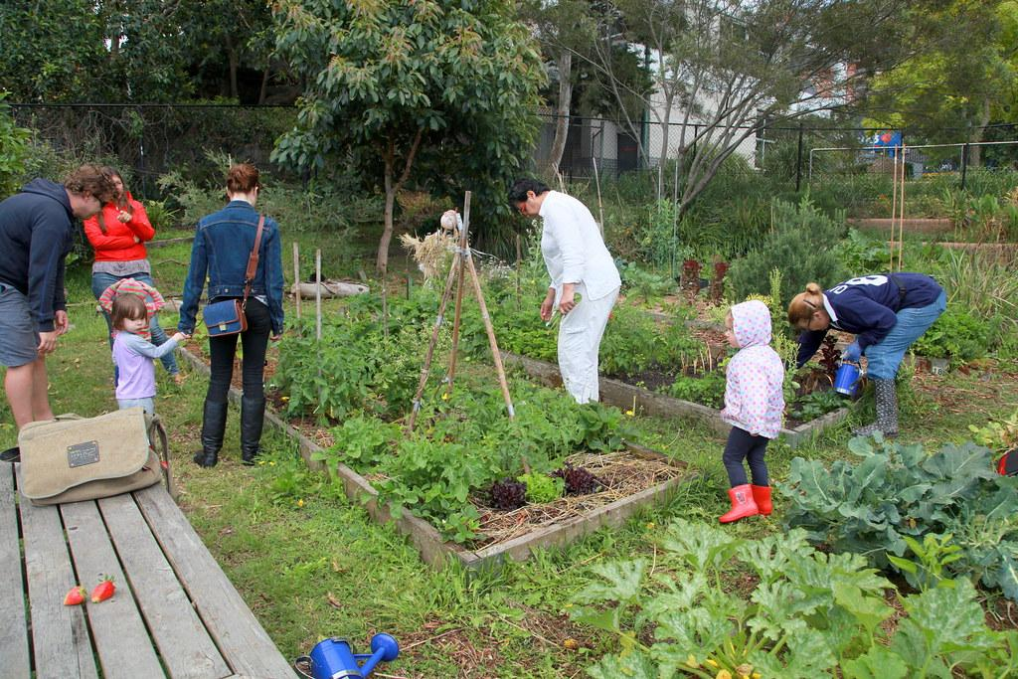
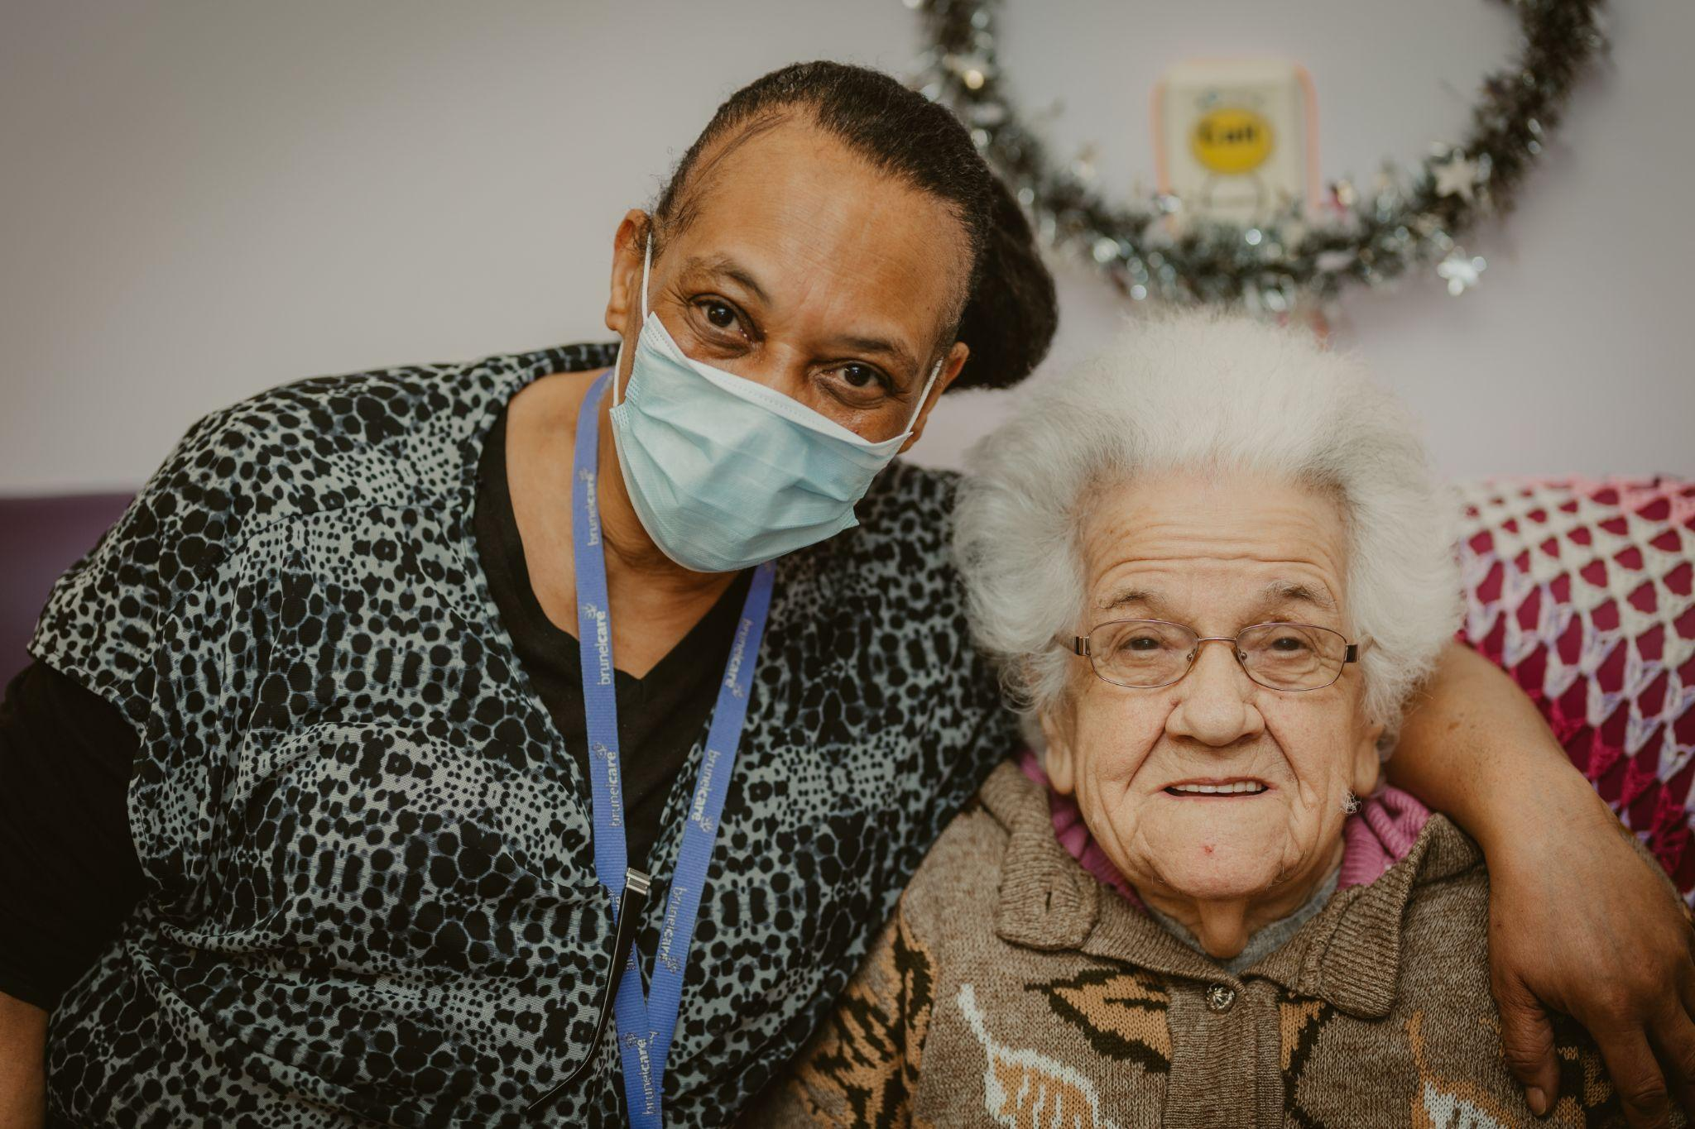
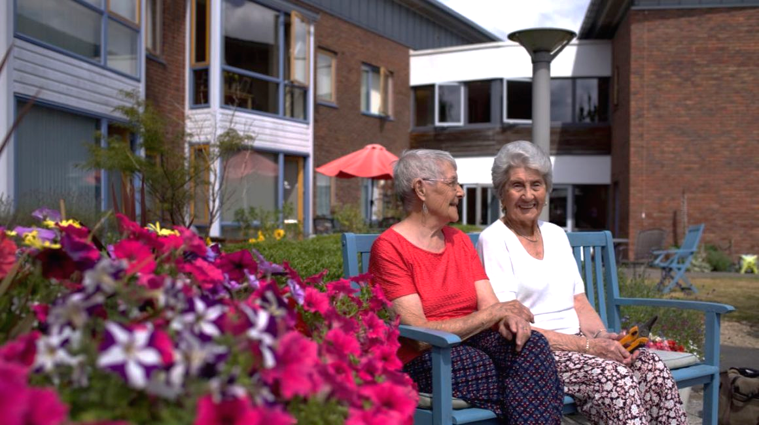
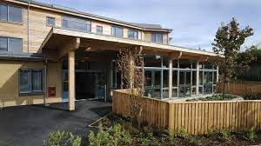
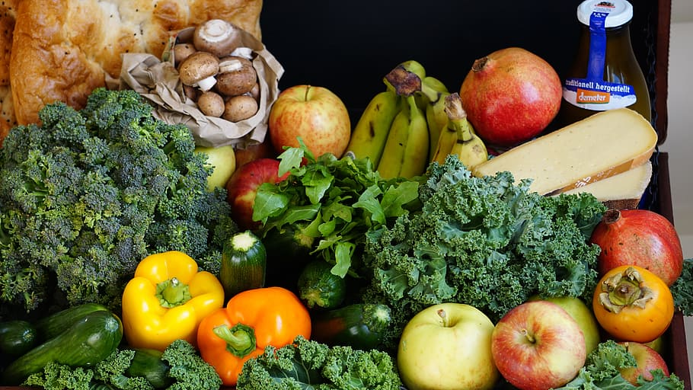
‘Health is made at home, hospitals are for repairs’

Slide 7
South Bristol ICP
What - “Health, social care and voluntary partners are coming together in South Bristol to work with you, your families and community to design and deliver care and support services to help you optimise your own wellbeing and live a good life.”
Who - SBICP = Community, Social Care, BCC, GPs, AWP, Sirona, Acutes, Citizens, and others…

Slide 8
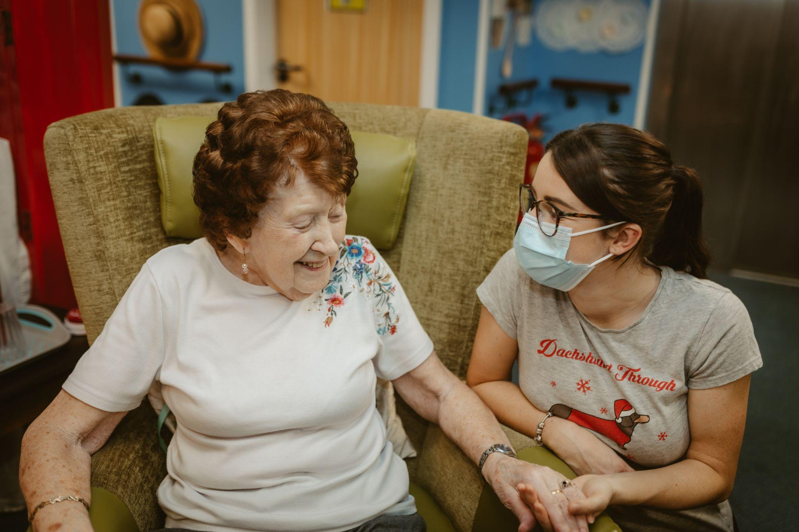
Priorities and Role
Community Mental Health - community connectors , peer support, Thrive, IPCTs.
Ageing Well
Co-production, Communication and Engaging Communities
Data, evidence.

Slide 9
Reflections
It’s messy and frustrating
No one’s day job -
How can we represent South Bristol?
What can we actually do?
Will we ever have any resources?
How do influence our organisations?
Community capacity - perspective
Governance, control and ICS pressures
Does the ICS even know we are here?

Slide 10
BUT….
Listening…not telling
Relationships, Trust, Honesty
Lightbulb moments…things can happen
Shared budgets

Slide 11
Social Care Impact
Everyone should receive the right care, in the right place, at the right time.
Grow care at home - hyper local family and community support
Extra Care community hubs and sheltered housing
Living with dementia - care homes part of community
Improve outcomes for groups with the poorest health,
Prevention - Falls, care
Integration - Shared roles, budgets and co location
Low intensity support - D2A
Technology, data and AI

Slide 12
ASK of ICS
See social care providers/ VCS as key partner
‘Wellbeing’ in Communities shapes good health
Co-production and role with ICS - Test and Learn
Inverted pyramid - with citizens at top
‘Fair Price for Care’ and social care change

Slide 13
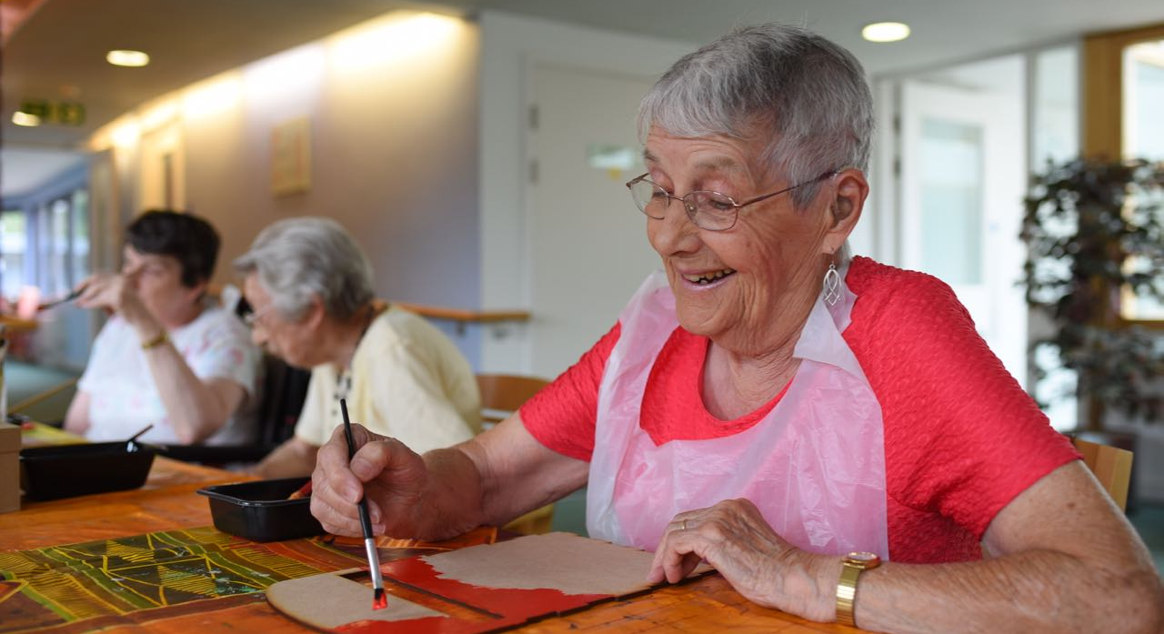
Any questions?

