Slide 1
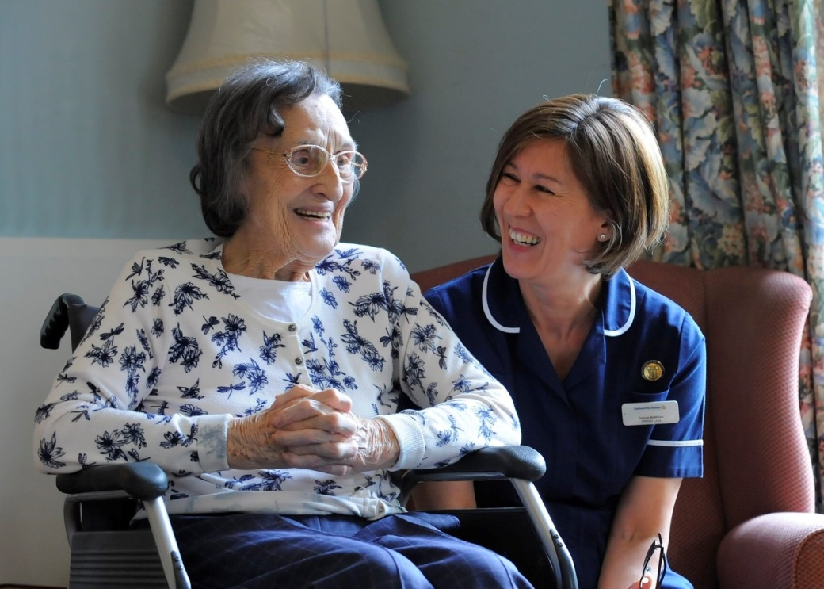
Medicines in
Adult Social Care
Care homes &
Care at Home
Laura Picton
Care and Support West (Bristol)
18 April 2018
1
Notes:
1

Slide 2
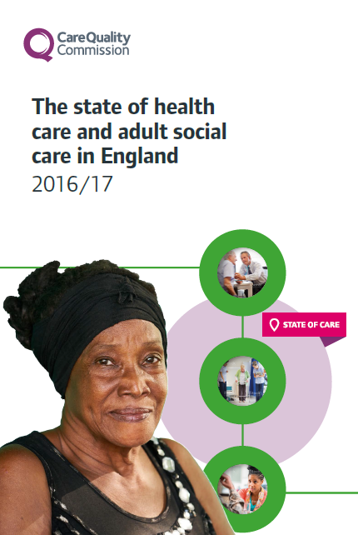
Our purpose
We make sure health and social care services provide people with safe, effective, compassionate, high-quality care and we encourage care services to improve
Register
Monitor and inspect
Use legal powers
Speak independently
Encourage improvement
Outstanding, Good, Requires Improvement, Inadequate
People have a right to expect safe, good care from their health and social care services

Slide 3
Unique oversight of health and care
Full picture of the quality of health and social care in England, with ratings for all sectors
Now have a baseline from which to draw conclusions about quality and safety of care and what influences this
21,256 adult social care services
152 NHS acute hospital trusts
197 independent acute hospitals
18 NHS community health trusts
54 NHS mental health trusts
226 independent mental health locations
10 NHS ambulance trusts
7,028 primary medical care services
Increasingly, CQC will report on quality of areas and coordination across services – for care fit for the 21st century
Is it safe?
Is it effective?
Is it caring?
Is it responsive?
Is it well-led?

Slide 4
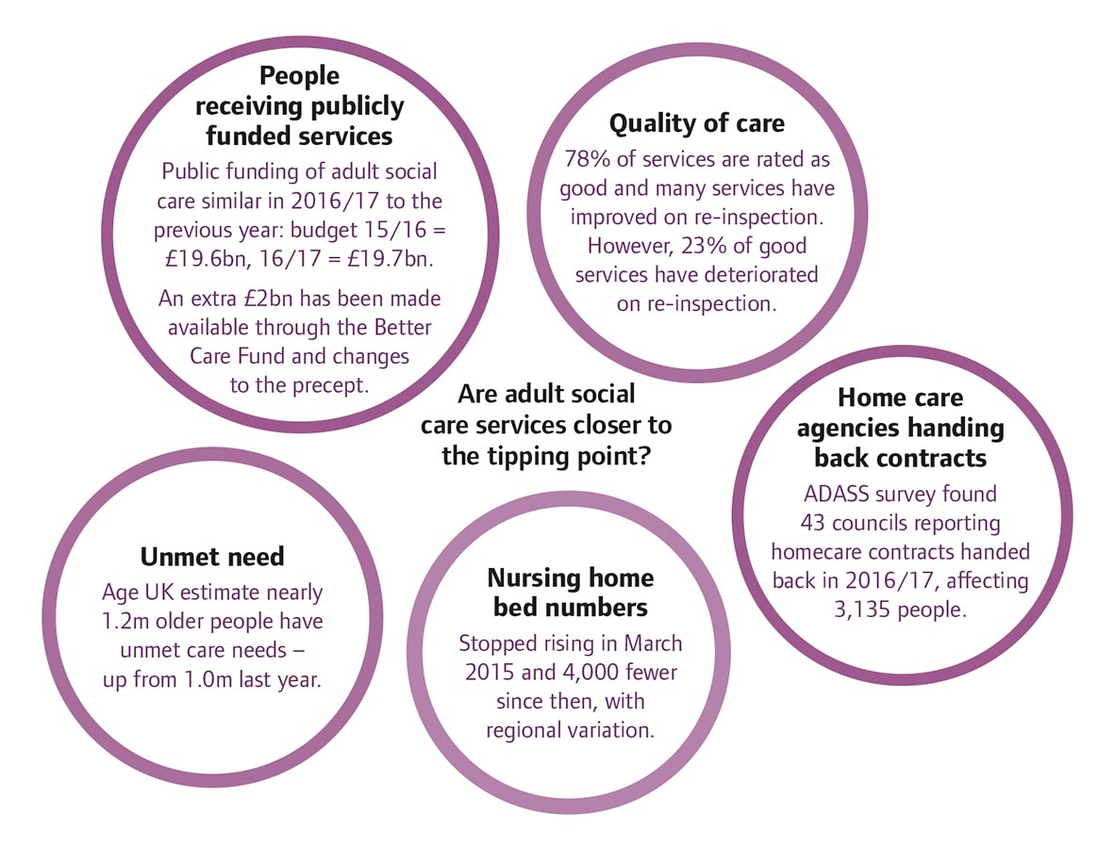
Are adult social care services closer to the tipping point?

Slide 5
Adult social care
78% rated good, but 19% rated requires improvement and 1% (303 locations) inadequate
Caring rated best – 92% good and 3% outstanding. Safe and well-led poorest – 22% requires improvement and 2% inadequate
High-performing services have strong leaders – innovative registered managers known to staff, people using the service, carers and families had a positive impact
High-quality services are person-centred – staff get to know people as people, understanding their interests, likes and dislikes
Most enforcement for poor care relates to governance, safety, staffing and person-centred care
Quality matters joint commitment developed

Slide 6
Bristol Local Authority ratings up to 3.4.18
Community
3% outstanding
80% good
12% requires improvement
2% inadequate
Total 51 ratings
Residential
4% outstanding
71% good
25% requires improvement
0% inadequate
Total 108 ratings

Slide 7
Medicines Safety
Adverse reactions to drugs are responsible for 6.5% of all admissions to hospital and over 70% are avoidable.
A third of people aged 75 years and over are taking at least six medicines
A person taking ten or more medicines is 300% more likely to be admitted to hospital
Patients and their carers often have inadequate information about their medicines. Between 30%-50% of newly prescribed medicines are not taken as prescribed.

Slide 8
Key lines of enquiry
To focus our inspection, we use a standard set of key lines of enquiry (KLOEs) that relate to the five key questions
KLOEs support consistency of what we look at under each of the five key questions and focus on those areas that matter most
KLOEs are supported by guidance on the key things to consider as part of the assessment; these are called prompts
Each KLOE has a defined set of ratings characteristics – what does ‘good’ look like?
S4: How does the provider ensure the proper and safe use of medicines?
8

Slide 9
Medicines key lines of enquiry
S4.1: Is the provider’s role in relation to medicines clearly defined and described in relevant policies, procedures and training? Is current and relevant professional guidance about the management of medicines followed?
Policies should be service specific, reflect practice be in date, read by and accessible to staff
NICE guidance:
SC1 for care homes
NG67 for people living in their own homes

Slide 10
Medicines key lines of enquiry
S4.2: How does the service make sure that people receive their medicines (both prescribed and non-prescribed) as intended (including controlled drugs and as required medicines), and that this is recorded appropriately?
Medicines records – MARs, controlled drugs, topical
Treatment of minor ailments
Additional guidance for when required medicines and those with variable doses
What adjustments are made for time sensitive medicines?
Compliance aids vs original packs

Slide 11
Medicines key lines of enquiry
S4.3: How are medicines ordered, transported, stored, and disposed of safely and securely in ways that meet current and relevant regulations and guidance?
Secure or controlled access to medicines in care homes
Risk assess storage in people’s own homes
Responsibility for ordering and collecting medicines
Safe disposal of unwanted medicines – controlled drugs
Suitable temperature for storing medicines
Storage in people’s rooms – e.g. creams

Slide 12
Medicines key lines of enquiry
S4.4: Are there clear procedures for giving medicines covertly, in line with the Mental Capacity Act 2005?
Assessment that person lacks capacity to make decisions about medicines
Best interest meeting to consider each individual medicine – should be the last resort
Discussion with pharmacy about how to administer safely and ensure continued effectiveness

Slide 13
Medicines key lines of enquiry
S4.5: How does the service make sure that people’s behaviour is not controlled by excessive or inappropriate use of medicines?
Inappropriate use of sedation
Antipsychotic medicines for people living with dementia
Psychotropic medicines for people with learning disabilities – STOMP-LD
Good care planning to anticipate behavioural patterns and environmental adjustments
Records, care plans and staff guidance

Slide 14
Medicines key lines of enquiry
S4.6: How do staff assess the level of support a person needs to take their medicines safely, particularly where there are difficulties in communicating, when medicines are being administered covertly, and when undertaking risk enablement assessments designed to promote self-administration?
Medicines support – person centred, medicine specific
Assumption that people can self-administer unless preference or risk assessment says otherwise
How do staff decide if a person needs to be given their medicines covertly? Is it always a last resort?

Slide 15
Medicines key lines of enquiry
S4.7: How does the service engage with healthcare professionals in relation to reviews of medicines at appropriate intervals?
Supporting people to attend appointments and reviews
Contacting the GP to arrange a medicines review
Knowing when to refer to healthcare professionals

Slide 16
Medicines key lines of enquiry
S4.8: How do staff make sure that accurate, up to date information about people’s medicines is available when people move between care settings? How do medicines remain available to people when they do so?
Medicines reconciliation
New medicines
Entry into new care services
Discharge from hospital

Slide 17
Paraffin based skin emollients: fire risk
Smoking or a naked flame could cause patients’ dressings or clothing to catch fire when being treated with paraffin-based emollient that is in contact with the dressing or clothing.
Advise patients not to: smoke; use naked flames (or be near people who are smoking or using naked flames); or go near anything that may cause a fire while emollients are in contact with their medical dressings or clothing
Change patient clothing and bedding regularly—preferably daily- because emollients soak into fabric and can become a fire hazard

Slide 18
Staff Training and Competency
All staff should receive appropriate training and support and should have an annual review of their knowledge, skills and competencies
Appropriate training, support and competency assessment is essential to ensure the safety, quality and consistency of care.
Tasks can be delegated from a Registered nurse to a care worker following DH and NMC guidance on delegation and accountability

Slide 19
Medicines Incidents
Home care providers must have robust processes for medicines-related safeguarding incidents
Home care providers should have robust processes for identifying, reporting, reviewing and learning from medicines-related problems.
These processes should support a person-centred, 'fair blame' culture that actively encourages people and/or their family members or carers and home care workers to report their concerns.

Slide 20
What can you do?
Keep up to date with NICE guidelines and other sources of best practice
Talk to other providers – share best practice
Use your medicines experts:
Medicines optimisation team
Community Pharmacy
GP practice

Slide 21
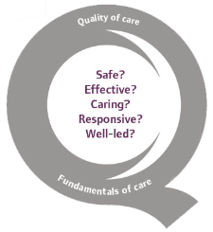
Thank you
www.cqc.org.uk
enquiries@cqc.org.uk
@CareQualityComm
#qualitymatters
Laura Picton
21

