Slide 1
To the ICS and beyond
Dr. Jeff Farrar QPM, Chair (Designate)
NHS Bristol, North Somerset and South Gloucestershire Integrated Care Board
2 March 2022

Slide 2
Developing Integrated Care Systems in England
Integrated care systems (ICSs) are partnerships of health and care organisations that come together to plan and deliver joined up services and to improve the health of people who live and work in their area. They exist to achieve four aims:
Improve outcomes in population health and healthcare
Tackle inequalities in outcomes, experience and access
Enhance productivity and value for money
Help the NHS support broader social and economic development
Notes:
Collaborating as ICSs will help health and care organisations tackle complex challenges, including:
Improving the health of children and young people
Supporting people to stay well and independent
Acting sooner to help those with preventable conditions
Supporting those with long-term conditions or mental health issues
Caring for those with multiple needs as population age
Getting best from collective resources so people get care as quickly as possible

Slide 3
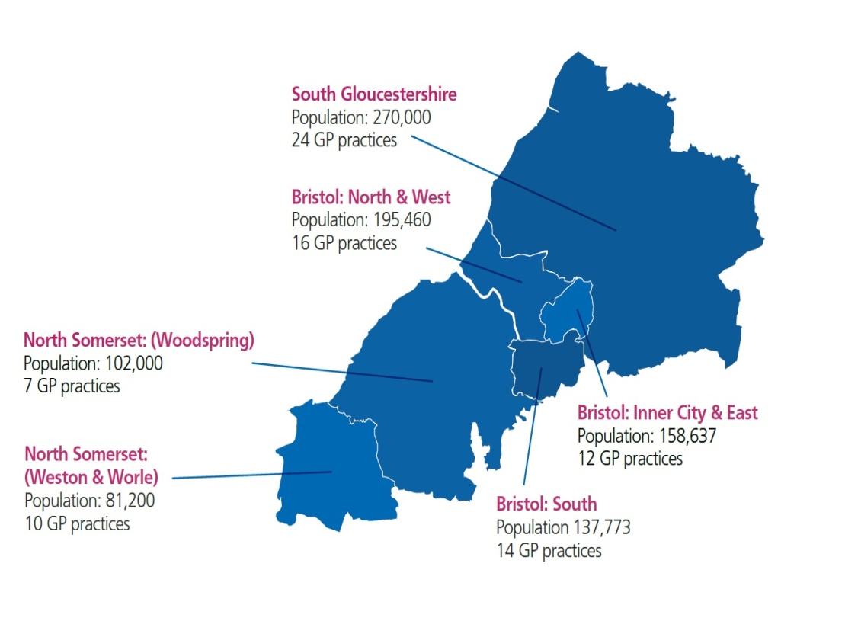
An overview of our ICS
Population: 1m
The 10 Healthier Together ICS partners are:
Clinical Commissioning Group:
BNSSG CCG
Local Authorities:
Bristol City Council
North Somerset Council
South Gloucestershire Council
Healthcare Providers:
Avon & Wiltshire Mental Health Partnership NHS Trust
North Bristol NHS Trust
Sirona Care and Health
South Western Ambulance Service NHS Foundation Trust
University Hospitals Bristol and Weston NHS Foundation Trust
GP Federation:
One Care (BNSSG) Ltd
We are developing integrated care partnerships (ICPs) in six localities:
Place: 6
CCGs: 1
Providers: 5
Local authorities: 3
PCNs: 18
We were designated as a ‘maturing’ Integrated Care System in December 2020, in recognition of what we have achieved together…. The next phase of journey involves transition to a new statutory form by July 2022
2020
ICS
designation
Feb 2021
White Paper
published
July 2022
ICSs operating in new statutory form
2016
Partnership formed
2019
Long term plan
Oct 2021
ICS Memorandum of Understanding

Slide 4
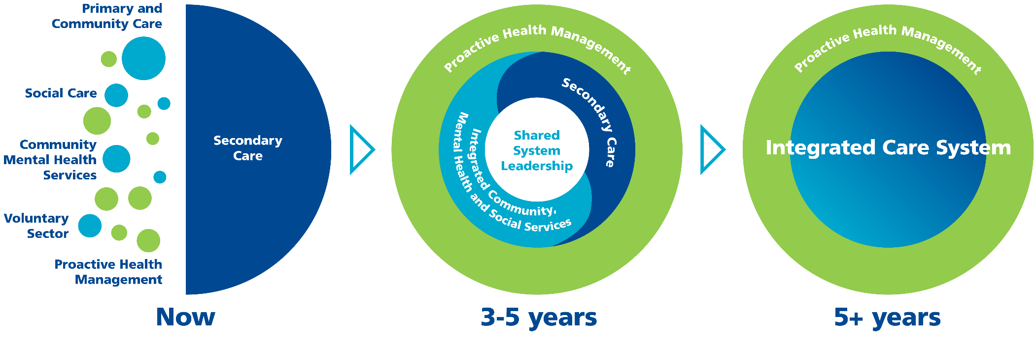
Our shared vision for the people of BNSSG
Healthier Together is the health and care partnership for people in Bristol, North Somerset and South Gloucestershire. We work together to improve the health of our population and make sure services work for everyone.
Our vision is for people in Bristol, North Somerset and South Gloucestershire to have the best start in life, and for the places where we live to be healthy and safe.
Everyone will have the opportunity to live longer in good health. When people need support from our services, they will be high quality and easy to access.
People will be better supported to take control of their own health and wellbeing, and become equal partners in care. Working alongside our communities, we’ll build on strengths and tackle inequalities together.
We’ll make it simple for health and care staff to work better together for the benefit of the people we care for – nurturing talent, removing barriers and acting on views and concerns.
Our vision for delivering our ambitions is to join up care at locality level and across our hospital systems to respond to what people with complex needs tell us matters to them

Slide 5
Our system goals
Reduce the inequality in how many years people in BNSSG live in good health, particularly improving healthy life expectancy for those with the poorest outcomes
Make it easy for people working in health and care to work with each other
Reduce our adverse environmental impact in energy, travel, waste, water, food, biodiversity and land use
Increase the number of years people in BNSSG live in good health
Become a place where health and care services fit with people’s lives and makes sense to the people engaging with them
Our workforce is healthy and fulfilled
Our communities are healthy, safe and positive places to live

Slide 6
Principles for how we work together as an ICS
Individuals @ the Centre | We work to achieve our vision to meet our citizens’ needs by working together within our joint resources, as one health and care system. We will develop a model of care and wellbeing that places the individual at its heart, using the combined strengths of health and social care. Citizens are integral to the design, co-production and delivery of services We involve people, communities, clinicians and professionals in all decision-making processes. We will take collective, considered risks to cease specific activity to release funds for prevention, earlier intervention and for the reduction of health inequalities. We will focus on the causes of inequality and not just the symptoms, ensuring equalities is embedded in all that we do.
Subsidiarity | Decisions taken closer to the communities they affect are likely to lead to better outcomes. The default expectation should be for decisions to be taken as close to communities as possible, except where there are clear and agreed benefits to working at greater scale.
Collaboration | Collaboration between partners in a place across health, care services, public health, and the voluntary sector can overcome competing objectives and separate funding flows to help address health and social inequalities, improve outcomes, transform people’s experience, and improve value for the tax payer. Collaboration between providers across larger geographic footprints is likely to be more effective than competition in sustaining high quality care, tackling unequal access to services, and enhancing productivity. ​ Through collaboration as a system we will be better placed to ensure the system, places, and individual organisations are able to make best use of resources We prioritise investments based on value, ensuring equitable and efficient resource allocation, and we take shared ownership in achieving this.
Mutual Accountability & Equality | We are coming together under a distributed leadership model and we are committed to working together as an equal partnership. We have a common understanding of the challenges to be addressed collectively and the impact organisations can have across other parts of the system. We engage in honest, respectful, and open dialogue, seeking to understand all perspectives and recognising individual organisations agendas and priorities. We accept that diverse perspectives may create dissonance, and we seek to understand and work through any disharmony, and move to conclusions and action in service of our citizens. We strive to bring the best of each organisation to the partnership. We adhere to a collective model of accountability, where we hold each other mutually accountable for our respective contributions to shared objectives. We develop a shared approach to risk management taking collective responsibility for driving necessary change while mitigating the risks of that change for individual organisations.
Transparency | 15. We pool information openly, transparently, early, and as accurately and completely as practical to ensure one version of the truth 16. We work in an open way and establish clear and transparent accountability for decisions.

Slide 7
BNSSG Integrated Care System: Whole-System Governance & Operating Model*
Constituent Organisations
1
BNSSG Partnership Board
2
*Notes:
does not currently include executive/ management functions and forums
Reporting/interaction lines are simplified here, detail on each group to represent more detail on interactions/relationships between groups
BNSSG Integrated Care Board
4
Forums for key input:
Citizens
Governing Boards / Committees
VCSE
Clinical and Care Professionals
5
3
6
Place-Based Partnerships (ICPs)
ICB Committees*
Provider Collaboratives
Weston, Worle & Villages
South
Glos.
Inner City & East Bristol
People
Quality & Performance
Audit & Risk
Finance, Estate & Digital
Clinical / Primary Care
Acute Provider Collaboration Board
Mental Health Provider Collab (TBC)
Woodspring
South Bristol
North & West Bristol
ICB Remuneration
7
System-wide Steering and other groups
DRAFT

Slide 8
BNSSG Partnership Board
The central partnership structure at system level that operates at the heart of the ICS philosophy and approach. Its mission is to work on behalf of the population of BNSSG by setting the strategic direction for the system, being the guardians of the joint outcomes, the assurers of genuine partnership working and, by establishing an inclusive culture, to provide the vehicle by which all voices in the ICS can be heard.
BNSSG Integrated Care Board
A new statutory organisation to lead integration within the NHS and support broader ICS goals
Place-based Partnerships (ICPs)
Deliver fully integrated services for the local population and strengthen the connection to people and communities to ensure we deliver the experiences that matter to people
Citizens
Ensures the views and needs of the people and communities we serve and heard and listened to, underpinned by principles of equality and inclusion
VCSE
Champions robust and meaningful engagement of the voluntary, community and social enterprise organisations/communities, underpinned by principles of equality and inclusion
Clinical and Care Professionals
Core part of system governance and sub committee of the ICB and Partnership Board with clear delegated decision making responsibilities and accountabilities
Notes:
The dual structure recognises that there are two forms of integration that will be enshrined in legislation: integration within the NHS to enable NHS organisations to work together across a system; and integration between the NHS, local authorities and other partners to deliver improved outcomes for health and wellbeing of their populations.
Guidance issued so far is prescriptive about the functions and governance of the ICB but less so with more local discretion form ICPs
ICB:
Develop a plan to meet the health and care needs of the population, having regard to the Partnership strategy
Allocate resources to deliver the plan across services, places, and providers
Establish joint working arrangements with partners that embed collaboration to deliver the plan
Establish governance arrangements to support collective accountability between partner organisations for whole-system delivery and performance
Arrange for the provision of health services, including contracting, service transformation programmes, supporting PCNs, and working with LA and VCSE partners to put in place personalised care
Lead system implementation of people priorities, including delivery of the People Plan and People Promise and supporting 'one workforce’
Lead system-wide action on data and digital
Use joined-up data and digital capabilities to understand local priorities, track delivery of plans, monitor and address unwarranted variation, health inequalities, and drive continuous improvement in performance and outcomes
Support wider goals of social and economic development and environmental sustainability
Drive joint working on estates, procurement, supply chain and commercial strategies to maximise value for money
Plan for, respond to, and lead recovery from incidents
Take on delegated commissioning from NHSEI for primary care and appropriate specialised services

Slide 9
To the ICS and beyond: what’s next?
Q4 (Jan-Mar 22)
Finalise plans
Q1 (Apr-Jun 22)
Complete transition*
Complete design of ICS governance arrangements (ICS Partnership Board and Integrated Care Board)
Begin long term plan updates
Designate ICB Chief Executive starts (14 Feb)
ICB Independent Non-Executive Members (NEDs) confirmed
Begin operating under new governance in shadow form (from June)
ICB constitution approved
Complete governing documents and transfer staff and assets to Integrated Care Board
ICB establishment: 1 July 2022*
*subject to passage of Health & Care Bill through parliament

Slide 10
Contact us:
Healthier Together Office, Level 4, 360, Marlborough Street, Bristol, BS1 3NX
0117 900 2583
Bnssg.healthier.together@nhs.net
www.bnssghealthiertogether.org.uk

