Slide 1
Is the service caring?

Slide 2
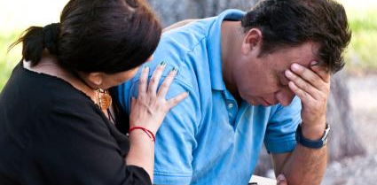
C1: Kindness and compassion
What evidence can you provide to show that the service is promoting a culture amongst staff to ensure people are supported in a respectful, kind and compassionate way?

Slide 3
Kindness and compassion… service user feedback
What do service users say about their staff and how well they feel treated and respected?

Slide 4
Are there any existing concerns about the way staff members interact with service users?
If so, how have these been dealt with?

Slide 5
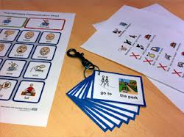
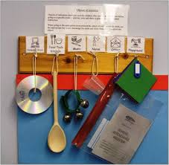
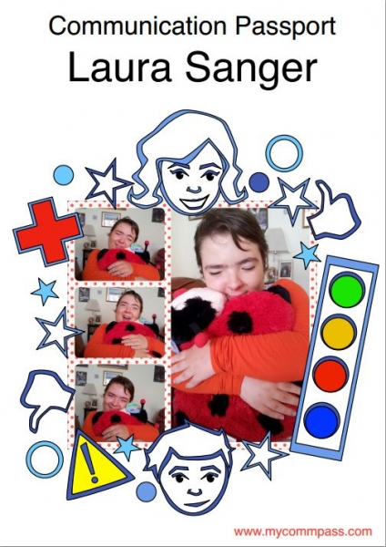
Meeting people’s communication needs

Slide 6
Do people using your service have specialist communication needs?
If so, do you use communication profiles (or equivalent) to identify these and the strategies you use to address them?
Break this down into:
Strategies you use to aid the person’s understanding of information
Strategies you use to aid the person’s communication of information

Slide 7
How are you gathering information about people’s preferences (likes and dislikes), personal histories, strengths and things they would like to achieve?

Slide 9
C1 – Kindness and compassion
Make sure that:
Staff treat people with kindness and compassion at all times
People feel genuinely supported and cared for by the service and that their needs (including their communication needs) are being properly met
Staff understand the personal histories, preferences and potential of the people they are supporting

Slide 10
C1 – Kindness and compassion
Make sure that:
Staff respond to people’s needs effectively and in a timely manner
you promote compassionate, respectful and compassionate behaviour amongst the staff team
Anything else?

Slide 11
C2 – supporting people to express their views and be involved in decision making

Slide 12
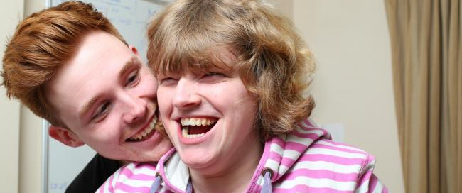
What evidence is there that staff are enabling people to express themselves effectively?

Slide 13
What information is there readily available to people about local advocacy services and relevant community organisations and how to access them?

Slide 14
Feedback from service users and staff …
Are there enough staff on duty and do they have enough time to meet people’s needs in an unhurried way?

Slide 15
C2 – supporting people to express their views and be involved in decision making
Make sure that:
Staff recognise when a person wants and / or would benefit from support from a representative or advocate
you provide people with information about other local services that might be of relevance to them and help people to contact these services if they need / wish to
Notes:
Asking people (and then capturing) what they would like to achieve is a good way of identifying their aspirations

Slide 16
C2 – supporting people to express their views and be involved in decision making
Make sure that:
You ensure that staff have both the time and the training needed to support people in a compassionate and personal way
Anything else?
Notes:
Asking people (and then capturing) what they would like to achieve is a good way of identifying their aspirations

Slide 17
C3: Promote and respect people’s privacy, dignity and independence
What evidence can you provide to show that the service is promoting a culture amongst staff around respecting people’s privacy and dignity?

Slide 18
What evidence can the service provide to show that people receive effective pain relief when they need it?

Slide 19
What measures can you evidence to show that you protect people’s personal data in line with the requirements of the General Data Protection Regulations (GDPR)?

Slide 20
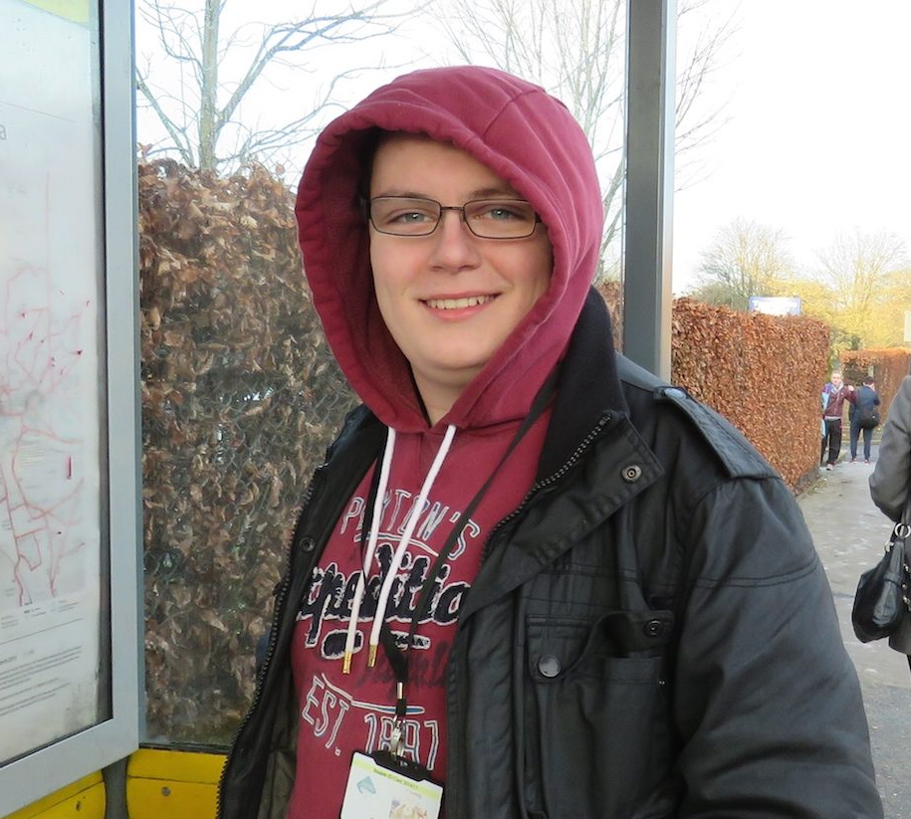
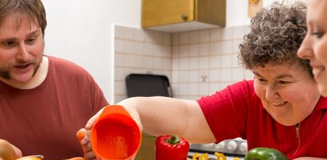
Promoting independence
What evidence is there that the service is promoting a culture of staff supporting people to be as independent as they can be?

Slide 21
What measures are in place to ensure that people’s friends and relatives are made to feel welcome and are able to visit without unnecessary restrictions?
Supporting relationships with family and friends

Slide 22
C3 – Promote and respect people’s privacy, dignity and independence
Make sure that:
Staff always respect people’s privacy and dignity including during intimate or physical care
Staff always respond swiftly and appropriately when people experience physical pain or emotional distress
People’s personal information is always held securely in line with Data Protection requirements and that their confidentiality is maintained

Slide 23
C3 – Promote and respect people’s privacy, dignity and independence
Make sure that:
People’s needs and preferences associated with any protected characteristics are taken into account when scheduling staff
People can be as independent as they want to be
Friends and relatives are made to feel welcome and do not experience unnecessary restrictions
Anything else?

