Slide 1
Making Sense of Integrated Care Systems
Hugh Evans – The Council Response
2 March 2022

Slide 2
Health and Care Bill
Background
The NHS Long Term Plan (Jan 2019) set out an ambition to increasingly focus on ‘local partnerships with local authority-funded services’
The Integration and Innovation White Paper (Feb 2021) established legislative plans to formalise integration between NHS, local authorities and other partners
Health and social care integration: joining up care for people, places and populations further fleshed out ‘place’ approach
Intended outcomes
Integrated Care Systems will enable collaboration between health and care partners
Shift away from competition towards collaboration and integration
Enabling greater collaborative commissioning between NHS and other partners
New standards to enhance data sharing across sectors
New duty to collaborate for NHS and local authorities
Flexible, ‘enabling’ framework for local partners to build on existing partnerships at place and system levels

Slide 3
Health and Care Bill
Legislative passage
July 2021 – Published
November 2021 – Voted in House of Commons
1st March 2022 – House of Lords Report stage starts (109 amendments tabled)
April 2022 – Scheduled to become law
Additional policy context
Build Back Better: Our Plan for Health and Social Care (Sep 2021) – Introduced plans to clear NHS backlog, put NHS on a sustainable footing and reform adult social care
People at the Heart of Care: Adult Social Care Reform (Dec 2021) – Introduced long-term plan and investment for adult social care reform
Health and Social Integration (Feb 2022) – Sets out additional governance model at ‘place-level’ and introduces plans for ‘shared local outcomes’

Slide 4
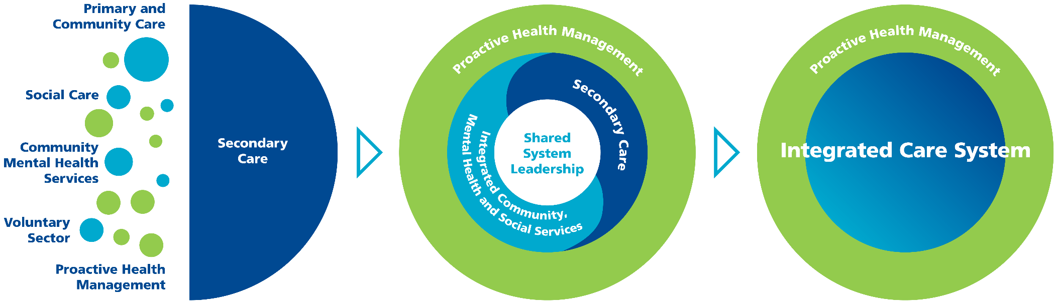
Vision – statutory perspective?
Where does the care provision sector fit within this model?

Slide 5
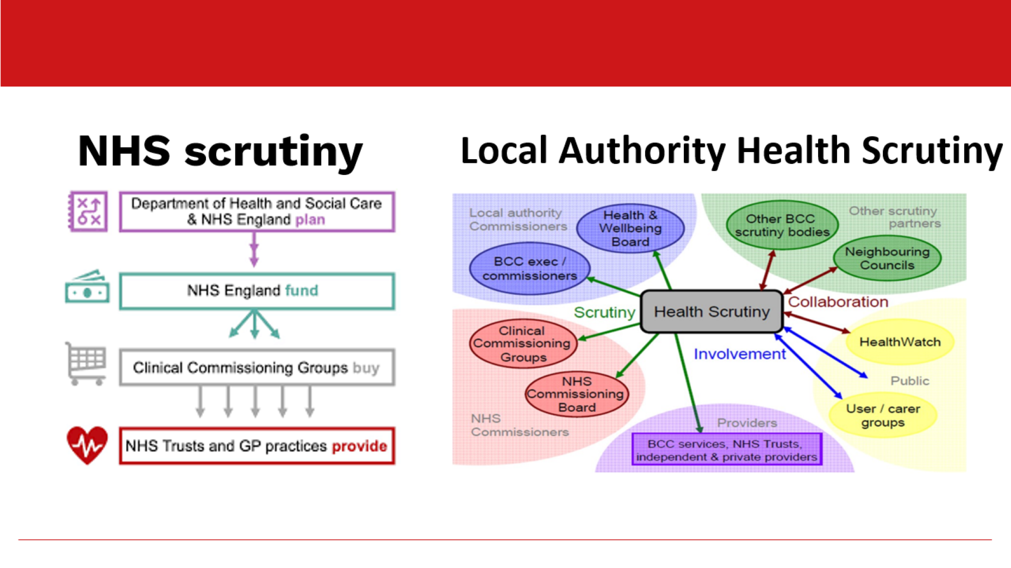
Democratic accountability

Slide 6
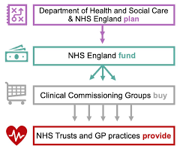
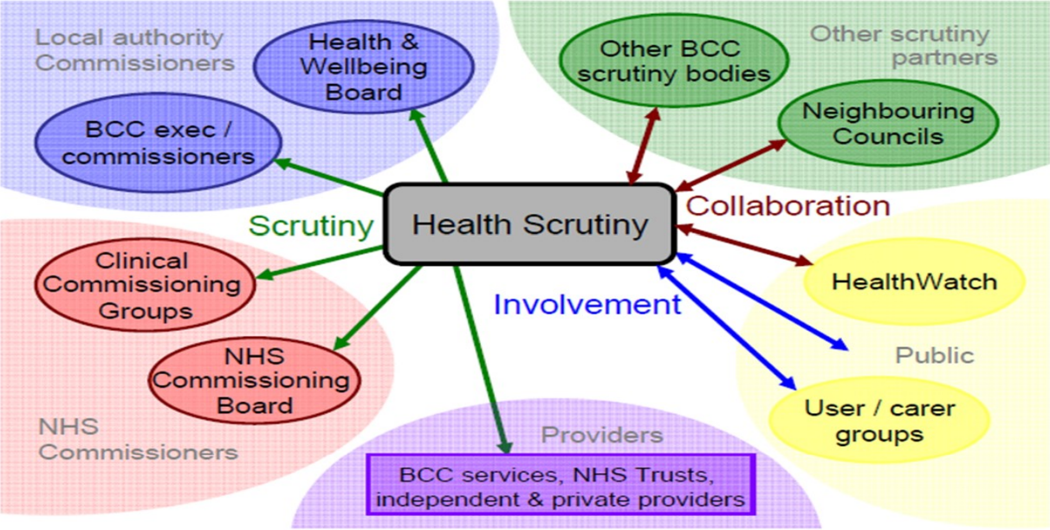
Democratic accountability
NHS scrutiny
Local Authority Health Scrutiny

Slide 7










BNSSG Partner Organisations – providers?

Slide 8
Integrated Care System (ICS)
From some time in 2022/23, all of England will be covered by Integrated Care Systems made up of these components.
Integrated Care Board – NHS led, responsible for NHS service delivery (replacing CCG)
Integrated Care Partnership – NHS, local authorities & partners, responsible for wider shared local outcomes around health and care
Place Boards - operating at local authority level, bringing together health and local government to pool budgets and produce a shared plan for health and care services in the area.
Integrated Care Partnerships - health and care organisations to provide fully integrated services designed to meet the specific needs of defined population within a specific local area
ICB and local authorities will also delegate some budgets and commissioning of services to ‘place-level’ Integrated health and social care boards
BNSSG
Healthier Together: Partnership of NHS Trusts, 3 LAs, providers, partners
Established in 2016 to deliver Sustainability and Transformation Plan
ICP will be built upon the established Healthier Together Partnership Board

Slide 9
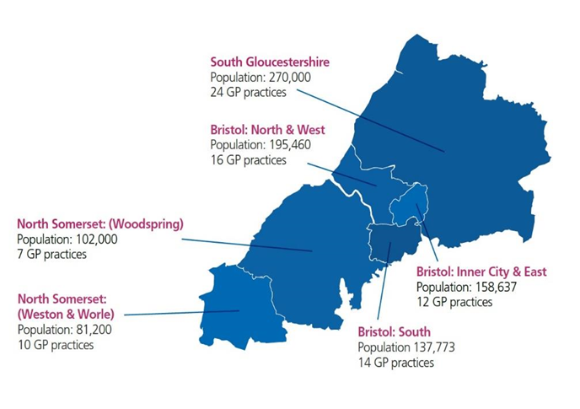
Integrated Care Partnerships

Slide 10
Building ICPs – challenge and necessity
Financial and demand challenges
Increased national underfunding of social care for over a decade
Significant demand increases, especially during COVID-19 era
Bristol City Council facing c.£20m funding shortfall, the majority of which is Adult Social Care
Smart (strategic and operational) partnership working across the system
Move to locality working – more effective joint working across sectors at ICP level
Standard Operating Procedures (SOP) – Streamlined and improved processes
Strengthening the local commissioned care offer
  Reduction in bed-based care and regularising spend
  Boosting the domiciliary and accommodation with care capacity
  Better local provision of high-level progressive services for people with complex needs
  Implementing Discharge to Assess pathways
Partnership approaches to housing/accommodation provision

Slide 11
Building ICPs – challenge and necessity
‘PLACE’ - Building the power of communities.
We must understand how the way that we work impacts geographical communities and communities of interest experiencing systemic inequity.
Council to increasingly become a ‘development organisation’ that promotes equity, inclusion, community and social development and resilience.
Care and support providers to attain increased parity of status within health, care and wellbeing systems and ‘places’.
Voluntary and community sectors to play an increasing role in the activity of ‘places’.
Development of smaller and more representative local enterprises to be encouraged and supported.
Functional activities of authorities and the NHS to be ‘de-mystified’ and made more accessible.
Budgets and commissioning to be less central, and increasingly ceded to localities.

