Slide 1
Health and care reforms
Understanding integrated care systems, place-based partnerships and the wider reform agenda
Chris Naylor
Senior Fellow in Health Policy

Slide 2
Health needs have changed significantly
By 2030, approximately one in five people in England will be aged 65 plus. There are also more people of working age with complex health and care needs.
In this context, integrating services to support people to live well with (multiple) long-term health conditions is increasingly important.
Health and social care services are often commissioned and provided in a way that is too focused on individual diseases/services and not on the whole person. The development of 'integrated care systems' creates an opportunity to change this.
Source: Age UK (2019)

Slide 3
From competition to collaboration
2012
2014
2019
2021

Slide 4
“Breaking down the barriers”
‘Integrated care systems are new partnerships between the organisations that meet health and care needs across an area, to coordinate services and to plan in a way that improves population health and reduces inequalities between different groups.’ – NHS England and Improvement
Commissioners / planners
Clinical commissioning groups
Local authorities
NHS providers
Acute trusts
Mental health trusts
Other providers of NHS & LA services
GPs and community pharmacies
Voluntary sector and social enterprises
Community trusts
Ambulance trust
Social care providers
Collectively understanding needs & setting priorities
Pooling resources & aligning strategies
Supporting changes to services and to infrastructure e.g. IT
Managing the performance of the system

Slide 5
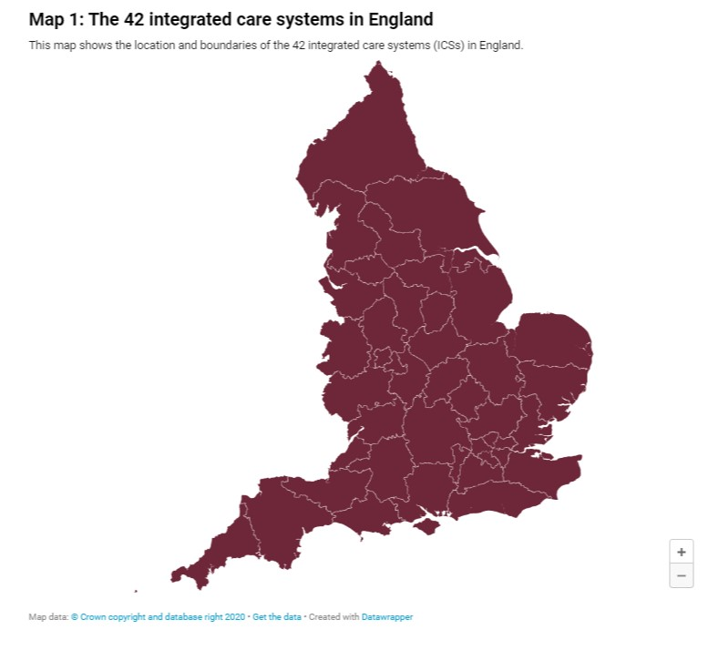
A timeline of ICS development
2015 – all parts of England develop sustainability and transformation plans (STPs)
2016 – STP footprints become sustainability and transformation partnerships
2017 – Ten STPs selected as first wave ICSs
2018-2020 – Further waves of ICSs selected
2021 – all parts of England covered by an ICSs (42 in total)
2022 – ICSs set to become statutory organisations with legal responsibility for NHS budgets and delivery

Slide 6
But how can ICSs be equal partnerships and statutory NHS organisations at the same time?
Reforms proposed in the Health and Care Bill mean that each ICS will be led by an ‘integrated care partnership’ and an ‘integrated care board’
Integrated Care Partnership | Integrated Care Board
Statutory committee with broad membership – NHS, local government (inc. social care, housing, public health), VCSE orgs, social care providers Responsible for developing an ‘integrated care strategy’ for population covering health and social care, built bottom-up from local assessments of needs and assets identified at place level | Accountable for use of NHS resources and performance, and delivery of national priorities Responsible for developing a plan to meet the local health needs, as identified by health and wellbeing strategies and the integrated care strategy produced by the Partnership Must include representatives from NHS providers, primary care, local govt Power to delegate some budgets to borough-level committees

Slide 7
“Systems within systems”
It’s not all about ICSs – much of the ‘work’ of integration will happen at more local levels (place, neighbourhood). The role of ‘provider collaboratives’ will also be increasingly important.
Tier | Construct | Approx population | Examples of potential focus
System | ICS | 1-3 million | Setting strategy; managing some resources and performance; supporting cross-cutting programmes eg digital infrastructure and estates; working with ‘provider collaboratives’
Place | Place-based partnership | 250,000-500,000 | Driving service change; joint working with local government; supporting primary care networks; building relationships with communities; developing the workforce
Locality / neighbourhood | Primary care network | 30,000-50,000 | Bolstering primary care services; building multi-disciplinary teams that bring different professionals together; preventive interventions for at-risk groups

Slide 8
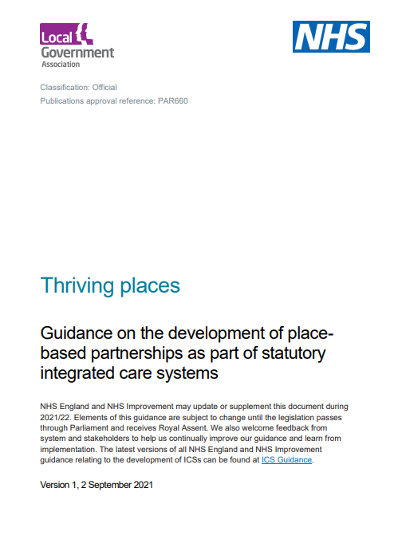
Place-based partnerships: The foundation of effective integrated care systems

Slide 9
Will any of this lead to a different outcome?
“My vision is that ICSs should feel different to any organisation we’ve had before”
Professor Sir Chris Ham
What could help ICSs to become fundamentally different from their predecessors?
Equal partnership between NHS, local government & the voluntary sector
Principle of subsidiarity to place/borough level
More nuanced models of collective accountability between local partners
Being held to account for broader outcomes related to population health
Better use of insights from local people, patients and families

Slide 10
Opportunities and risks
The proposed reforms remove some of the barriers to collaboration and by doing so create opportunities to deliver better services
Translating the reforms into tangible changes for people using services will depend on local efforts to build relationships across boundaries and develop new ways of working
Local leaders want to make the most of this opportunity but sometimes lack the headspace to engage creatively with local partners at the same time as delivering national priorities
There is currently no national plan for tackling the workforce crisis in health and social care – without this, it will be difficult for the reforms to have the impact that they otherwise could

Slide 11
What would success look like?
For patients and service users
Joined-up, co-ordinated care and support that meets individuals’ needs in a flexible way
For the wider public
Organisations and communities working together to influence the wider factors that shape health and wellbeing
For people working in health and care
Staff are well supported and can use their skills to greatest effect, whichever part of the system they work in

Slide 12
Resources
Integrated care systems explained: making sense of systems, places and neighbourhoods
https://www.kingsfund.org.uk/publications/integrated-care-systems-explained
Developing place-based partnerships: The foundation of effective integrated care systems
https://www.kingsfund.org.uk/publications/place-based-partnerships-integrated-care-systems
Thriving places. Guidance on the development of place-based partnerships as part of statutory integrated care systems
https://www.england.nhs.uk/publication/integrated-care-systems-guidance/
Reform for people - a joint vision for integrating care
https://www.nationalvoices.org.uk/publications/our-publications/reform-people-joint-vision-integrating-care

Slide 13
Thanks
Chris Naylor
@chrisbnaylor
c.naylor@kingsfund.org.uk

