Slide 1
Care & support for people with a Learning disability
Bethany Kruger, November 2019

Slide 2
What does a learning disability mean to you……
https://www.youtube.com/watch?v=tfkVA2BKIyY

Slide 3
What is a learning disability?
‘A significantly reduced ability to understand new or complex information, to learn new skills (impaired intelligence), with;
A reduced ability to cope independently (impaired social functioning)
Which started before adulthood, with a lasting effect on development.
(Department of Health (DH) (2001:14) Valuing People. A New Strategy for Learning Disability for the 21st Century)
Notes:
Different abilities: mild, moderate, severe and profound & multiply.
To label or not to label, that is the question. Labelling may facilitate access to services, and may facilitate the right treatment, intervention & support. Many people are proud of who they are; however others prefer not to have a label, as it can have negative connotations.
Autism ,Downs Syndrome, Prader-Willi Syndrome
Angelman Syndrome – neurological condition affecting nervous system, severe physical and intellectual disability. Fascination with water.
Fragile X Syndrome - is a genetic condition and is the most common known cause of inherited learning disabilities.
Williams Syndrome - This condition is characterized by mild to moderate intellectual disability or learning problems, unique personality characteristics, distinctive facial features, and heart and blood vessel (cardiovascular) problems.
Rett Syndrome – divided into 4 stages,

Slide 4
What does a learning disability mean to you…..
Sarah Pickard - https://www.downs-syndrome.org.uk/news/sara-pickard-at-the-women-of-the-year-awards/
Three men - https://www.bristolpost.co.uk/news/local-news/three-men-who-want-live-3528810

Slide 5
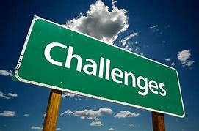
Challenges for people……..
Great risk of health inequalities
Recognising own changes as symptoms of ill health
Ability to communicate pain and discomfort to others

Slide 6
Challenges for services ….….
Accessibility – access & information
Delays in care – recognition
Services are poorly organised – diagnosis/ sharing of information
Diagnostic overshadowing
Knowledge and skills of staff – specialised skills
Mental Capacity Act 2005 - consent
Notes:
Delays in care - Others’ ability to recognise problems and the significance & others to act and take action

Slide 7
Unmet needs of people
If you have a learning disability you are 4 times more likely to die of something which is preventable
Disparity between ages for people with a learning disability with the general population: 23 years for men and 27 years for women.
The more significant the learning disability, the increased risk of an early death: mild, age 62yrs & profound/ multiply, 40yrs.
Difference of white British and BAME groups: death for people of BAME groups was 35yrs compared to 61yrs.
Pneumonia, or aspiration pneumonia: identified as causes of death in 41% - these are potentially treatable.
Learning Disabilities Mortality Review (LeDeR) Programme (2018)
Notes:
If you have a profound and multiple learning disability, more likely to have complex medial conditions, increase an earlier death.

Slide 8
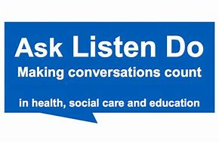
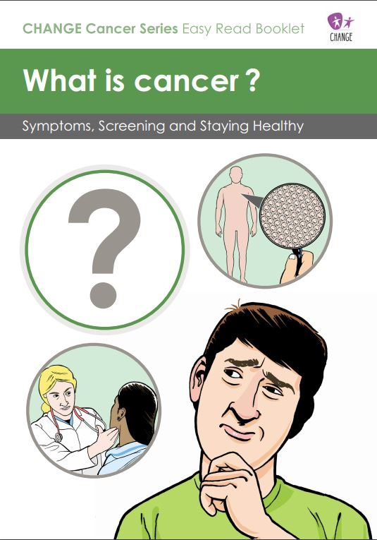
How to make it right………..
Ask Listen Do - learn from and improve the experiences of people themselves and their families
Provision of reasonable adjustments – from the beginning
Communication – accessible information
Person-centred – respecting families views
Good co-ordination of care – seamless without gaps
Develop knowledge and skills – attitudes, inequalities and specialised support
Learning Disabilities Mortality Review (LeDeR) Programme (2018)

Slide 9
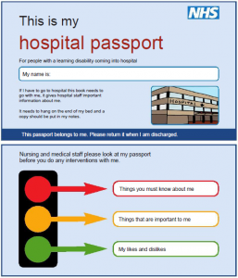
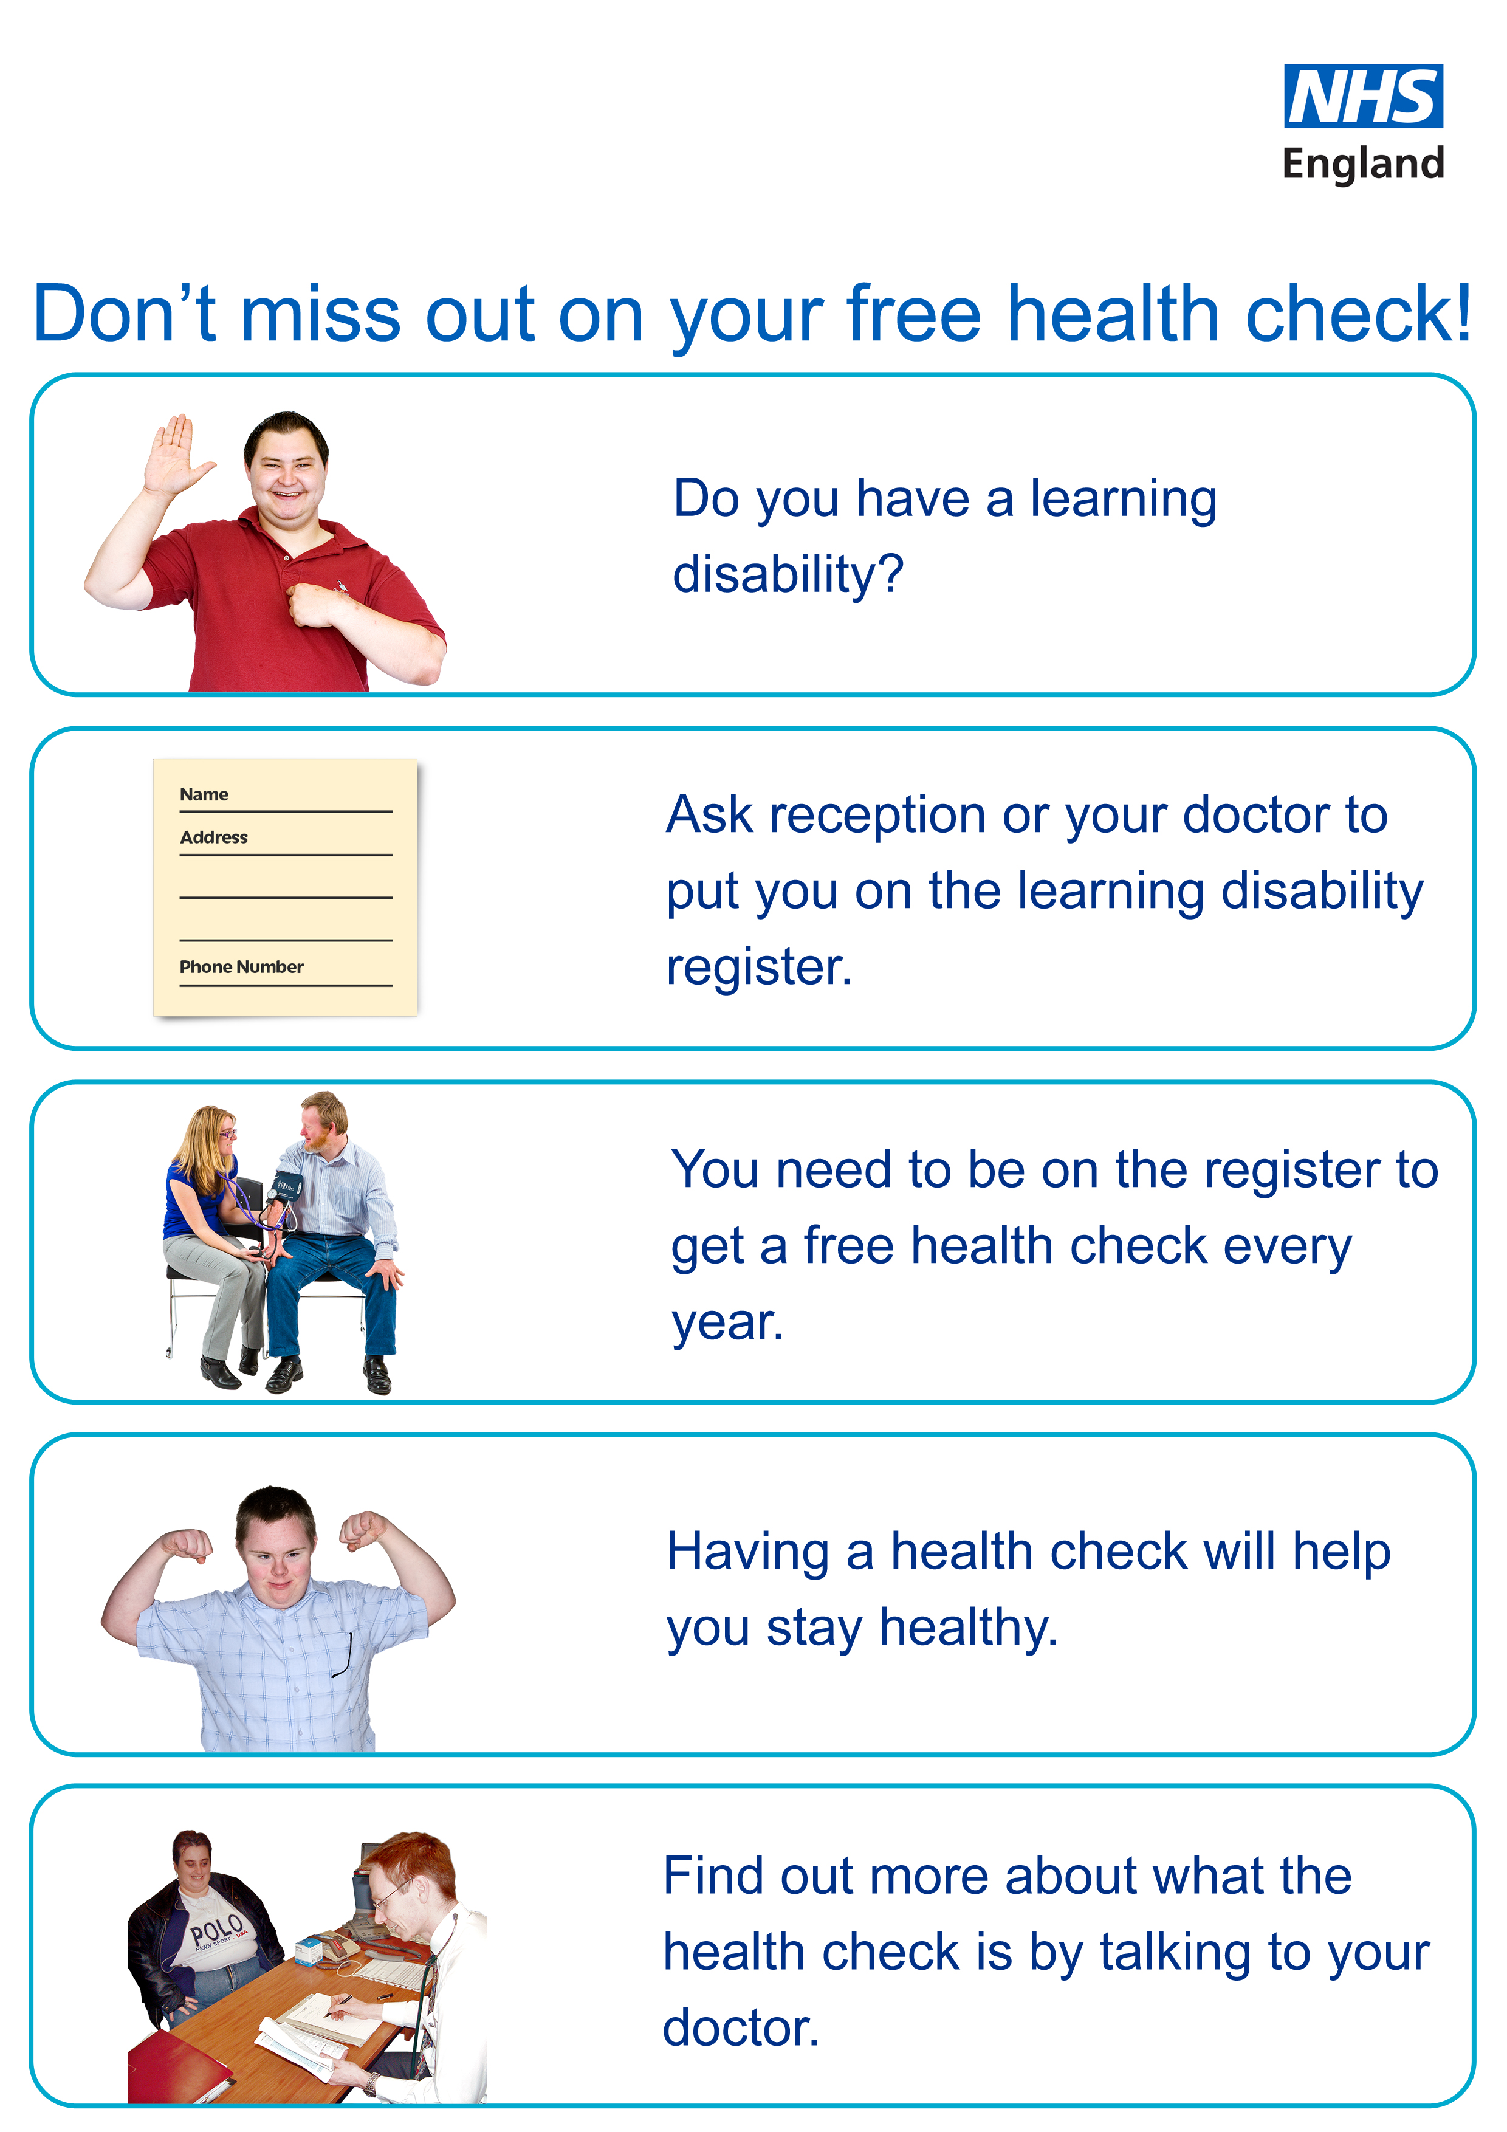
Support……….
Learning Disability Services
Community Learning Disabilties Teams & Health Liaison Nurses
Healthcare Passports/ Easy read information
Annual Health Checks

Slide 10
https://www.youtube.com/watch?v=Um4ZJqKzUgQ

