Slide 1
Care and support west annual meeting- how capital allowances RELEASE CASH on property
november 2019

Slide 2
UNDERSTANDING YOUR opportunity
Have you over the past 3 years –
Purchased a property that is being used to provide Care facilities
Built a property that is being used to provide Care facilities
Extended an existing property
Refurbished an existing property
Purchased the share capital of a company that owns a Care property
If the answer is yes then you could be sitting on significant tax savings waiting to be released

Slide 3
Aim of VERITAS ADVISORY and CSW Members
Care Home owners release cash from their properties
Veritas achieve this by helping CSW Members
Does your Care Home qualify for this opportunity
Misconception – Assume the accountant will have made a full claim – Recent review on a £19m spend found original claim £3m but Veritas increased that to £7m

Slide 4
Property expenditure
Expenditure is a necessary business cost
Government incentives to encourage expenditure on
Acquisition of new home
New buildings project
Refurbishment and refit
Extension
Upgrade equipment

Slide 5
How it Works
Basic Tax Return | Without Capital Allowances | With Capital Allowances
Profit before tax | £200,000 | £200,000
Deduct Allowable Costs i.e. Debt Finance | (£100,000) | (£100,000)
Capital Allowances | No Claims | (£100,000)
Profit Subject to Tax | £100,000 | 0
Tax to Pay (@ 19%) | £19,000 | 0

Slide 6
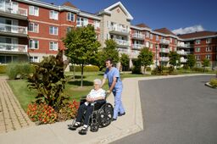
acquisitions
2nd Hand building
Due diligence at HOT’s
Parties agree value in contract
Opportunity from 1 March 2008
C.A’s £1million-£1.5million
Benefit
£10million care home acquisition, cash benefit £285,000 if clear entitlement

Slide 7
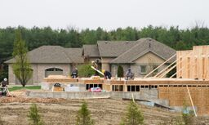
DevelopmentS
Build Cost = £10,000,000
P & M and Integral = £4,000,000
SBA = £5,500,000
Cash benefit year 1 = £80,000-£270,000
After 10 years = £590,000
Tax Planning
Claim plant and machinery and integral features first

Slide 8
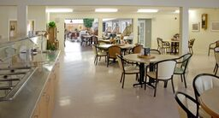
Refurbishments / FIT OUT
Cost = £5,000,000
P & M and Integral = £3,000,000
SBA = £2,000,000
Cash benefit year 1 = £50,000-£220,000
After 10 years = £470,000
Tax Planning
Benefit is greater for LLP’s - £1.2million over 10 years

Slide 9
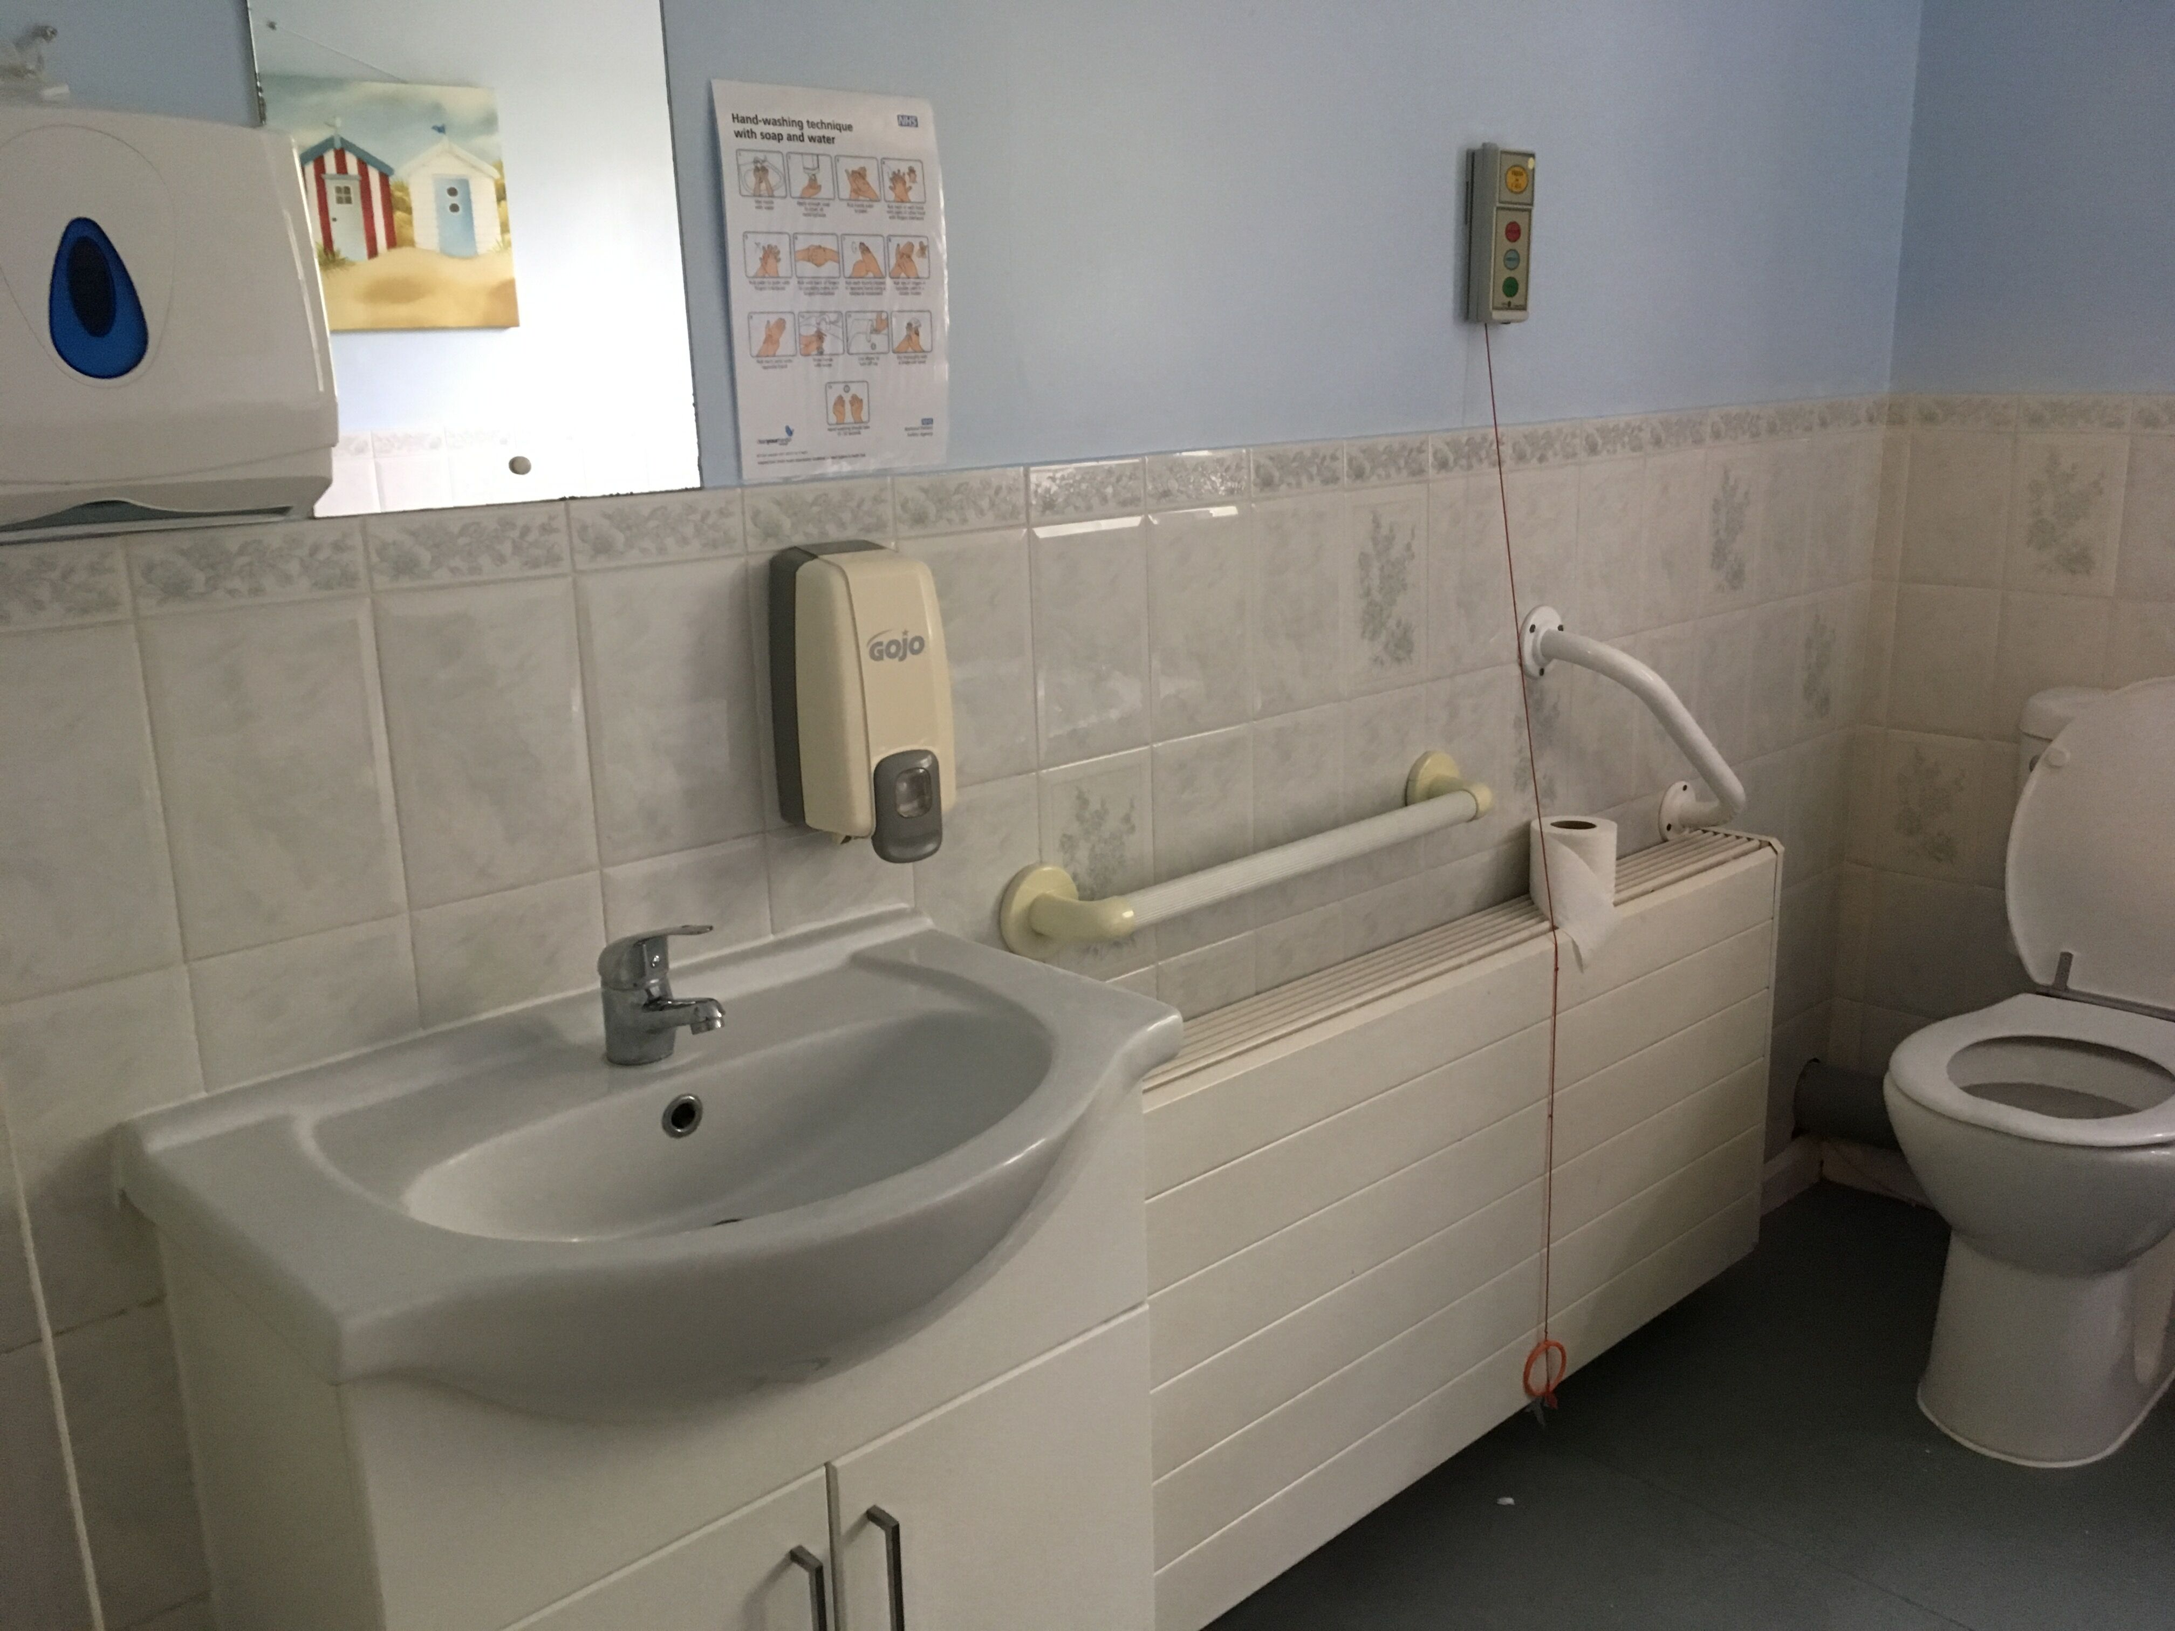
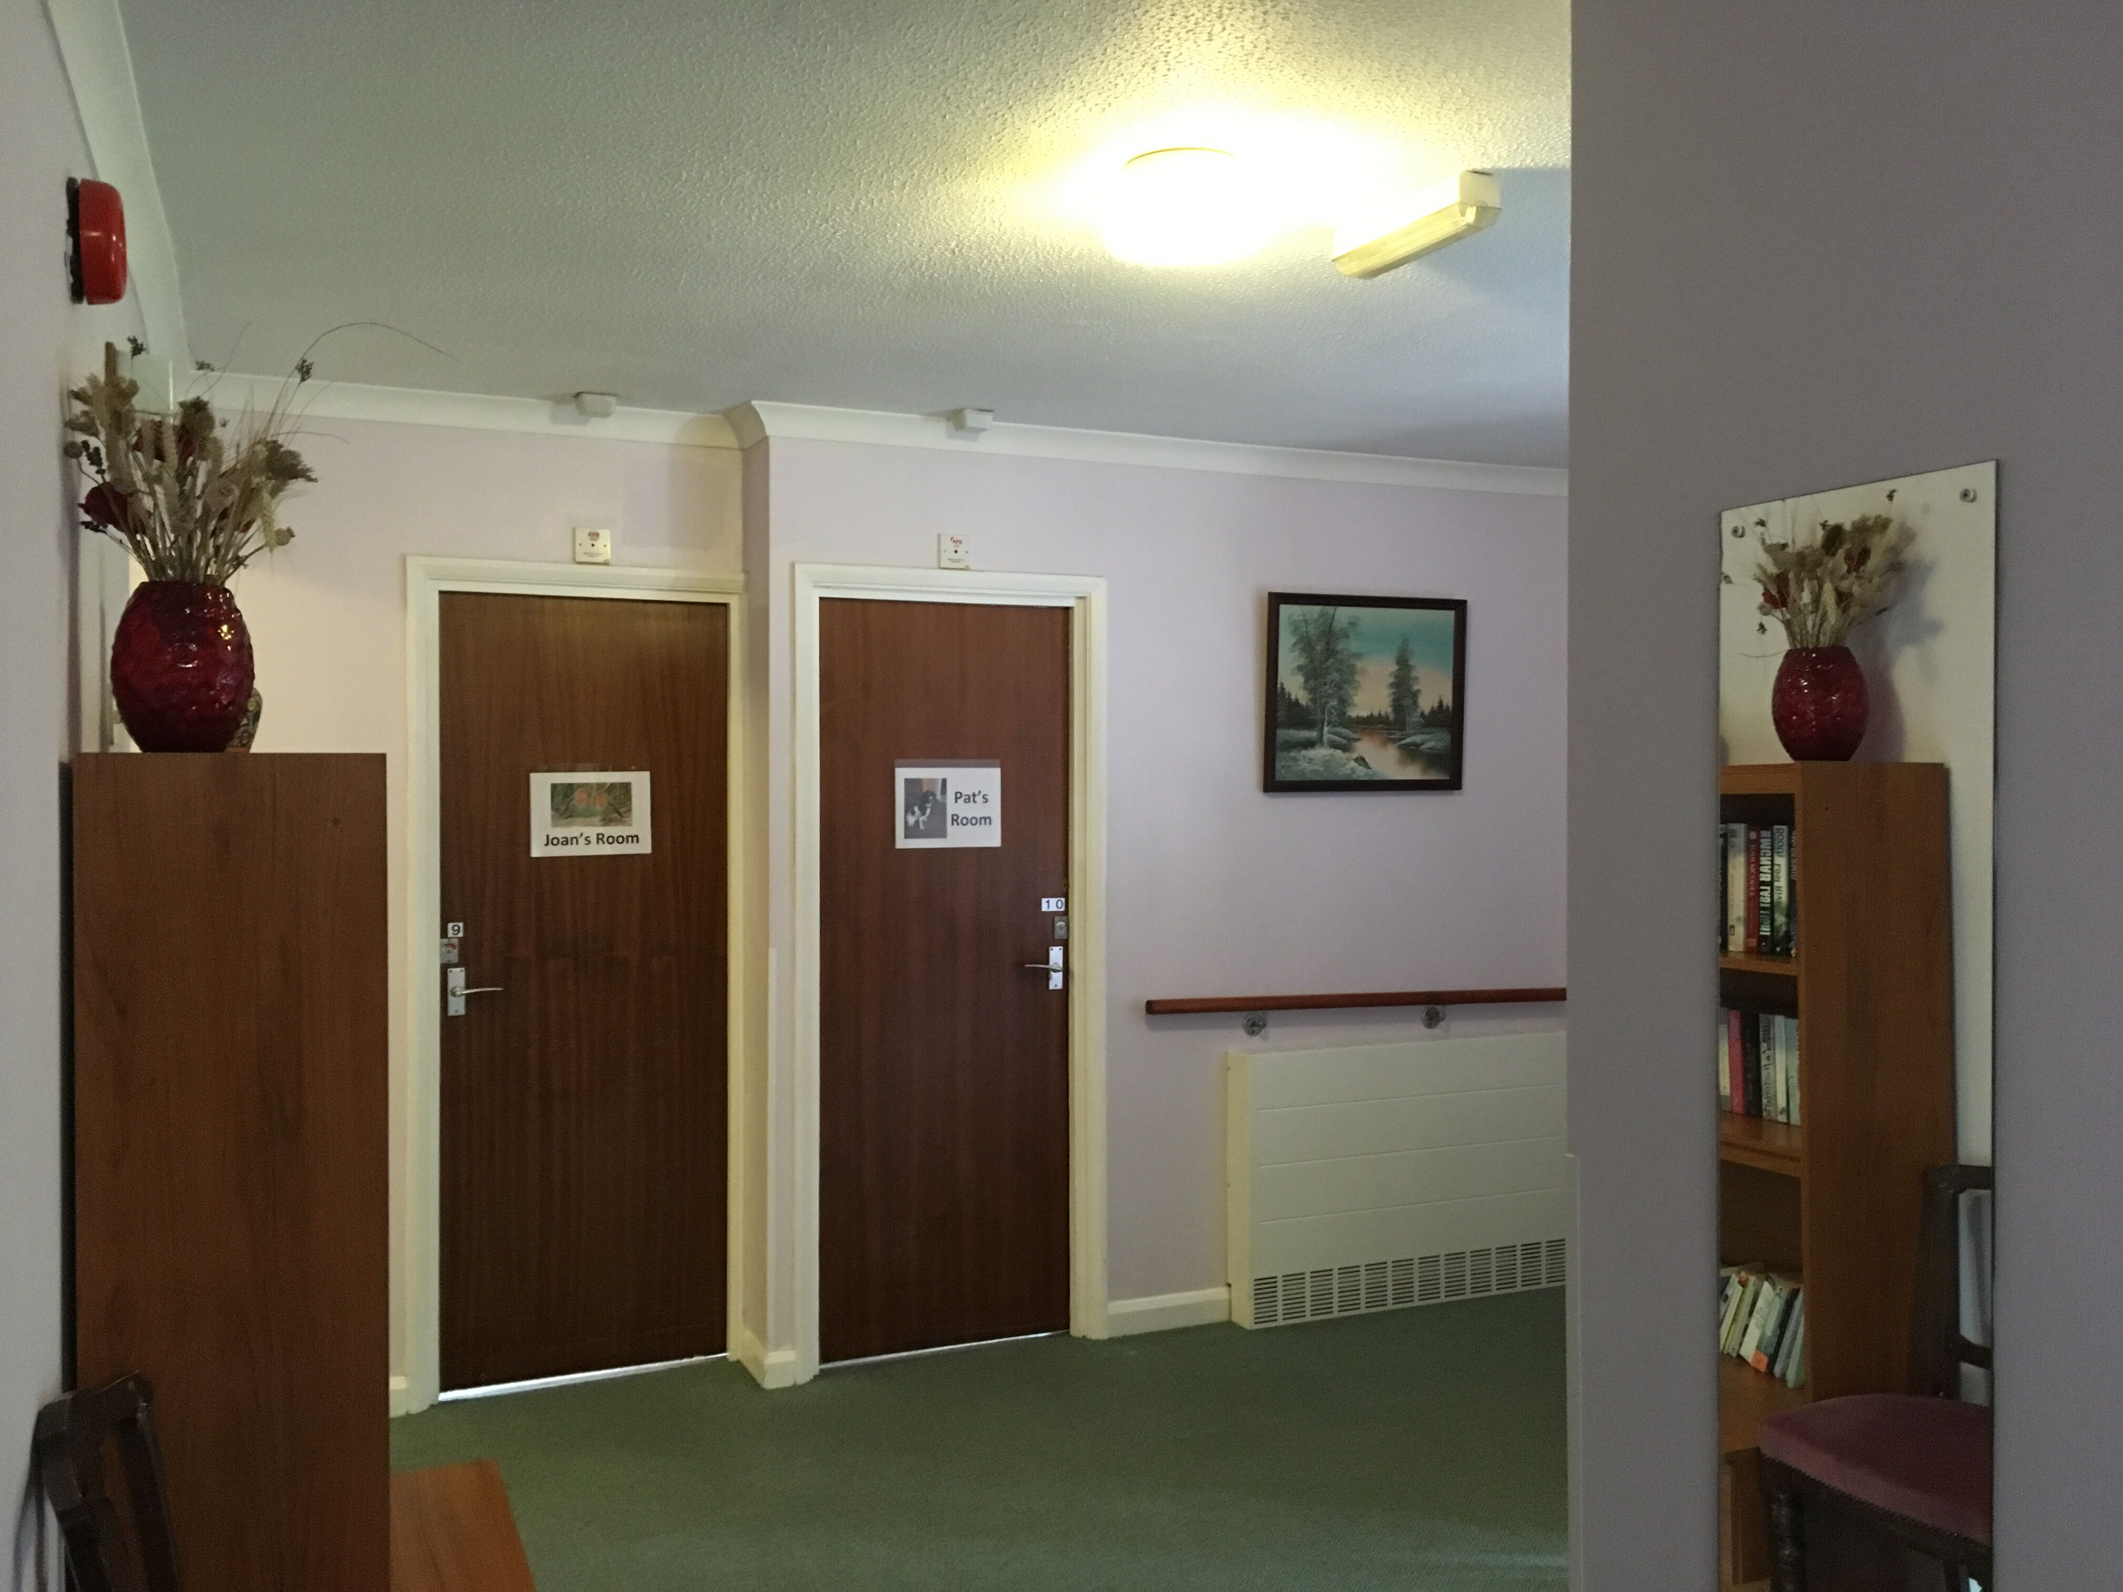
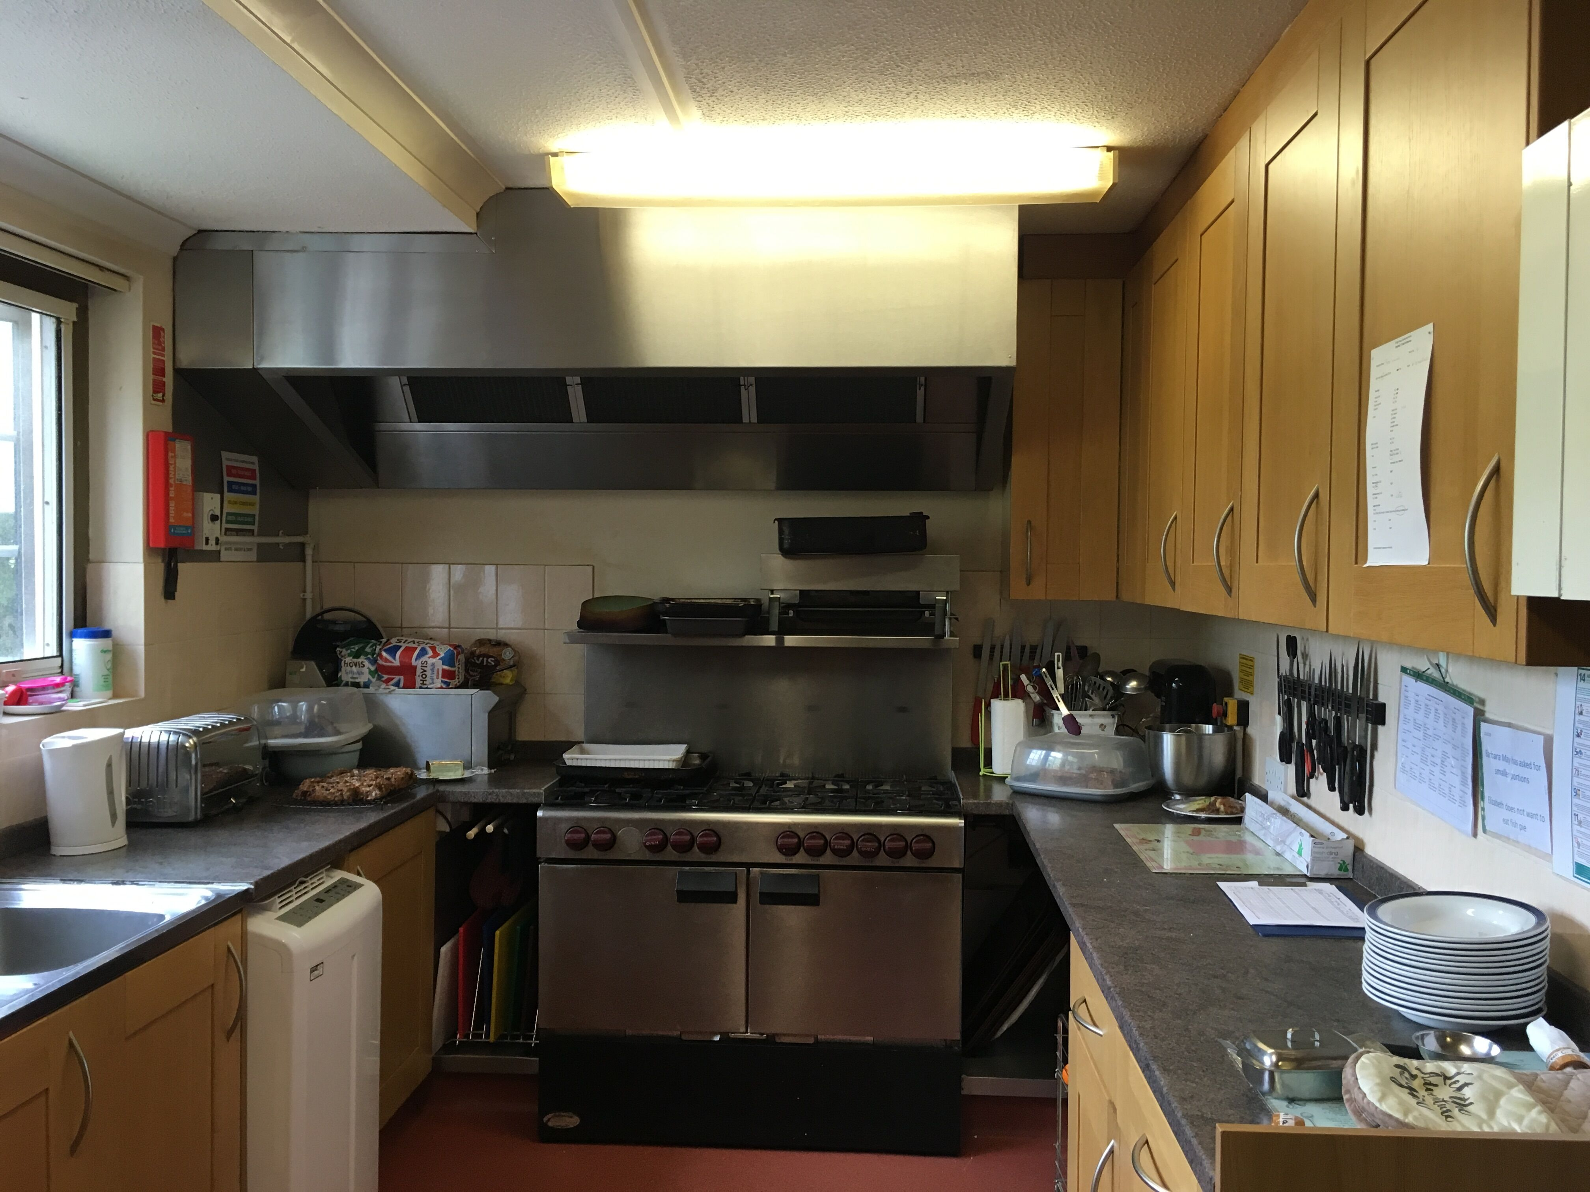
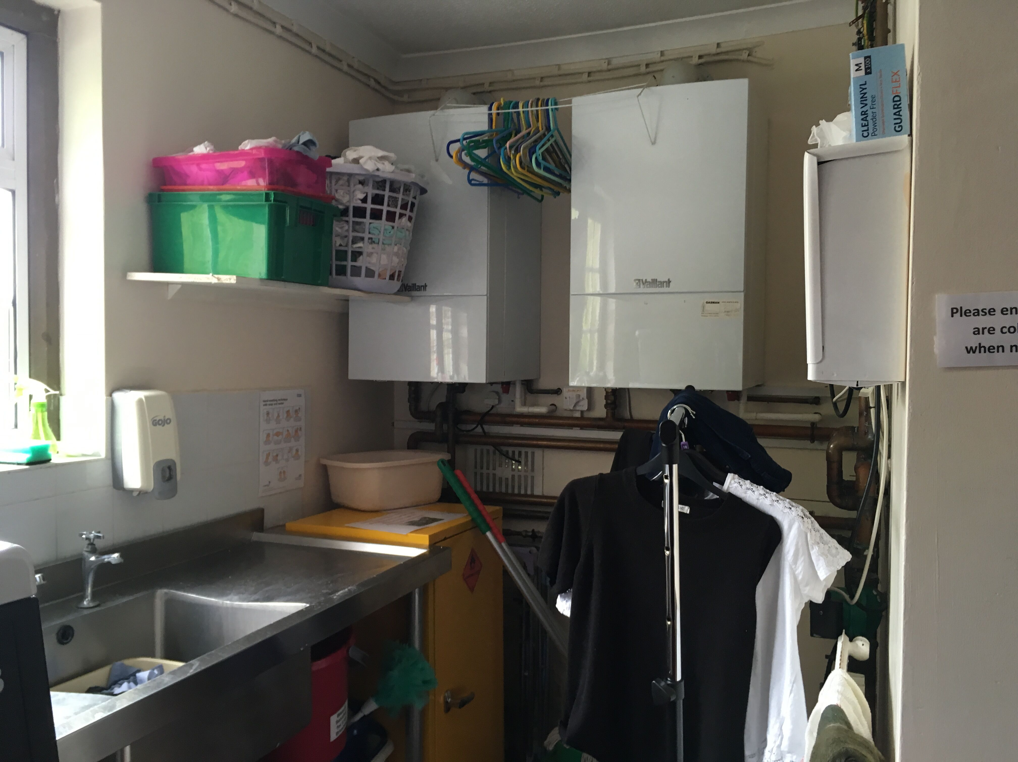
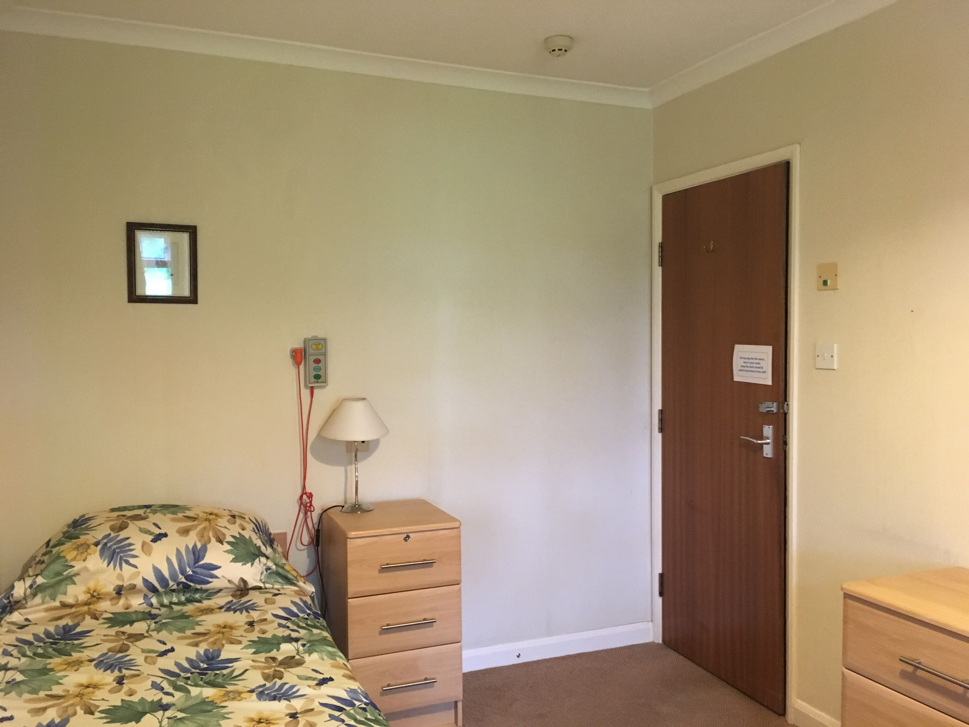
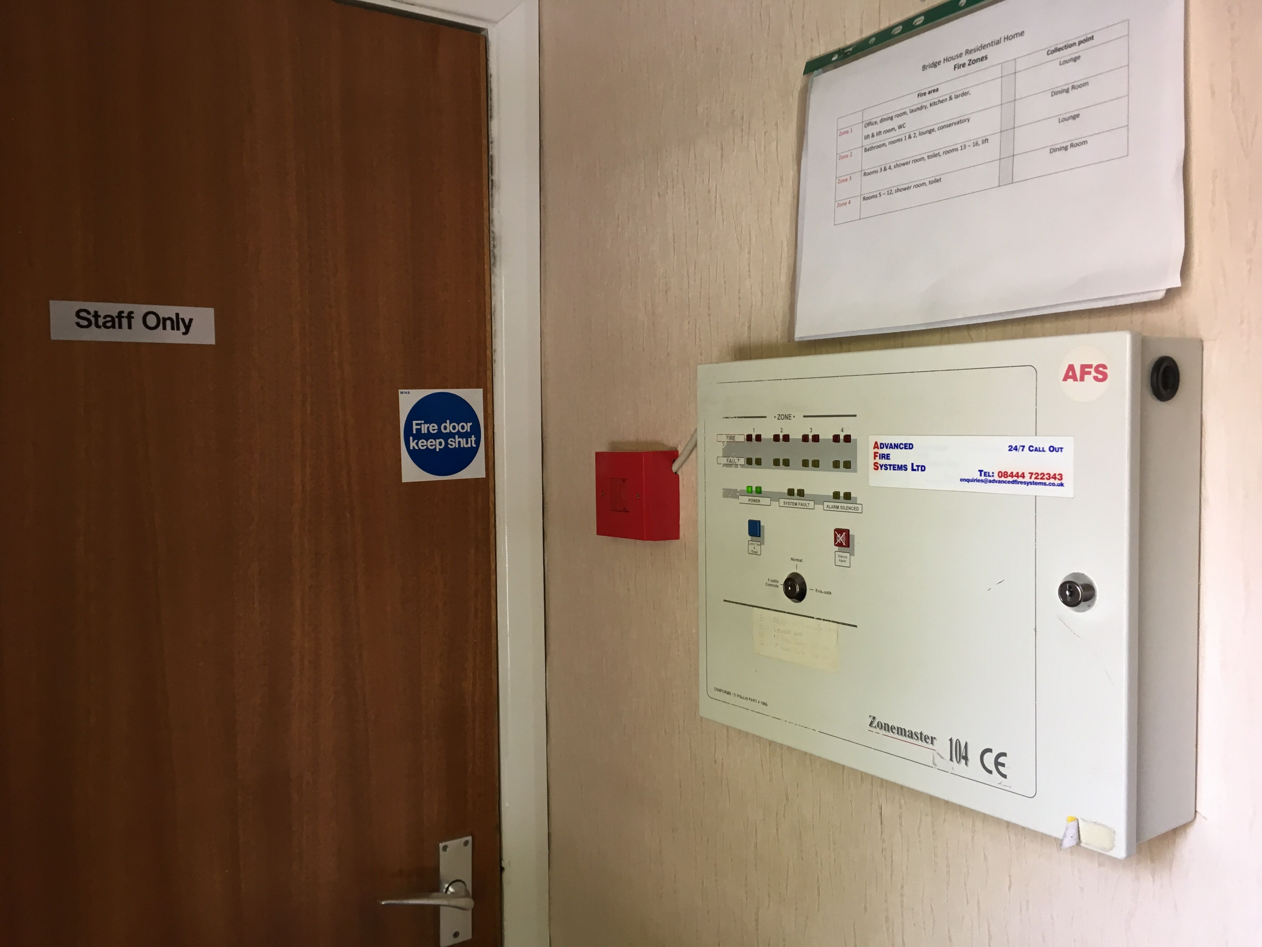
Hidden assets

Slide 10
FaCTS and Figures
Can claim historically, never lose claim if still own the item
Detail not required to claim
Use Annual Investment Allowances £1million from January 2019, 2 years
New Structure and Buildings Allowance @2% now in legislation

Slide 11
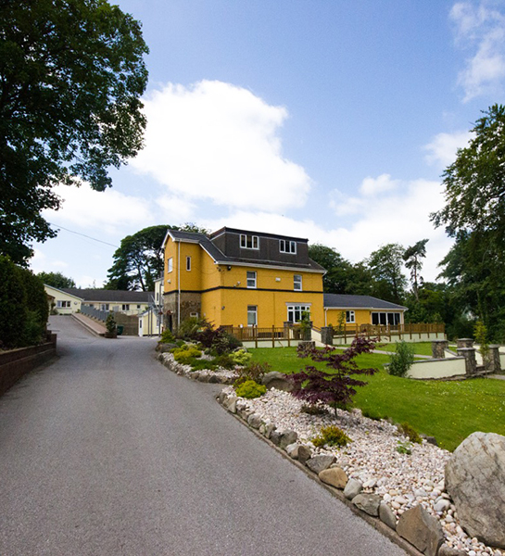
Case care home – simple claim gone wrong
Glais House Care Limited v HMRC
Accountant instructed counsel for client
Incorrect basis of claim by both Seller and Buyer
Valuation Office said methodology of claim was wrong
Contract allocated fixtures on the wrong value
Claim for £318,792; claim reduced by 20%, plus significant legal fees incurred

Slide 12
THE VERITAS PROCESS
Stage 1- Free Initial Assessment Stage 2 – Prepare Claim
Fact Find Review – information collated Site Survey & Valuation
Research & due diligence requirements Costs and technical review
Prepare illustration of potential claim Processing Claim with Accountants
Engage with client Claim submitted and accepted

Slide 13
Reference from David Holmes, Chairman of Surrey Care Association
"I found working with Veritas to be a rewarding experience. Ross was sensitive to my needs and pressures, and worked efficiently to minimise the impact of work on our business. The outcome was very positive, and will save significant amounts of tax for years to come. I would recommend their services to anyone”
David Holmes
Chairman of Ashcroft Care Services Limited

Slide 14
Clive Curd
Dip Prop Invest, MRICS, MCIOB
clive.curd@veritasadvisory.co.uk
DDI: 020 3793 7154
Mob: 07502 376 973
Ross McNaughton
FCCA
ross.mcnaughton@veritasadvisory.co.uk
Mob: 07785 502615
30 Newman Street, London, W1T 1PT
Telephone: 020 3130 0293
www.veritasadvisory.co.uk

