Slide 1
Market Sustainability Report (2023/24)

Slide 2
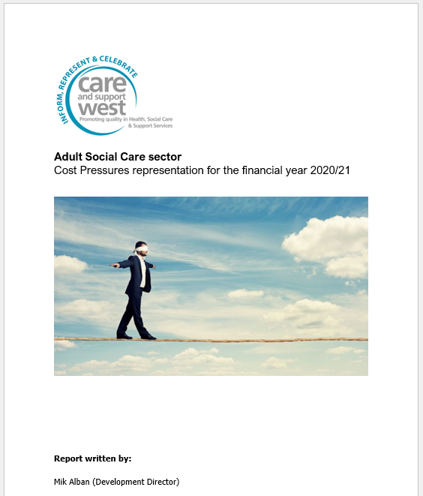
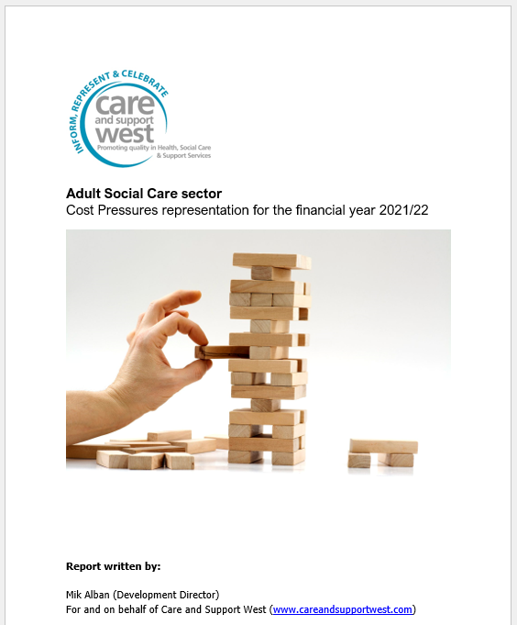
Annual Cost Pressures reports …

Slide 3
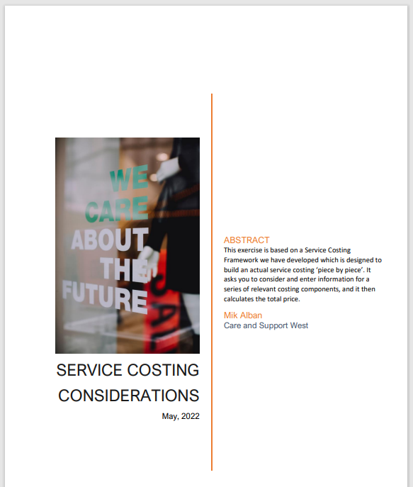

Slide 4
Market Sustainability Report
Sent out questionnaires …
Got back 34 out of a total of 112 sent (just over 30%).
Responses from organisations providing full range of adult social care services … including large, medium and small organisations.
There were variations … but overall, no one was having it easy … clear and concerning picture emerged in relation to a number of areas.

Slide 5
High levels of staff turnover.
Managers having to cover shifts and struggling to find time to complete their management tasks.
Increasing reliance on agency staff.
Staff having to work excessive amounts of overtime.
(Despite these strategies) … services having to run short staff at times.

Slide 6
Services having to be reduced or cancelled … or close completely.
Chronic undervaluing of frontline social care staff in terms of:
Struggles to find people for management and clinical lead positions.
the crucial tasks they carry out
the knowledge and skills they need
the human qualities they require.

Slide 7
Increasing inability to recruit staff of the necessary calibre.
Current cost pressures … staffing, inflationary and service development … as bad as they have ever been.

Slide 8
In terms of market sustainability …
37% of respondents indicated that unless they received an inflation equalling uplift in April … they gave themselves 12 months or less.
Another 9% gave themselves up to 2 years.
The other 37% didn’t know.

Slide 9
Conclusions … or solutions
To attract the staff required, basic pay rates need to value people for the nature of the work, the skills and the human qualities needed.
There has to be ‘clear water’ between what people can earn working in social care and what they can earn working in retail, hospitality etc …

Slide 10
Realistically, you are looking at a starting salary range for frontline adult social care staff of £12.50 - £15.50 an hour.
Will need to be higher in Domiciliary Care and services supporting more complex and / or challenging clients …

Slide 11
Anti-social hours enhancements …
Weekends … an additional 20% an hour.
Waking nights … an additional 30% an hour.
Bank Holidays … an additional 50% to 100% an hour.
Evenings after 7pm … additional 10% an hour.
Management on call … 10% of hourly rate (for every hour on call).
Additional 10% for hours worked over Full Time hours.

Slide 12
Benefits package
Benefit packages in terms of annual leave, sickness and pensions that serves to ‘retain’ staff.

Slide 13
Estimate that the basic recalibrating of hourly rates (from where we are now to where we need to be) equates to around a 39% increase.
If you start adding in enhanced antisocial hour rates and better benefits packages …
Starts to converge with Unfair to Care’s figure of 41.1% extra for Support Workers to ‘achieve parity with their NHS counterparts performing similar roles’.

Slide 14
Korn Ferry’s expertise in ‘job evaluation’

Slide 15
Working with people with different and at times complex needs.
The interpersonal skills needed to relate to individuals in flexible and specific ways.
The potential to experience verbal and / or physical aggression … and other difficult working conditions.
Often working long and busy shifts without much rest.
Understanding of complex conditions, such as brain injury or advanced dementia.

Slide 16
Problem solving: “The need to adapt to ‘in the moment’ situational change.
Accountability … extent to which the role is answerable for actions and their consequences.
= TOTAL JOB SIZE
Home - Unfair To Care

Slide 17
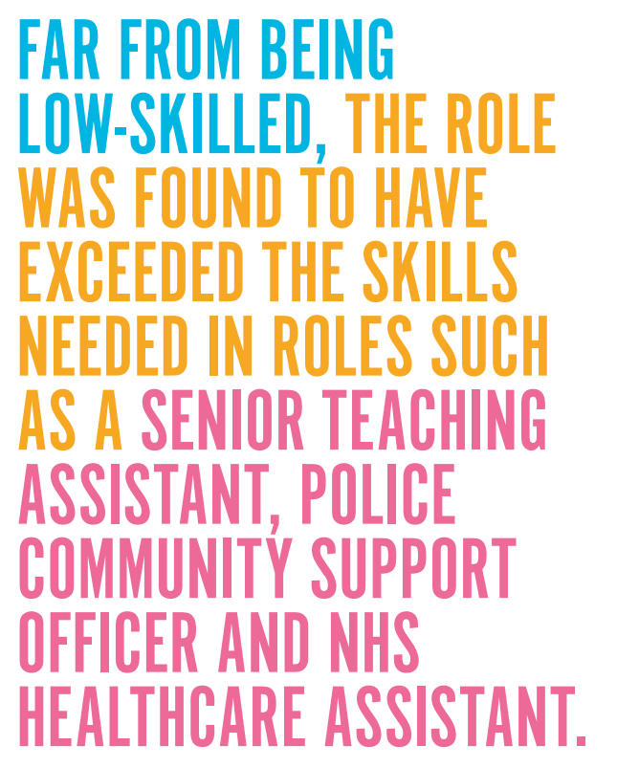

Slide 18
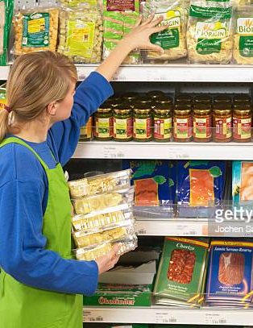
And yet people get paid less than they would for stacking a shelf, waiting a table, making a coffee … or pulling a pint.

Slide 19
Inflationary costs …
Given the sustained cost pressures that providers have been subjected to over many years …. a ‘reset’ figure of 20% for ‘hotel’ costs is probably realistic.

Slide 20
Additional amount needed from central government
Working on a split of 70% staff costs : 30% ‘hotel’ costs … you are looking at around a 34% increase (or an additional £6.8 billion a year to ‘save the sector’.

Slide 21
Few final words
If we were to lose social care, it is not going to just bounce back.
If it were to fail, it will have implications for our society to an extent to which we haven’t begun to properly consider.

Slide 22
In many areas there is already insufficient provision to meet the identified need.
In terms of scale, there are currently 818,000 service users receiving long term care … more if you include private paying clients.
Who is going to care for and support these people if social care can’t?
And where families have to step in, what is going to be the impact on their wellbeing and ability to be economically active?

Slide 23
There are around 32.95 million people are currently in employment in the UK …
and around 1.5 million of these work in the adult social care … or 4.55% of the current workforce.
So considerable potential for further economic displacement and loss of tax revenue there.
It would be wise to view the funding (and potential failure) of social care against this backdrop.

Slide 24
Copies of the Executive Summary of our Market Sustainability report available within the hall …
Or you can download the full report from our website …
Market Sustainability Report 2023 — Care & Support West (careandsupportwest.com))

Slide 25
Thank you for listening
Any thoughts or questions?
Mik Alban
Care and Support West (Development Director)
mik.alban@careandsupportwest.com

