Slide 1
Capacity Tracker Updates – DHSC Reporting Window
Alex Arvidsson – Capacity Tracker Regional Lead (Midlands & South-West)
April 2024

Slide 2
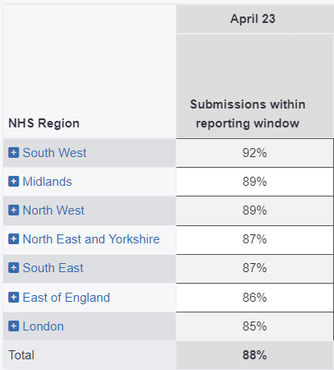
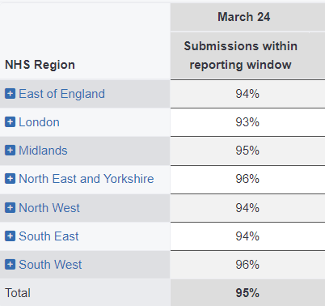
DHSC Reporting Window – Care Home Uptake
c
c
Good News: There has been a +7% increase in Care Home submissions nationally between
April 2023 – March 2024 Reporting Windows.
Notes:
The LA-breakdown by region has been shared via previous emails.

Slide 3
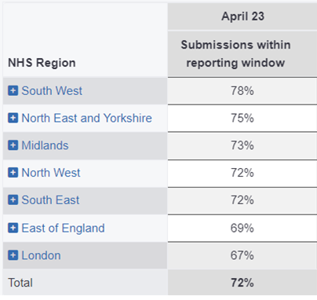
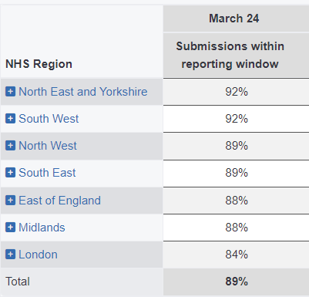
DHSC Reporting Window – Homecare Uptake
c
c
Good News: There has been a +17% increase in Homecare submissions nationally between
April 2023 – March 2024 Reporting Windows.
Notes:
The LA-breakdown by region has been shared via previous emails.

Slide 4
Key Focus
Next reporting window: 8th - 15th April 2024 (extra day as it falls over weekend). Window closes on 11.59pm on 15/4.
No re-set from 1st April 2024 – BAU, please remind providers.
Top Tips (for providers)
To update/refresh as soon as the window opens; less reminders/saves time chasing!
To attend training sessions to get a better understanding of the system & how to quickly update their information.
April-May 2024: Care Home Training & Homecare Training
To have additional users registered on CT to cover periods of absence.
To register for a CT account, click here
Providers that are closing down/no longer active
- please notify/de-register with CQC & submit a ‘nil return’ on CT,
until the CQC information has been updated.
Support Centre team are available to provide help by calling 0191 691 3729 (Mon-Fri 8am-5pm, excl bank holidays) or by email necsu.capacitytracker@nhs.net
.
Legal Requirement Information
Important Reminders
Key Links & Contact Details

Slide 5
Upcoming CT Training (Providers) Care Homes:
Weekday | Date | Time | Teams Link
 |  |  | Microsoft Teams meeting Join on your computer, mobile app or room device Click here to join the meeting Meeting ID: 372 172 762 94 Passcode: fK2FKW
Wednesday | 10 April 2024 | 13:30
Tuesday | 07 May 2024 | 14:30
Wednesday | 15 May 2024 | 13:30
Homecare:
Weekday | Date | Time | Teams Link
 |  |  | Microsoft Teams meeting Join on your computer, mobile app or room device Click here to join the meeting Meeting ID: 358 742 106 527 Passcode: MjbFvJ
Tuesday | 09 April 2024 | 14:30
Wednesday | 08 May 2024 | 13:30
Tuesday | 14 May 2024 | 14:30
We highly recommend that users attend the training sessions to develop their understanding of CT.
No advanced booking required, just click the Teams link at the date & time of the session you would like to join.

Slide 6
Key Contact Details
CT Support Centre | 0191 691 3729, necsu.capacitytracker@nhs.net Monday to Friday from 8am to 5pm (excluding public holidays) For registration, password, technical support and queries about updating data.
CQC National Customer Service | 03000 616161, enquiries@cqc.org.uk If a provider is no longer active – please contact CQC to de-register If a provider is missing from CT & needs to be onboarded – please contact CQC as we cannot create provider accounts!
NHSBSA – NHS Business Services Authority ASC Enforcement Team | 0300 330 2088, nhsbsa.adultsocialcareenforcement@nhs.net Monday to Friday from 8:30am to 4:30pm. Website: https://www.nhsbsa.nhs.uk/adult-social-care-enforcement

Slide 7
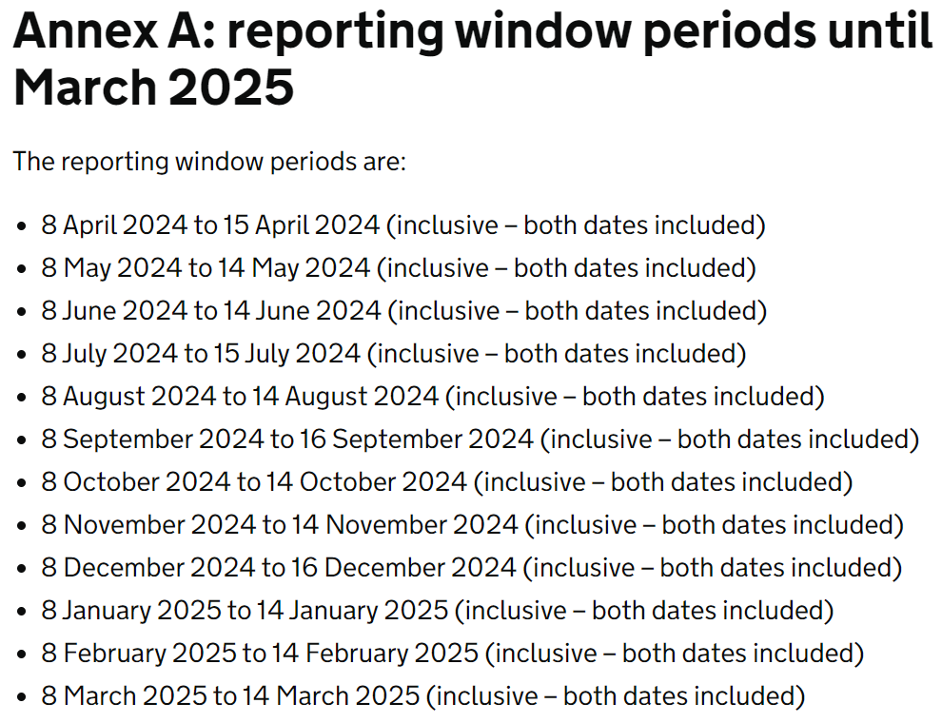
Key Link
https://www.gov.uk/government/publications/adult-social-care-provider-information-provisions-data-collection/adult-social-care-provider-information-provisions-guidance-for-providers-on-data-collection
(Updated April 2024)

