Slide 1
Technology in Care
practical applications that make you more efficient
and
drive quality improvement
Paul Kaye, Director
QUIQSOLUTIONS
1

Slide 2
Today’s presentation
About QuiqSolutions and Citation
A new approach - using technology for audits and surveys
Live Demonstration – smart phones ready please
Paper vs Digital
Introducing CQC Pro
Questions & Discussion
QUIQSOLUTIONS

Slide 3
About QuiqSolutions and Citation
Software House formed in 2011 based in Shropshire
CQC Compliance solutions for Health & Social Care and other sectors
Care Homes, Home Care, GPs, Dentists, Acute Trusts, Ambulance Services, Hospitals, Mental Health, Local Authorities..
Used by NHS England and all 200 CCGs
Any standards: CHC, Safeguarding, SEND Assurance Tools
Working with AHSNs (Academic Health Science Networks)
Technology partner for Citation
QUIQSOLUTIONS

Slide 4
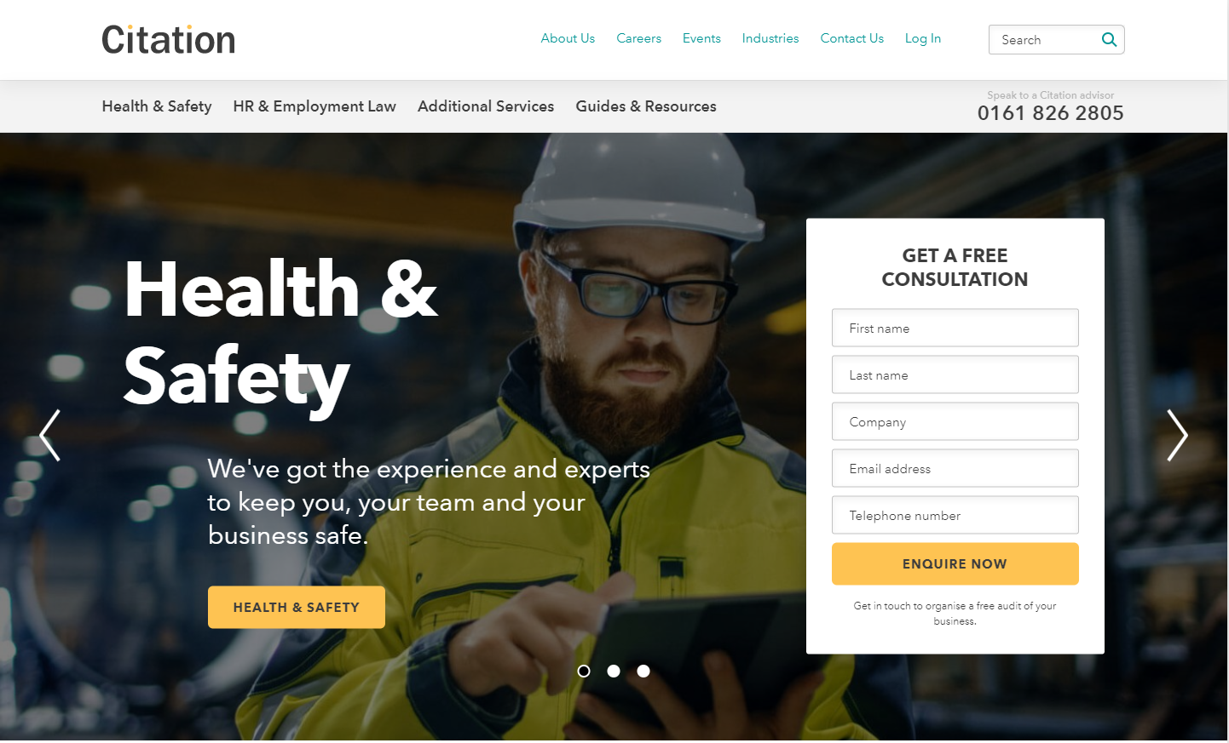
About QuiqSolutions and Citation
Health & Safety
Employment Law
Fire Risk Assessments
ISO Accreditation
CQC Compliance

Slide 5
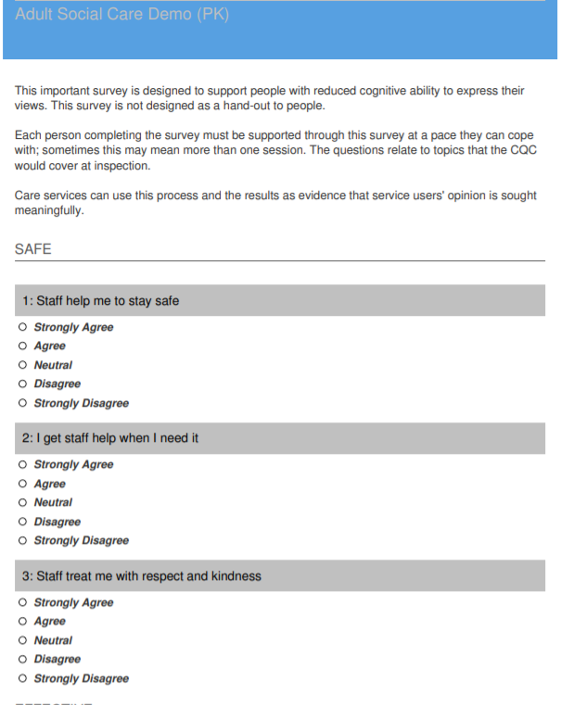
A new approach – using technology for your surveys & audits
Survey / Audit platform developed with Citation
Pre-loaded CQC KLOE Audits, Policy and Training Checklists
Pre-loaded Service User, Relative & Friend and Staff Surveys
“Build your own” Survey and Audit builder tool
Schedule for Automatic notification
Follow-up, review and action plans
Real-time view, all held in one place

Slide 6
Live Demonstration – Digital Survey & Audit function
Objective – build a digital survey
Step 1 - Create some questions
Step 2 - Pick some volunteers to complete the survey
Step 3 – Collate the responses and report
Step 4 – analysis and follow up actions

Slide 7
Live Demonstration – digital survey & audit function
Objective – build an electronic survey
Step 1 - Create some questions
Do staff treat you with dignity and respect?
Do you like the food here?
Would you recommend this care service?
Do you feel safe?
Are you able to take part in activities that you like?
What changes would you make?
Do you feel listened to?

Slide 8
Live Demonstration – digital survey & audit function
Objective – build an electronic survey
Step 2 - Pick some volunteers to complete the survey
Do you have access to email right now via 4G or on using WiFi?
Are you willing to provide me with your email address?
Will you answer questions as if you were a service user in a care home?

Slide 9
Live Demonstration – digital survey & audit function
Paper vs Digital
Print Hard Copies
Design the survey
Gather responses and enter into a spreadsheet
Check for responses
Circulate – by hand, post, in the care home…
Produce Manager’s report
Evaluate and agree actions

Slide 10
Live Demonstration – digital survey & audit function
Objective – build an electronic survey
Step 3 – Collate the responses and report

Slide 11
Live Demonstration – digital survey & audit function
Objective – build a digital survey
Step 4 – analysis and follow up actions
Respond to any concerns raised
Create Action Plans
Highlight the good comments – use as a positive
Repeat survey to confirm feedback is positive after making changes

Slide 12
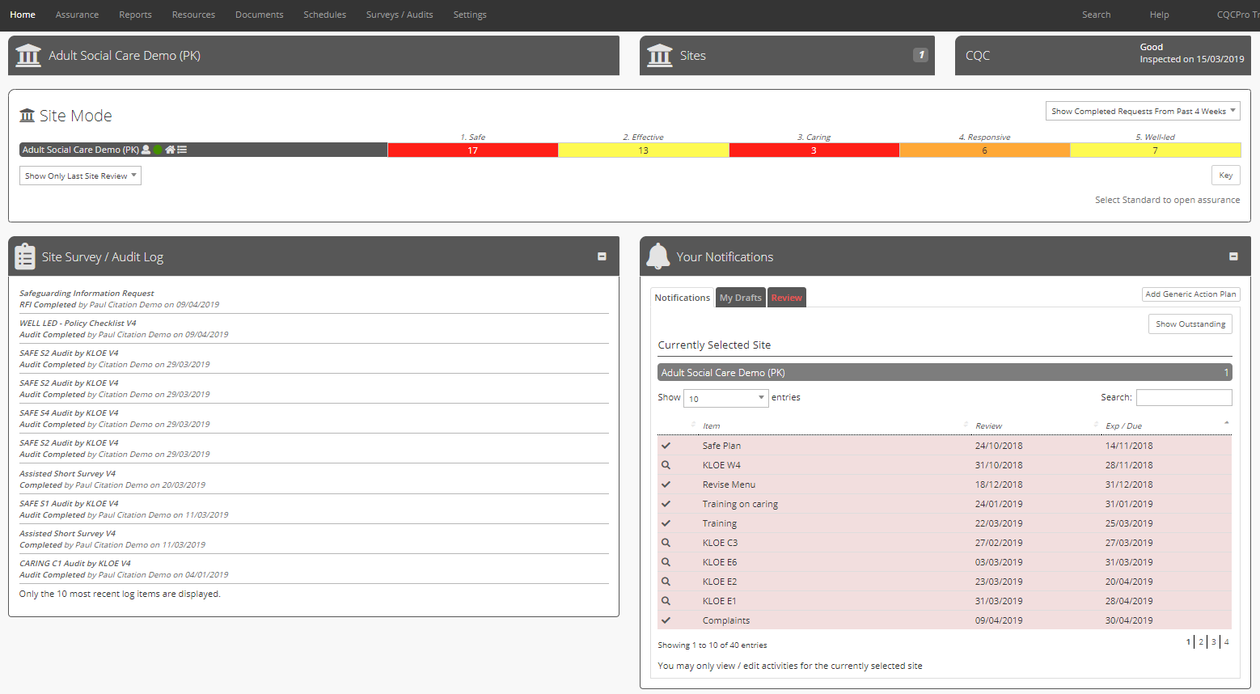
Introducing CQC Pro
Online Quality Assurance platform used by over 400 care organisations
Benchmark your service against the CQC KLOEs
Create Action Plans to implement improvement
Manage all of your audits, surveys and policies in a single platform
Set reminders to embed quality assurance as a continual process

Slide 13
Why CQC Pro?
Be prepared for CQC
Simplifies a complex process
Provides a roadmap to prepare
Comprehensive – includes everything needed in one place
Intuitive and Easy-to-use
Professional – Best Practice for Quality Assurance
“It’s about being prepared and evidencing to themselves and CQC the things they are good at and the things they are doing to continually improve”

Slide 14
Technology in Care - Questions and Discussion

Slide 15
Contacts / Further Information
https://www.citation.co.uk/additional-services/care-services/cqc-pro/
New enquiries: 0345 844 1111 (09:00-17:00 Monday-Friday) hello@citation.co.uk
Existing clients: 0345 844 4848 enquiries@citation.co.uk

