Slide 1
Keeping Community Connections Alive
Sam Hawker & Leanne Thorne
AbleCare Homes

Slide 2
Why bother with community engagement?
All members of the community can play a vital role in ensuring the health and wellbeing of residents in care homes.
Being in a care home can feel very isolating.
It can help give residents more time for socialisation and interaction.
By engaging with the community you can help to challenge negative public perception and show how great your homes are.
Community engagement can be very fulfilling for those involved on all sides from residents to staff working in the care home and the volunteers themselves.

Slide 3
How do I get started?
You are probably doing more than you realise already.

Slide 4
How do I get started?
You are probably doing more than you realise already.

Slide 5
How do I get started?
You are probably doing more than you realise already.
Start small and things will grow as your network expands.
If you are unsure how a local group can get involved, just ask them.
It may help to start off a relationship with an event such as an afternoon tea that you invite a local group to come along to.
Don’t be afraid to approach people and ask, you will be surprised how many positive responses you get.

Slide 6
Asset Map A good way to start is by drawing an asset map of your local community and put your home at the centre of it.

Slide 7
Asset Map A good way to start is by drawing an asset map of your local community and put your home at the centre of it.

Slide 8
Asset Map
Family Volunteers
Paid Entertainers
Staff Friends & Families
Nuns

Slide 9
Asset Map
Schools
Silverhill
St Mary Redcliffe
Kingsweston
Badminton
Universities
UWE
Bristol University
Family Volunteers
Colleges
City of Bristol
South Glos & Stroud
Bath College
Paid Entertainers
Staff Friends & Families
Youth Groups
Duke of Edinburgh
National Citizens Scheme
Nurseries
Southern Links Children’s Centre
Jack & Jill Nursery
Once Upon A Time Nursery
Winterbourne Early Years
Little Hayes & Hillfields
Nuns

Slide 10
Asset Map
Alive Activities Gardening Club
The Big Lunch
Schools
Universities
Making Pals
Family Volunteers
Colleges
Corporate Volunteers
Paid Entertainers
Staff Friends & Families
Paws for Wellbeing
Church Groups
The Bake A Smile Project
Equal Arts
Youth Groups
Nurseries
Heritage Lottery Funded Project WW2
Nuns
Pets As Therapy
Bristol Bears Rugby Community Foundation
Scout & Brownie Groups
HenPower

Slide 11
Asset Map
Alive Activities Gardening Club
The Big Lunch
Avon Wildlife Local Garden Project
Windmill Hill City Farm
Schools
Universities
Making Pals
Family Volunteers
Colleges
Corporate Volunteers
Paid Entertainers
Making Pals Fishing Trips
Staff Friends & Families
Paws for Wellbeing
Local Shops & Cafes
Church Groups
The Bake A Smile Project
Equal Arts
Youth Groups
Nurseries
All-Aboard Watersports
Heritage Lottery Funded Project WW2
Nuns
Garden Centre
Bristol Museum Art Project
Pets As Therapy
Bristol Bears Rugby Community Foundation
Scout & Brownie Groups
Avon Riding Centre
HenPower

Slide 12
Asset Map
Alive Activities Gardening Club
Bristol Aging Better
The Big Lunch
Avon Wildlife Local Garden Project
Windmill Hill City Farm
Schools
Universities
Making Pals
VOSCUR Website
Family Volunteers
Colleges
Corporate Volunteers
Paid Entertainers
Making Pals Fishing Trips
Staff Friends & Families
Paws for Wellbeing
Local Shops & Cafes
Church Groups
The Bake A Smile Project
Equal Arts
Postcode Lottery
Youth Groups
Nurseries
All-Aboard Watersports
Heritage Lottery Funded Project WW2
Nuns
Garden Centre
Bristol Museum Art Project
Pets As Therapy
Bristol Bears Rugby Community Foundation
Scout & Brownie Groups
Avon Riding Centre
HenPower
Super Market Token Schemes

Slide 13
Asset Map
Alive Activities Gardening Club
Bristol Aging Better
The Big Lunch
Avon Wildlife Local Garden Project
Windmill Hill City Farm
Schools
Universities
Making Pals
VOSCUR Website
Family Volunteers
Colleges
Corporate Volunteers
Paid Entertainers
Making Pals Fishing Trips
Staff Friends & Families
Paws for Wellbeing
Local Shops & Cafes
Filming for Training Resource
Church Groups
The Bake A Smile Project
Play Co-Written with Resident
Equal Arts
Postcode Lottery
Youth Groups
Nurseries
All-Aboard Watersports
Heritage Lottery Funded Project WW2
Nuns
Garden Centre
Bristol Museum Art Project
Pets As Therapy
Bristol Bears Rugby Community Foundation
Scout & Brownie Groups
Avon Riding Centre
HenPower
Super Market Token Schemes

Slide 14
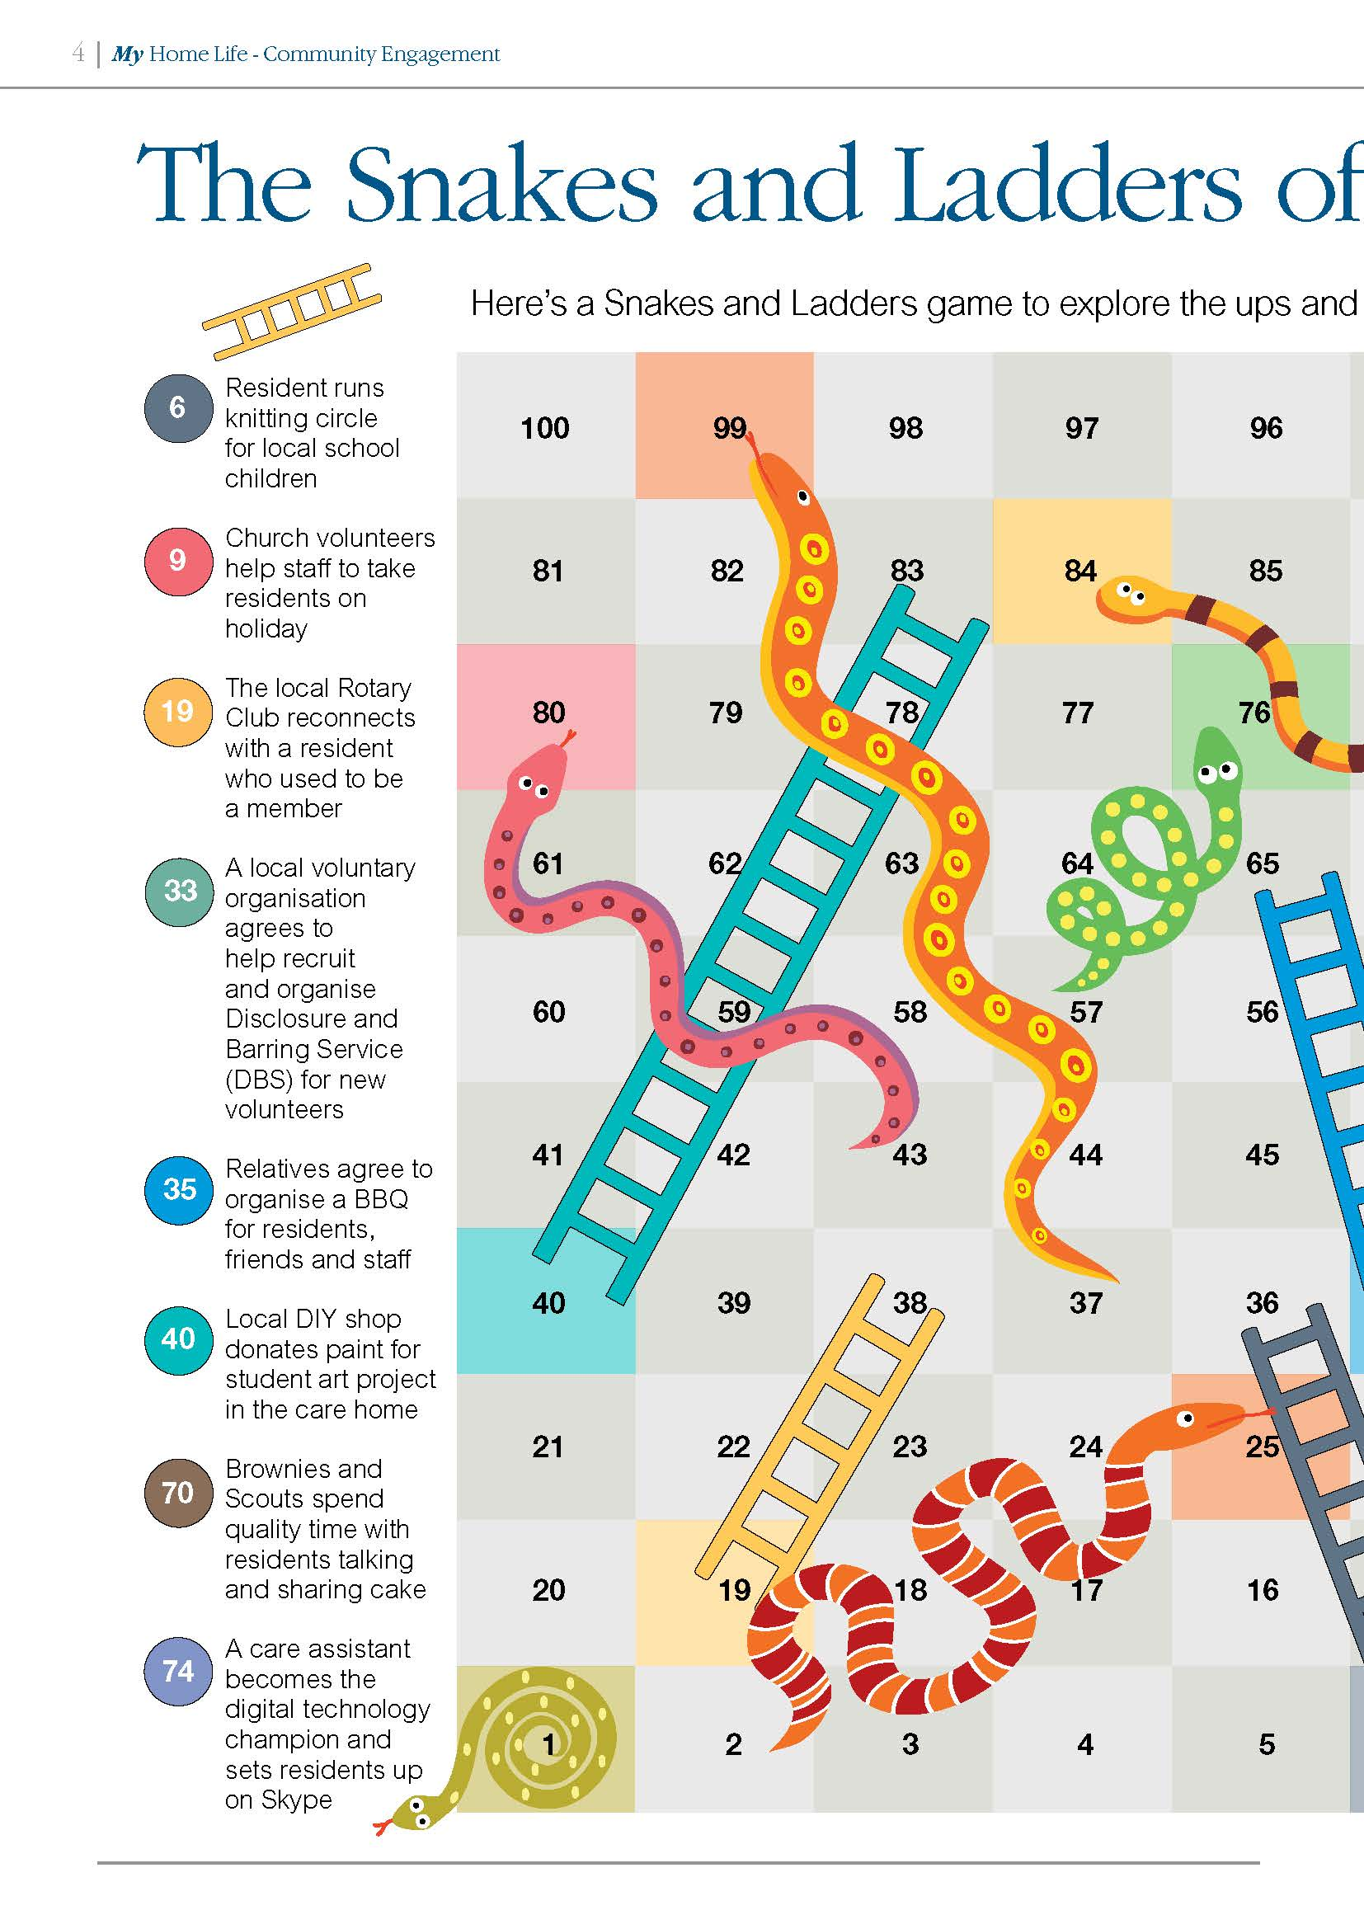
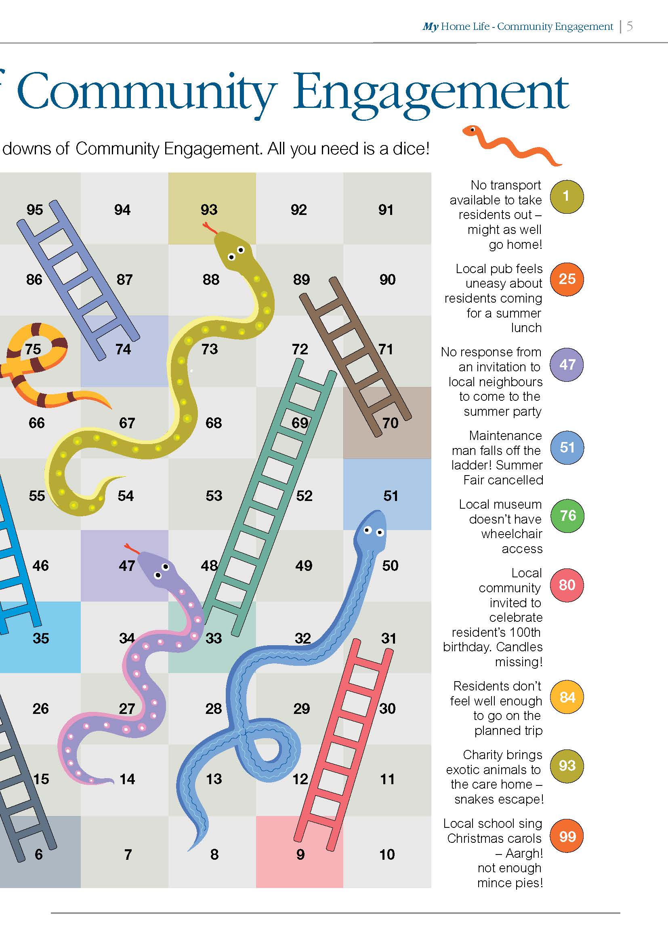

Slide 15
Your Pledges

Slide 16
Final Thoughts
Start small, the more you do the more contacts you make
Don’t give up if things don’t work first time
Think about DBS/references but don’t let it stop you
Share with each other

Slide 17
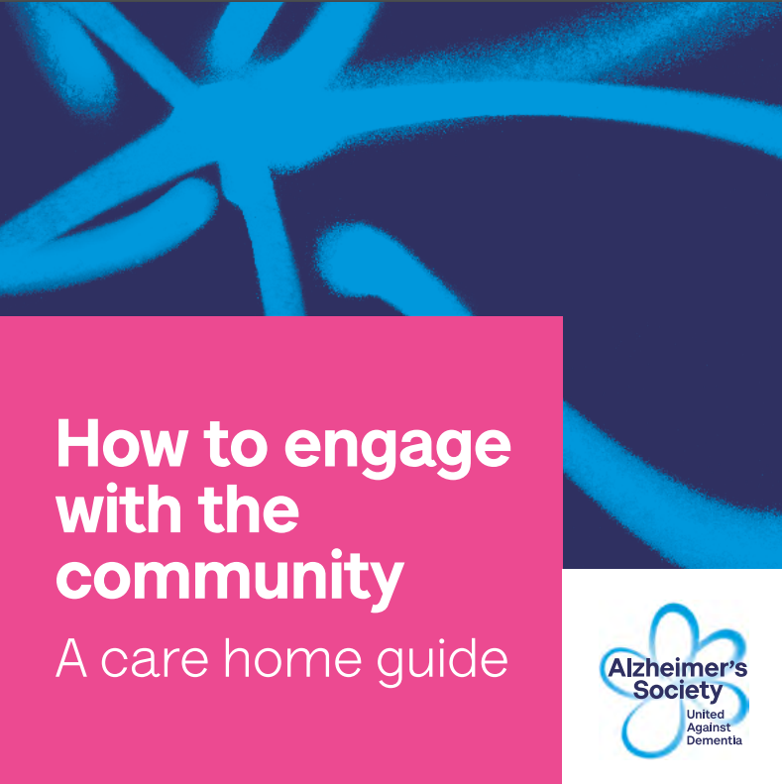
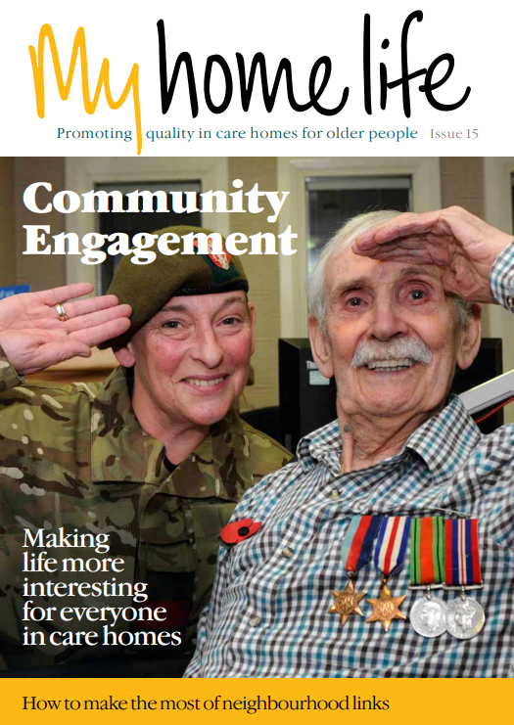
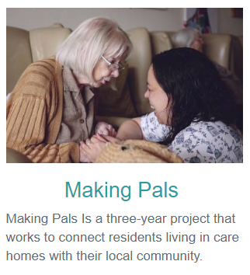
Useful Resources
https://www.alzheimers.org.uk/sites/default/files/2018-05/Care_Home_toolkit.pdf
file:///X:/Documents%20from%20Old%20Network/C&SW/Engagement%20MHL-Newsletter-web.pdf
https://www.stmonicatrust.org.uk/guide
https://aliveactivities.org/projects/all-projects/

