Slide 1
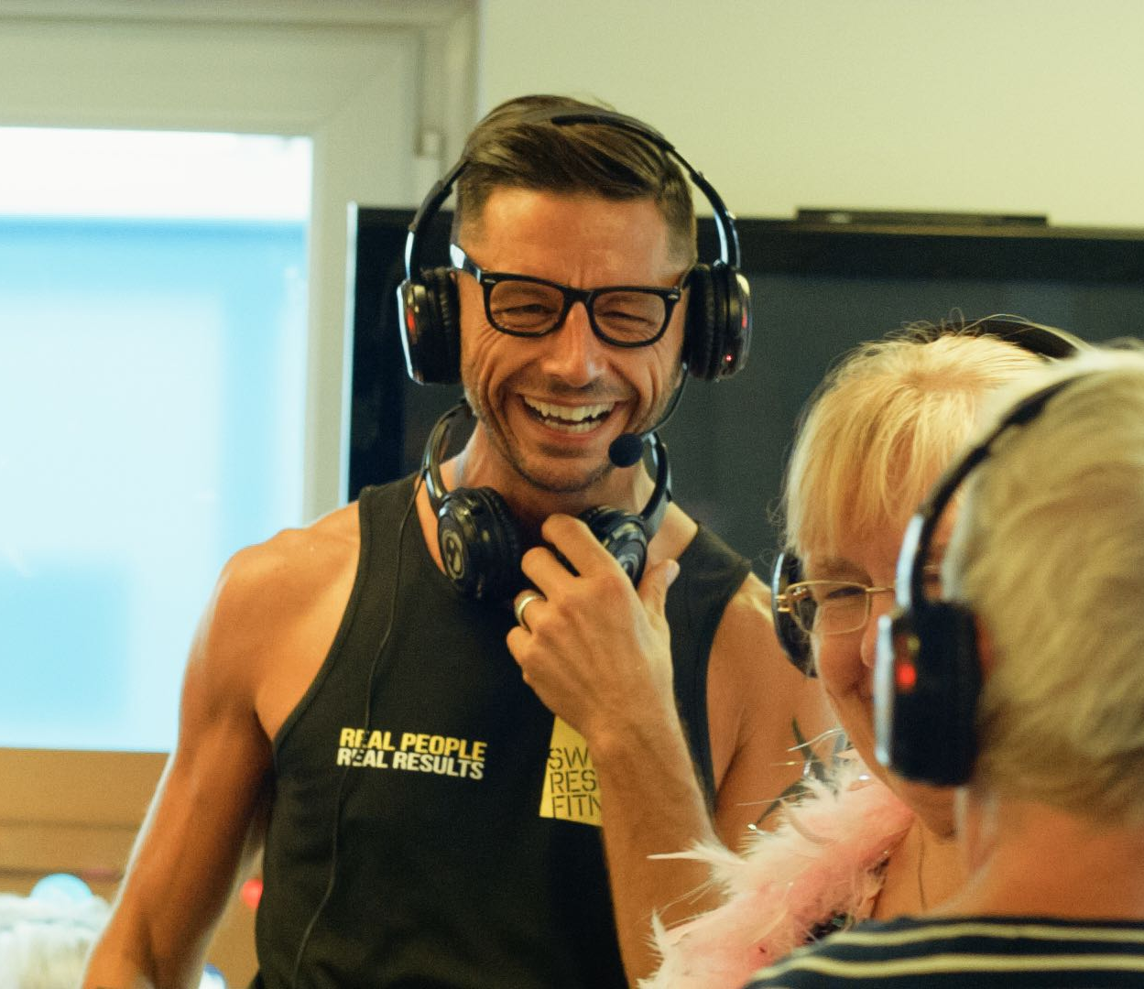
Who are Sweet Silent Disco?
Mark has recently worked as a fitness instructor and delivered Silent Disco Yoga classes
Came across the idea of using the headset technology and power of music in different settings with a variety of groups of people
We have now delivered over 200 sessions in care homes, activity centres, schools and private events

Slide 2
What do we do?
A unique and immersive experience
All participants wear a wireless headset and listen to a custom playlist of music
Interaction with the facilitator through the headsets
Props and lighting used for a great atmosphere!
Themed discos available – e.g. Christmas, Summer, Valentines

Slide 3
What are the benefits?
Engaging and fun activity
A form of light and music therapy
Particularly beneficial to people with dementia
Enjoyable for people with a wide range of needs
Gentle form of exercise

Slide 4
“Dementia often means that the person becomes locked away in their own world. Music can break into this world and free them to experience positive memories, often joining in by singing along and moving or swaying in time to the music. This benefit usually lasts after the music has stopped and can contribute to the overall wellbeing of people with more advanced dementia when other forms of communication do not. Feeling part of a community again is very positive.” - Dr Judy Haworth, Dementia Specialist, Bristol NHS Trust
“Silent disco is a really innovative approach with the potential to improve health and wellbeing in people with dementia through increasing physical activity and social interaction”. - Dr Liz Coulthard, Consultant Senior Lecturer, Dementia & Cognitive Neuroscience.

Slide 5
What we offer
Care Homes and Activity Centres
Corporate Events
Private Parties and Events
Headset Hire
Prices start from £85

Slide 6
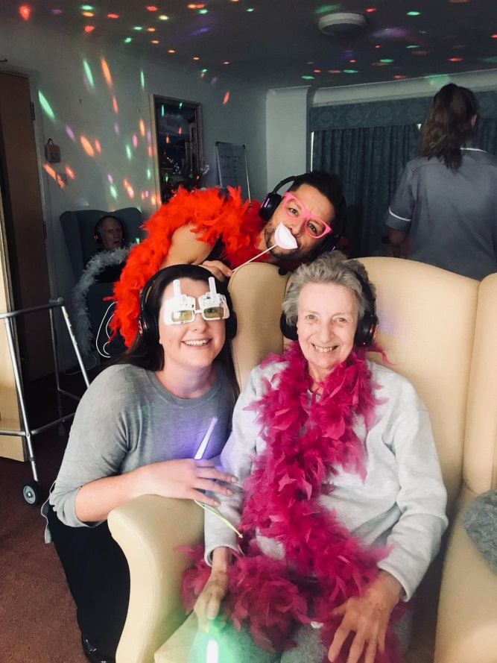
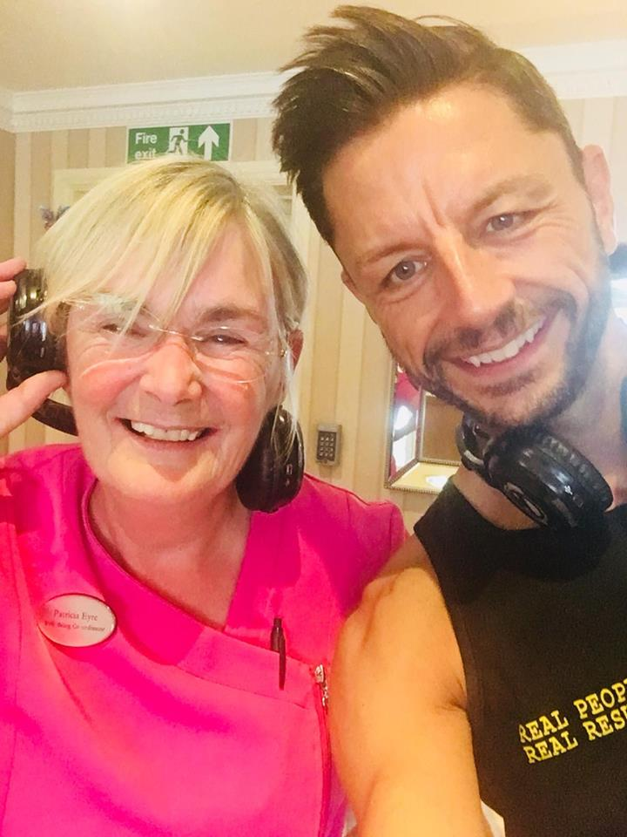
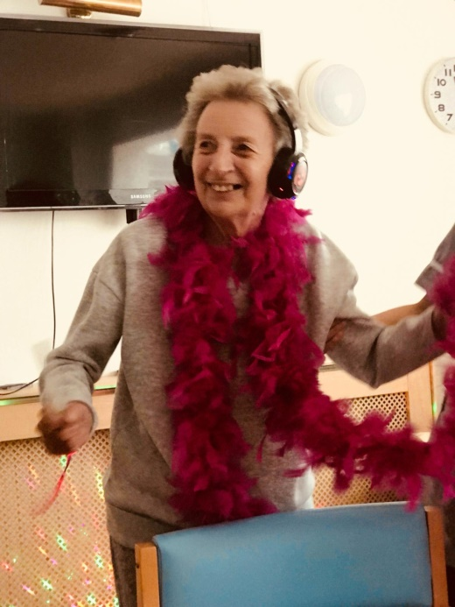
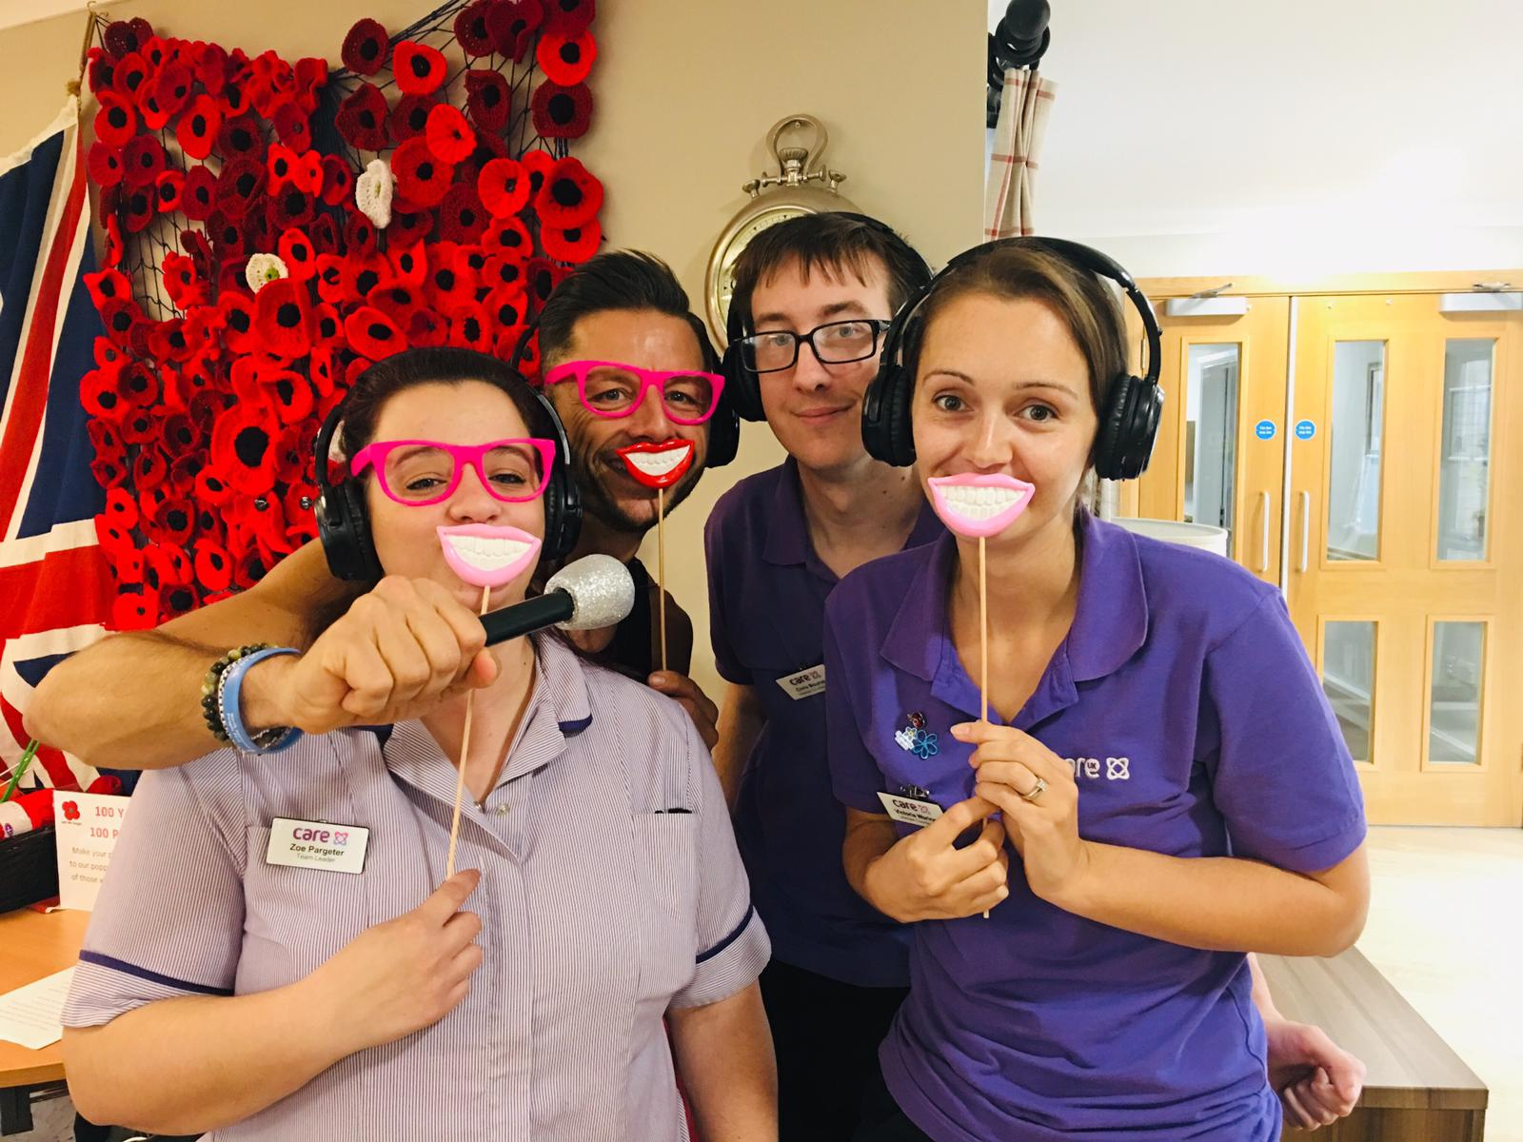
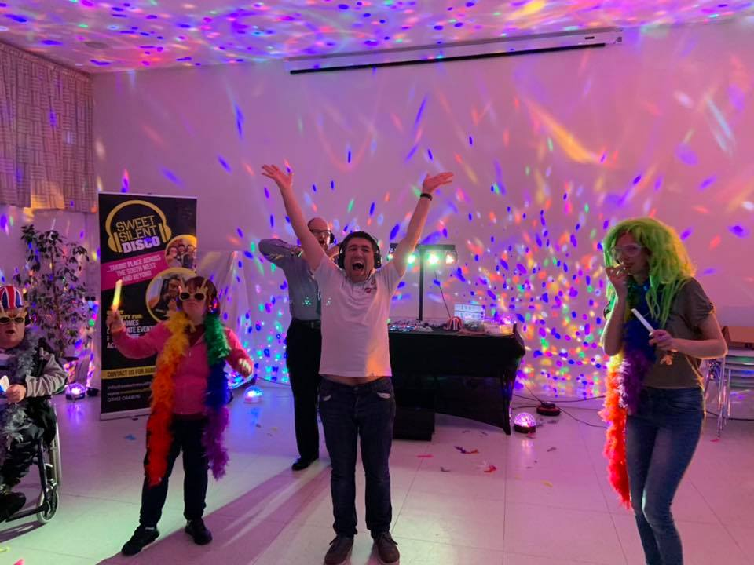
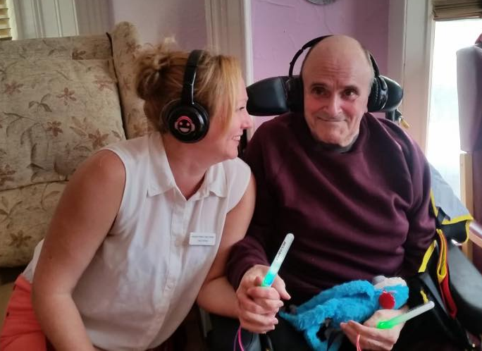

Slide 7
Sweet Silent Disco in action
BBC Radio Bristol Video

Slide 8
Mark Sweeting
mark@sweetresultfitness.co.uk
www.sweetsilentdisco.co.uk
07412066876

