Slide 1
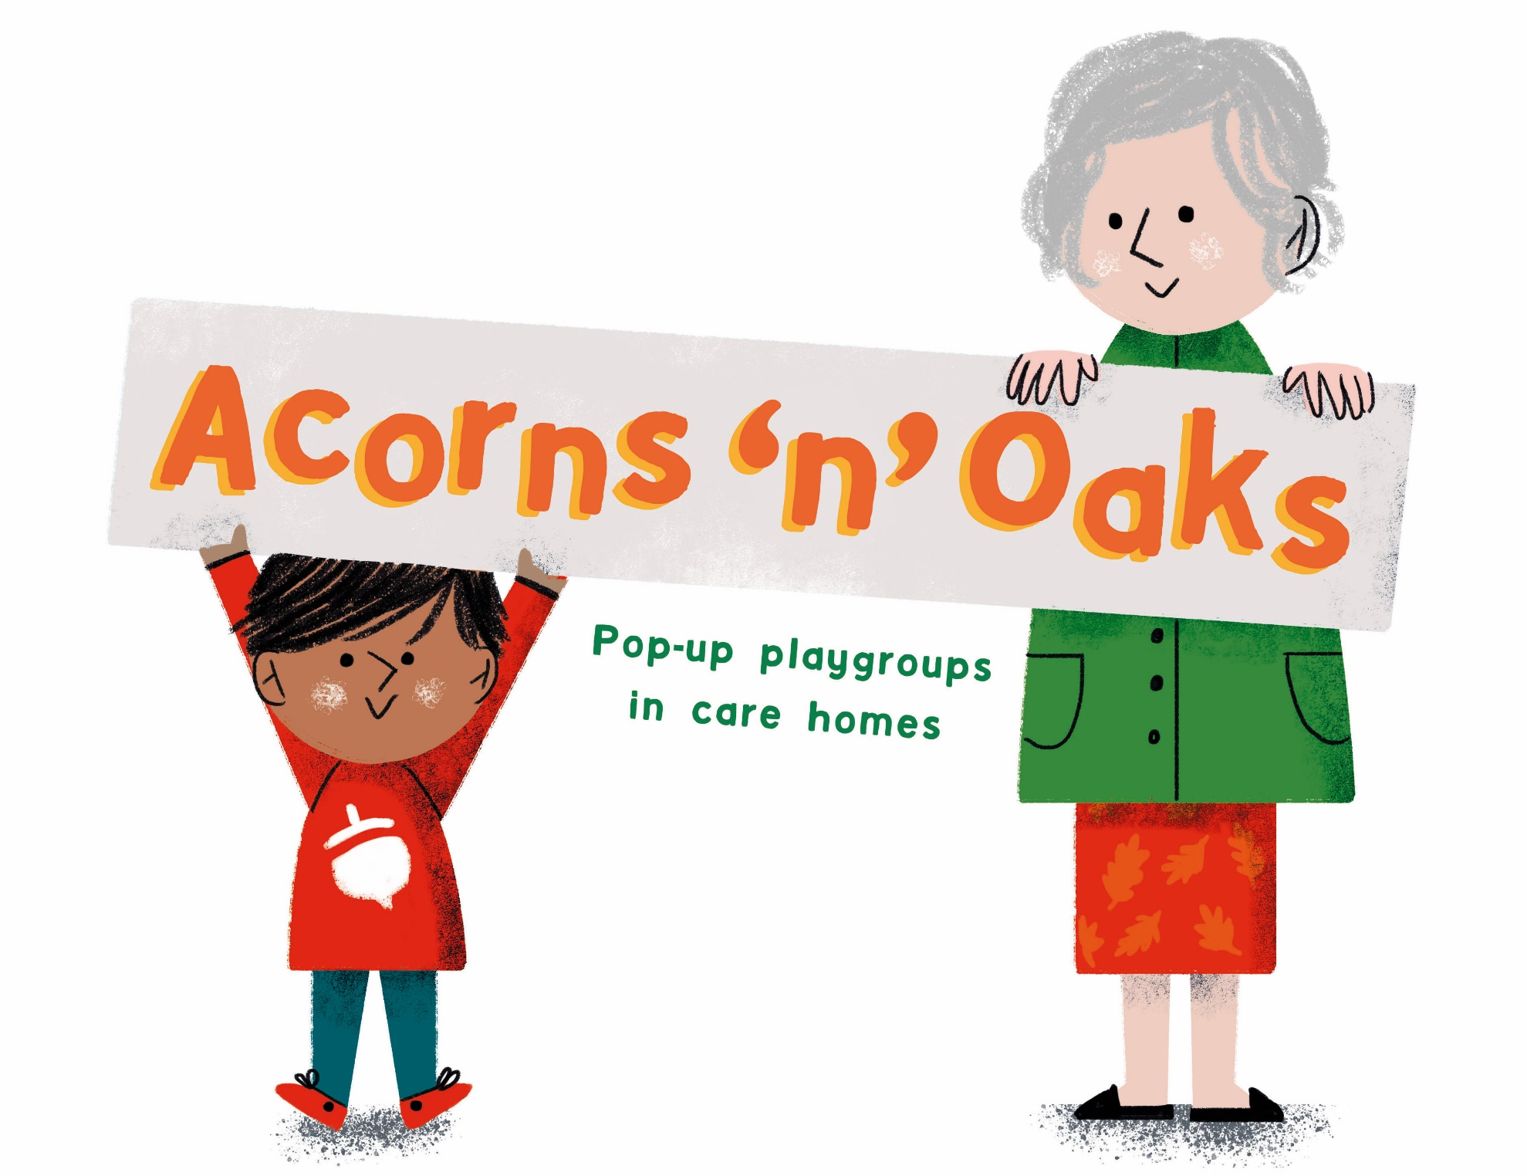

Slide 2
Acorns ‘n’ Oaks Playgroups CIC
Who are we?
What do we do?
Registering
Perceived Benefits – to care homes
- to families
Research evidence
Our vision

Slide 3
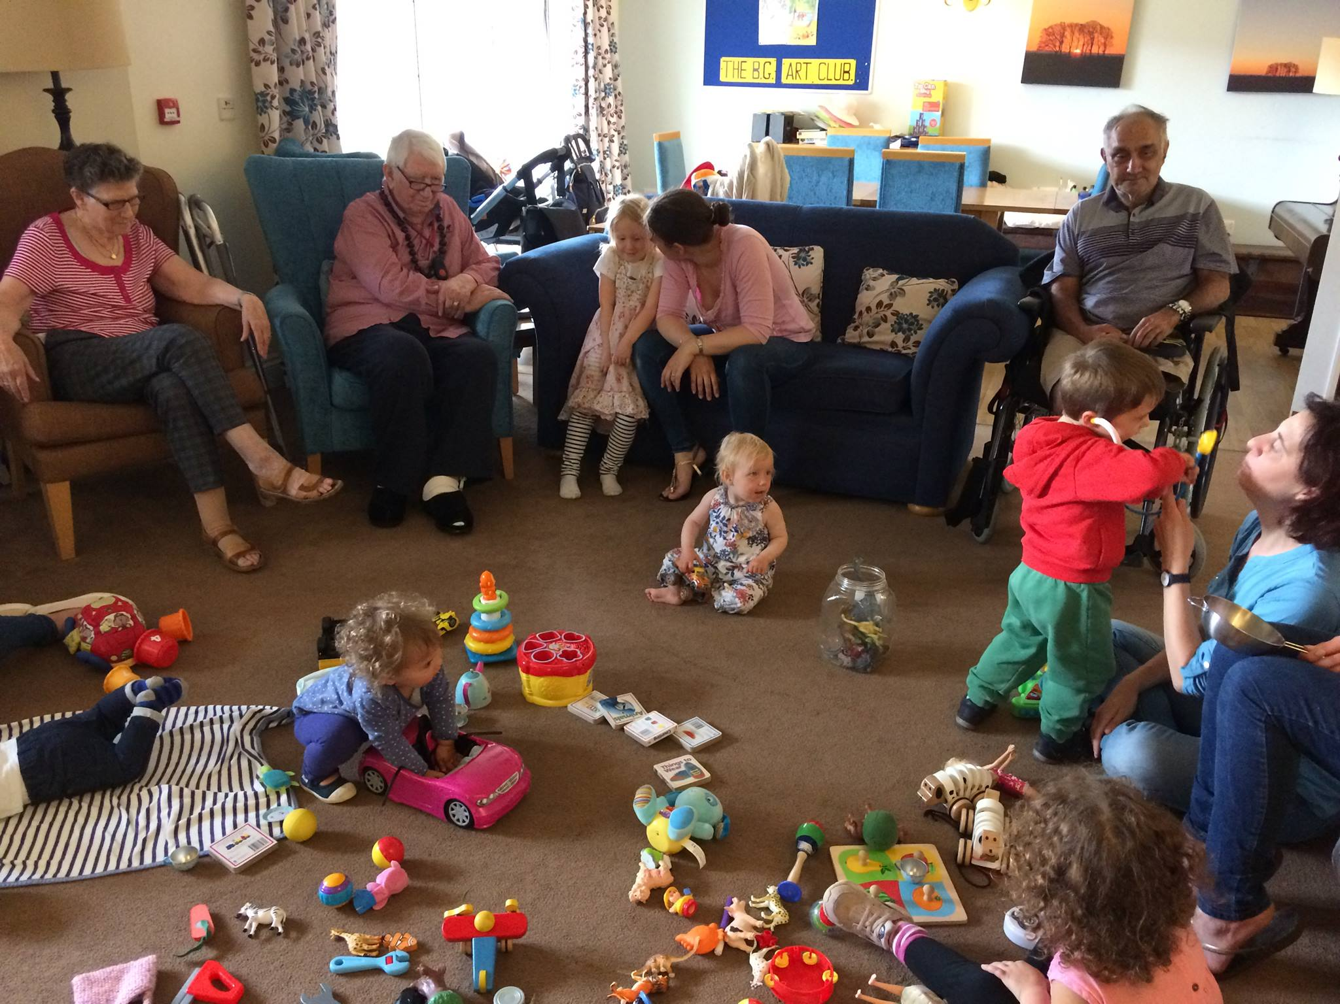

Slide 4
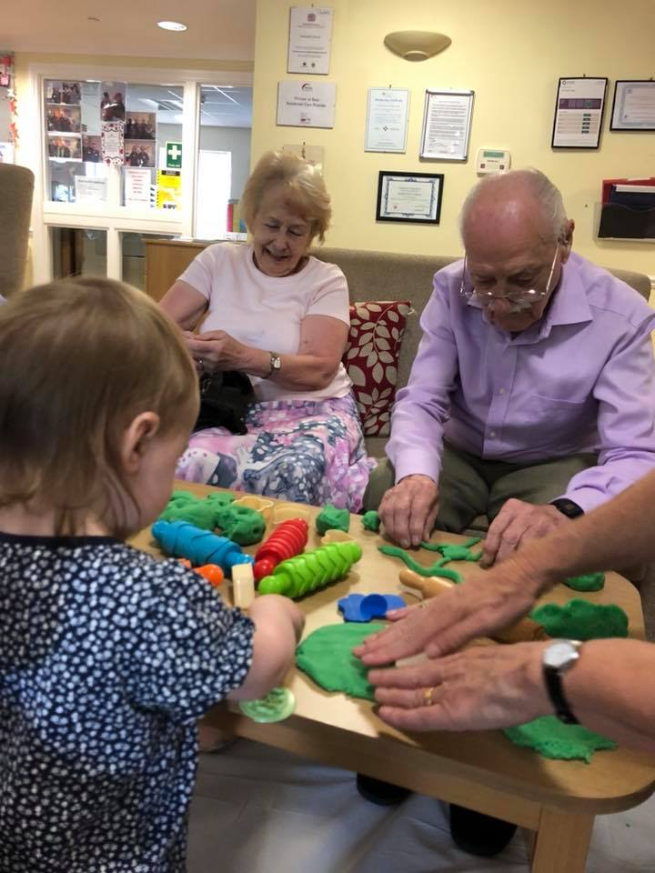

Slide 5
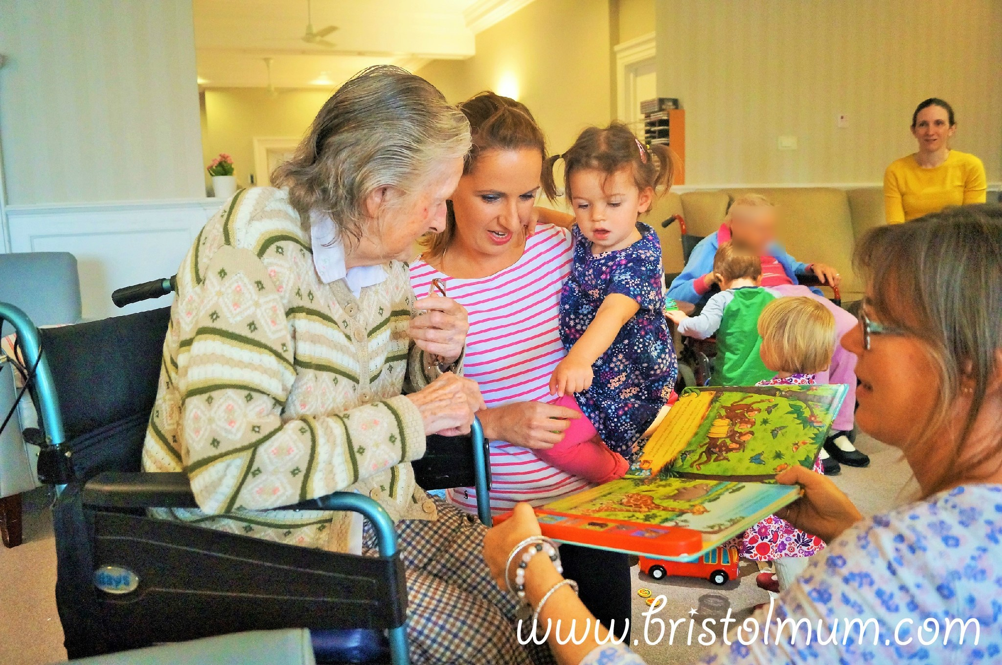

Slide 6
